Slide 1
Mrs Alsey’s Great Picture Quiz
Can you guess what the picture is from the zoomed in pictures?
Good Luck!

Slide 2
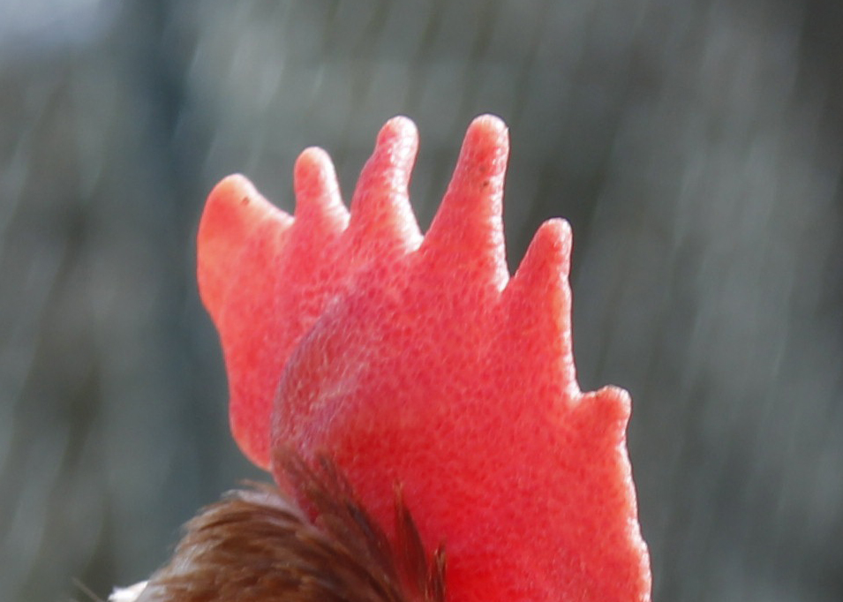
What is it? I have 8 in my garden!

Slide 3
That’s right it’s a chicken!

Slide 4
What is it? You might have one on your wrist!

Slide 5
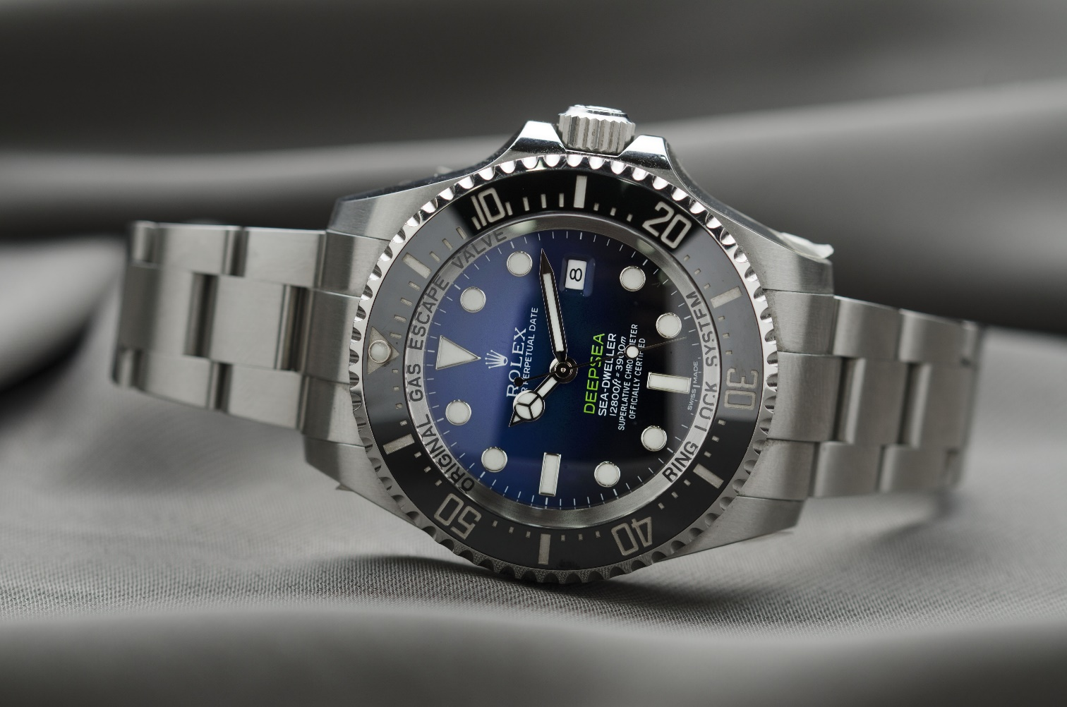
That’s right it’s a watch!

Slide 6
What is it? One of my son’s favourite dinners!

Slide 7
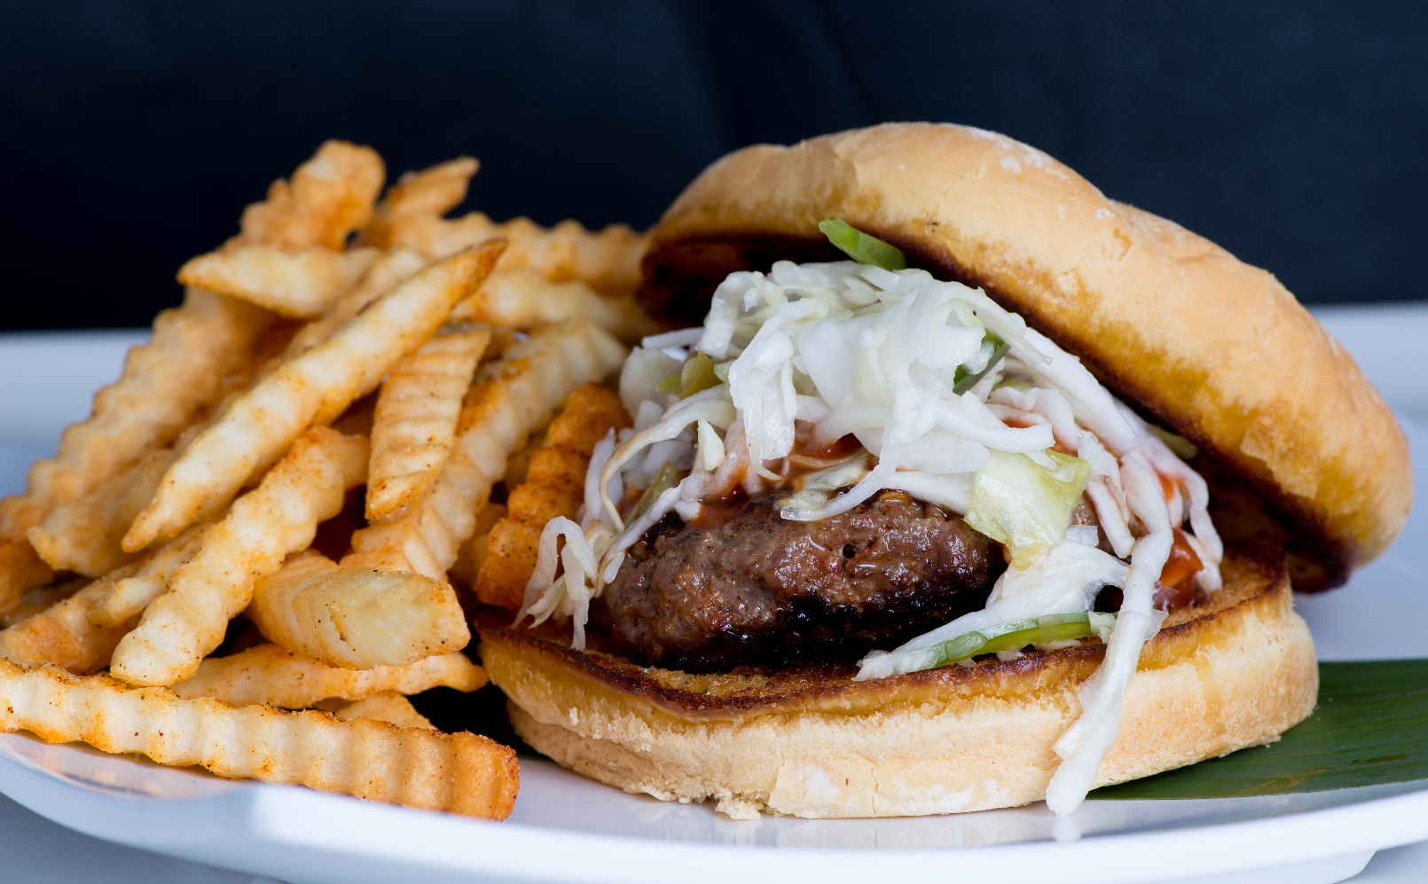
That’s right it’s burger and chips!

Slide 8
What is it? Useful when needing just a bit of something!

Slide 9
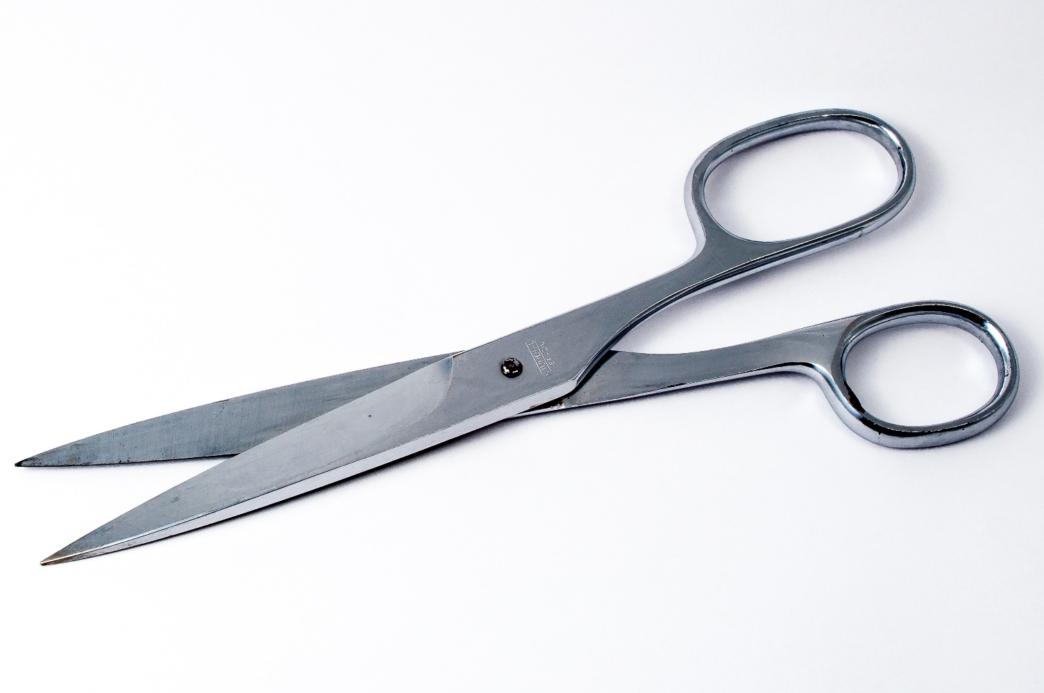
That’s right it’s a pair of scissors!

Slide 10
What is it? This could send you into a spin!

Slide 11
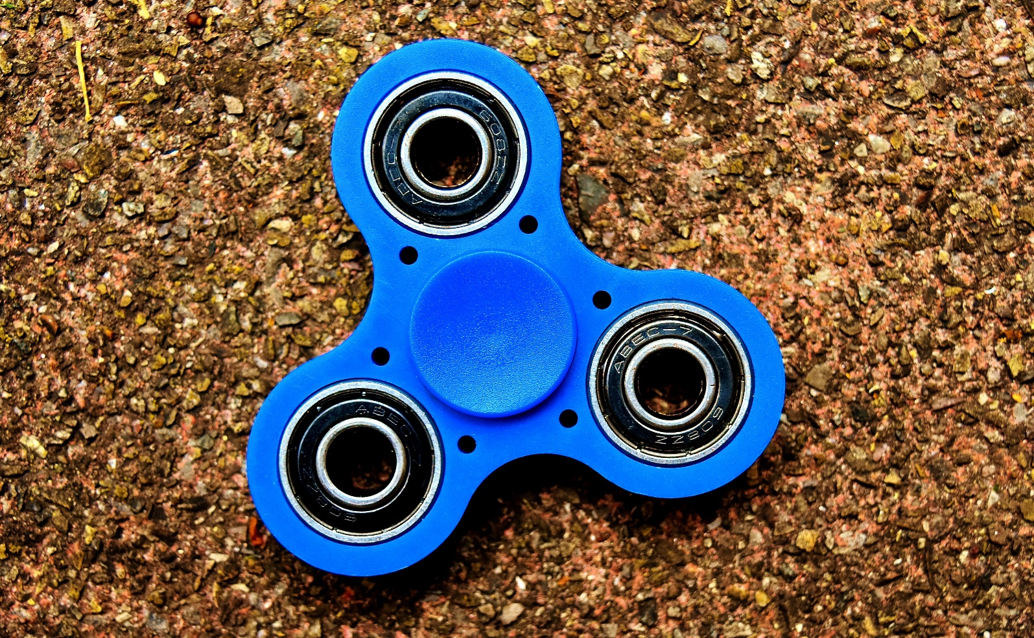
That’s right it’s a fidget spinner!

Slide 12
What is it? This is probably very useful at the moment!

Slide 13
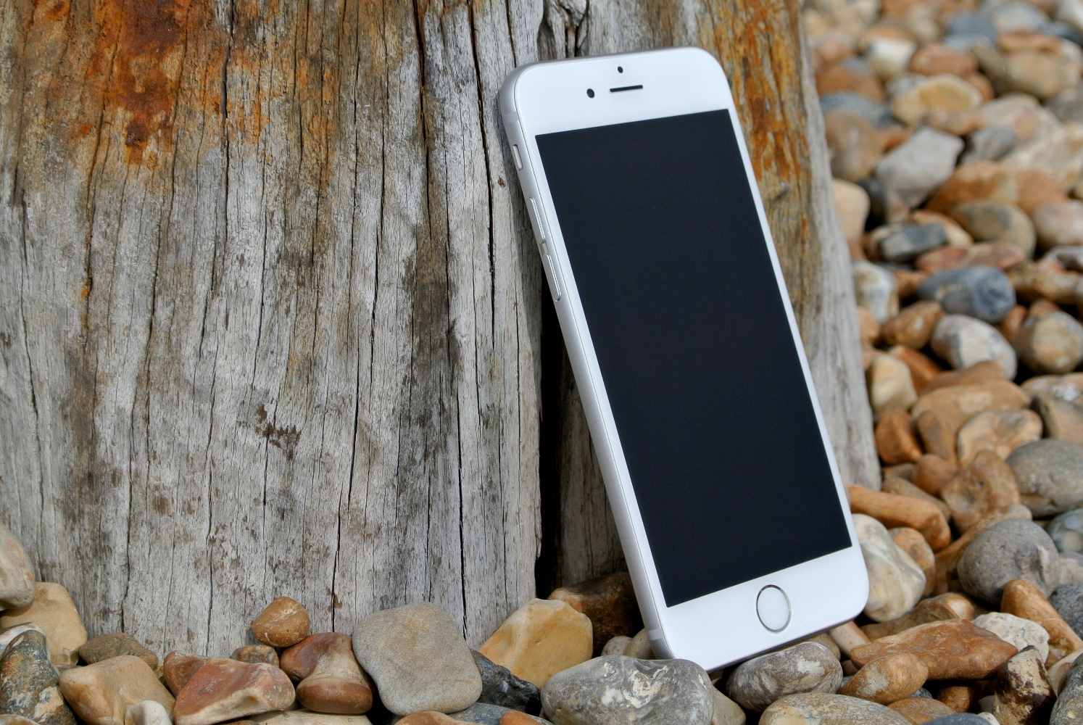
That’s right it’s a mobile phone!

Slide 14
What is it? These are very yummy!

Slide 15
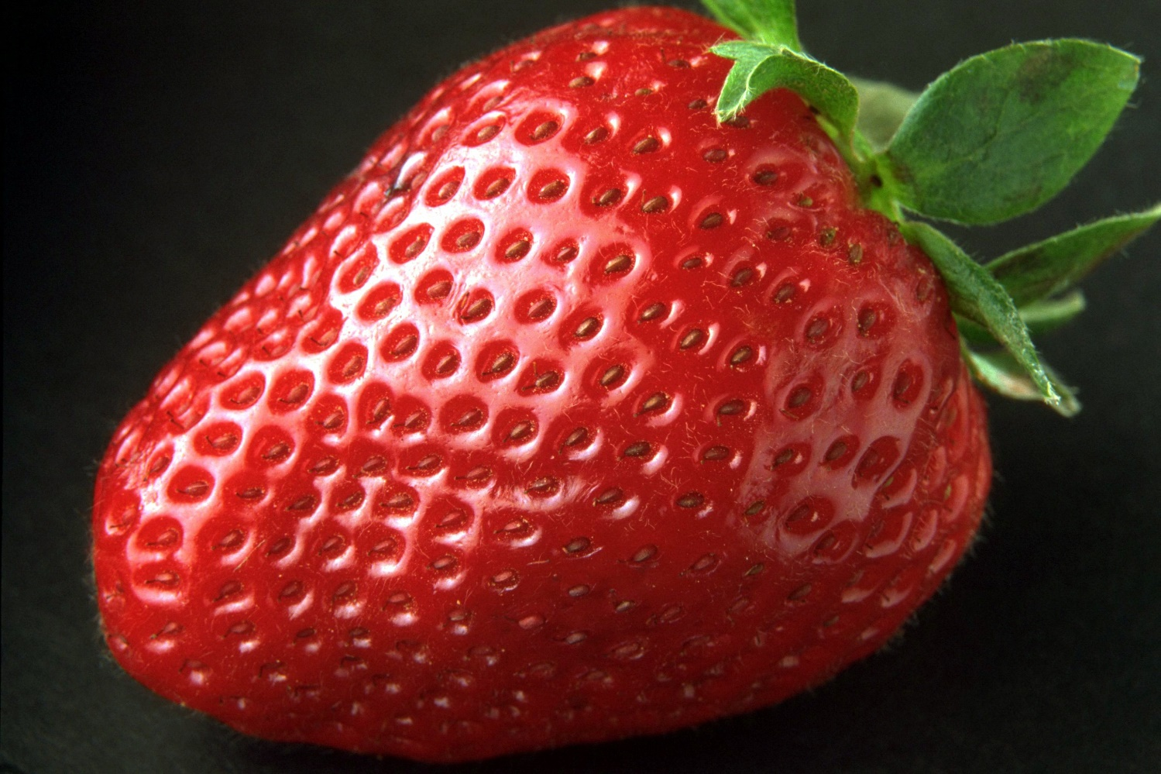
That’s right it’s a strawberry!

Slide 16
What is it? This is very fluffy!

Slide 17
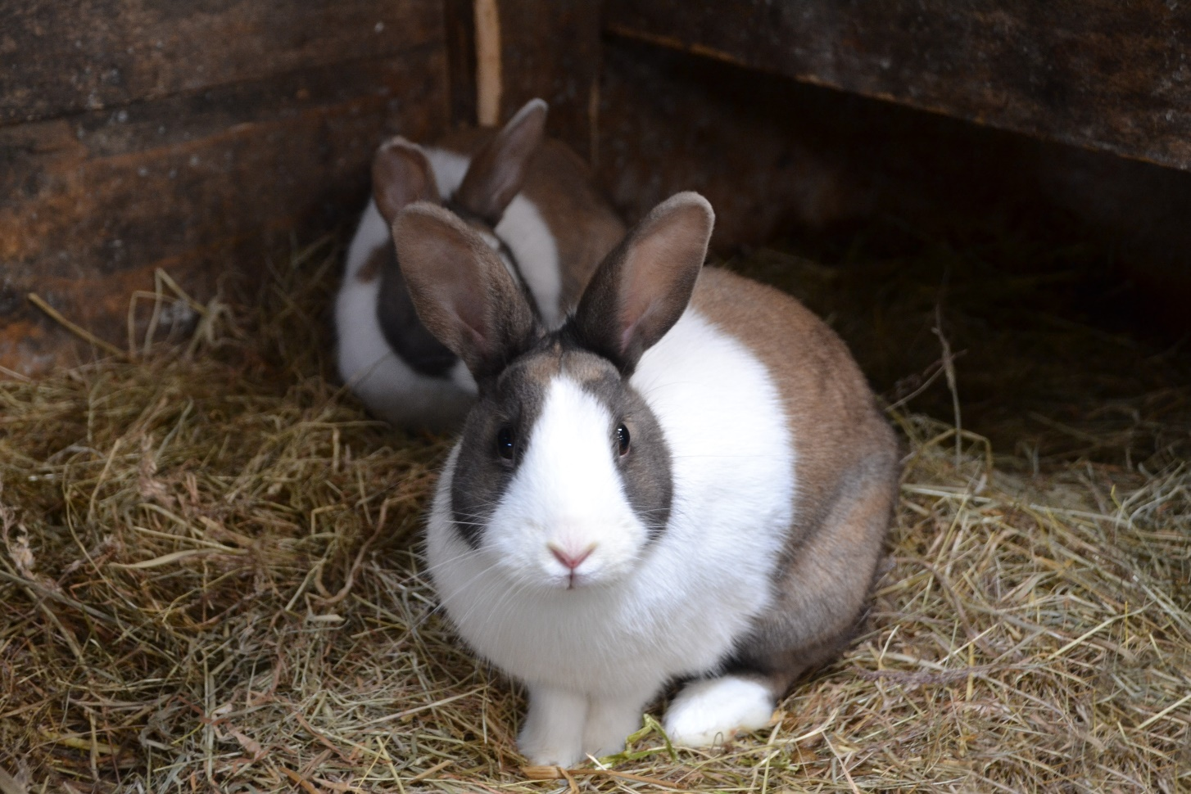
That’s right it’s a rabbit!

Slide 18
What is it? This sunny weather makes me want one of these!

Slide 19
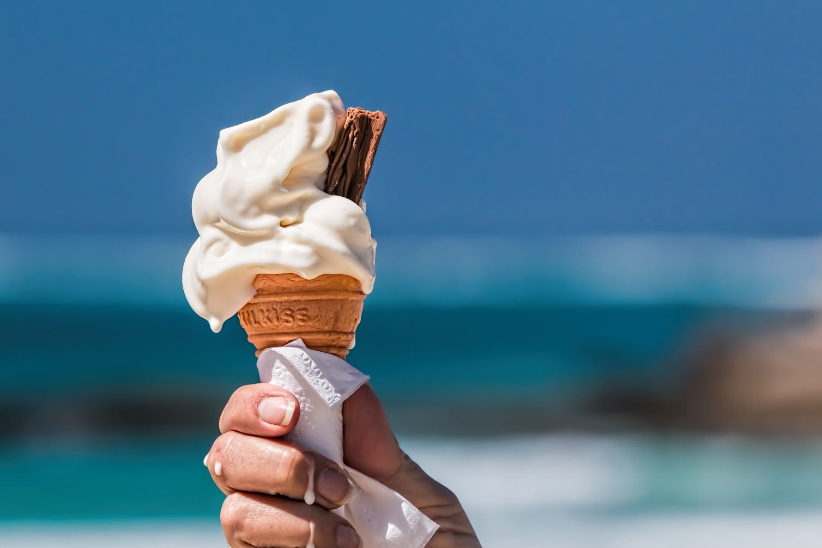
That’s right it’s a 99 Ice-cream!

Slide 20
What is it? Lots of these fluttering around my garden today!

Slide 21
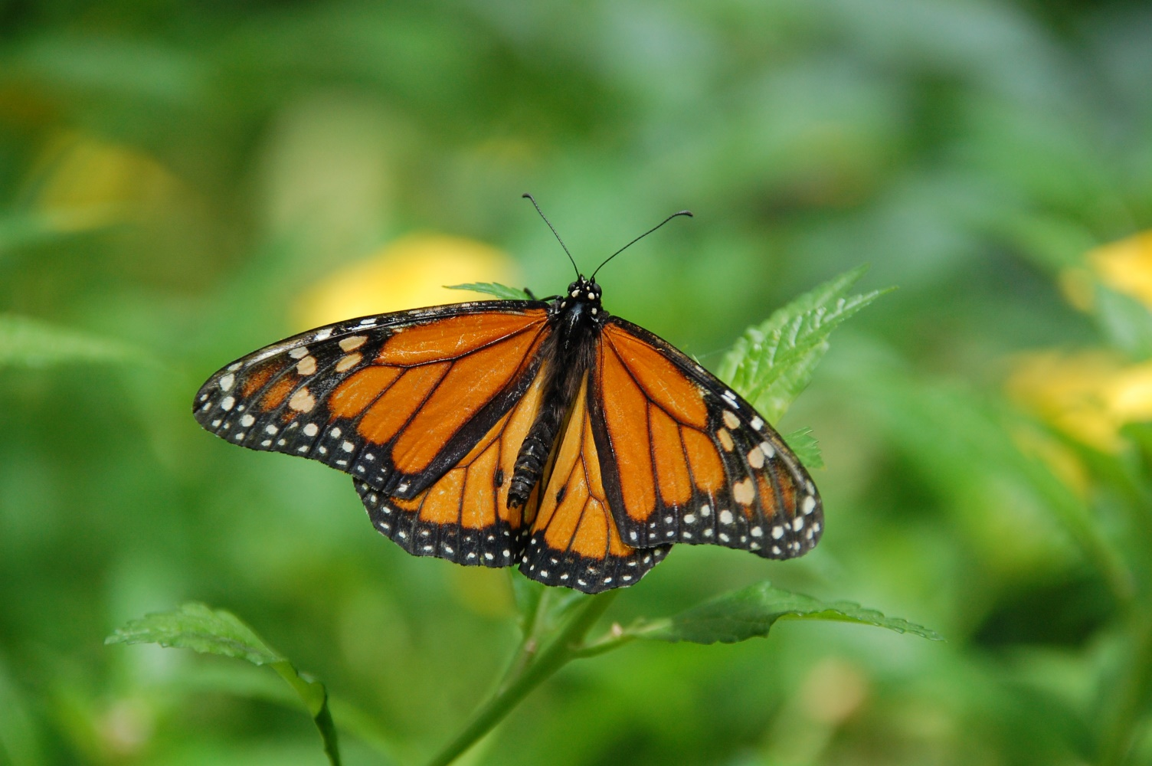
That’s right it’s a butterfly!

Slide 22
Well Done!
Have a great Easter!

