Slide 1
Mrs Brackenridge’s Film Quiz

Slide 2
1.Which Disney film features a song called ‘The Bare Necessities’?

Slide 3
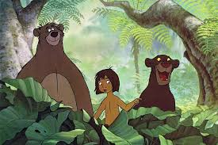
Which Disney film features a song called ‘The Bare Necessities’?
The Jungle Book

Slide 4
2. What was the name of Dorothy’s dog in the film ‘The Wizard of Oz’?

Slide 5
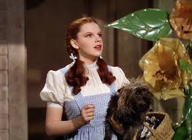
What was the name of Dorothy’s dog in the film ‘The Wizard of Oz’? Toto

Slide 6
3. What’s the next line in this film song?
Clap along if you feel like a roof without a roof
Because I’m happy…

Slide 7
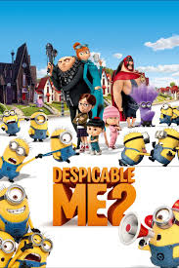
What’s the next line in this film song?
Clap along if you feel like a roof without a roof
Because I’m happy
Clap along if you feel like happiness is the truth

Slide 8
4. Which movie features two characters called Simba and Mufasa?

Slide 9
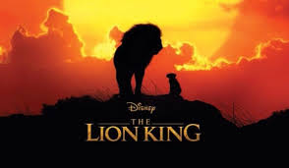
Which movie features two characters called Simba and Mufasa?
The Lion King

Slide 10
5. In the film ‘Toy Story’ to whom does Woody belong?
Andy
Sid
Buzz
Billy

Slide 11
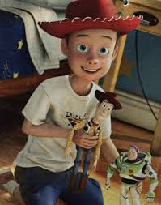
In the film ‘Toy Story’ to whom does Woody belong?
Andy
Sid
Buzz
Billy

Slide 12
6. What position does Harry Potter play on the Quidditch team?
chaser
seeker
keeper

Slide 13
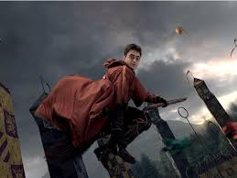
6. What position does Harry Potter play on the Quidditch team?
chaser
seeker
keeper

Slide 14
7. Complete the film song lyric:
Everything is ....

Slide 15
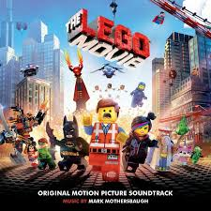
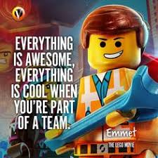
Complete the film song lyric:
Everything is awesome!

Slide 16
8. Who is this?

Slide 17
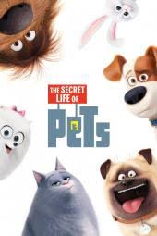
Who is this?
Max

Slide 18
9. Which film is based on a singing competition between a mouse, an elephant, a pig, a gorilla and a porcupine?

Slide 19
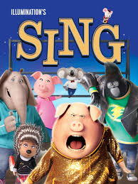
Which film is based on a singing competition between a mouse, an elephant, a pig, a gorilla and a porcupine?
Sing

Slide 20
10. What are the small, orange men in Charlie and the Chocolate Factory known as:
Oompa Fumpas
Oompa Loompas
Oompa Dumpas?

Slide 21
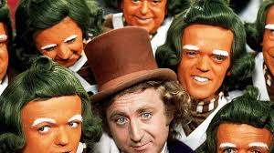
10. What are the small, orange men in Charlie and the Chocolate Factory known as:
Oompa Fumpas
Oompa Loompas
Oompa Dumpas?

