Slide 1
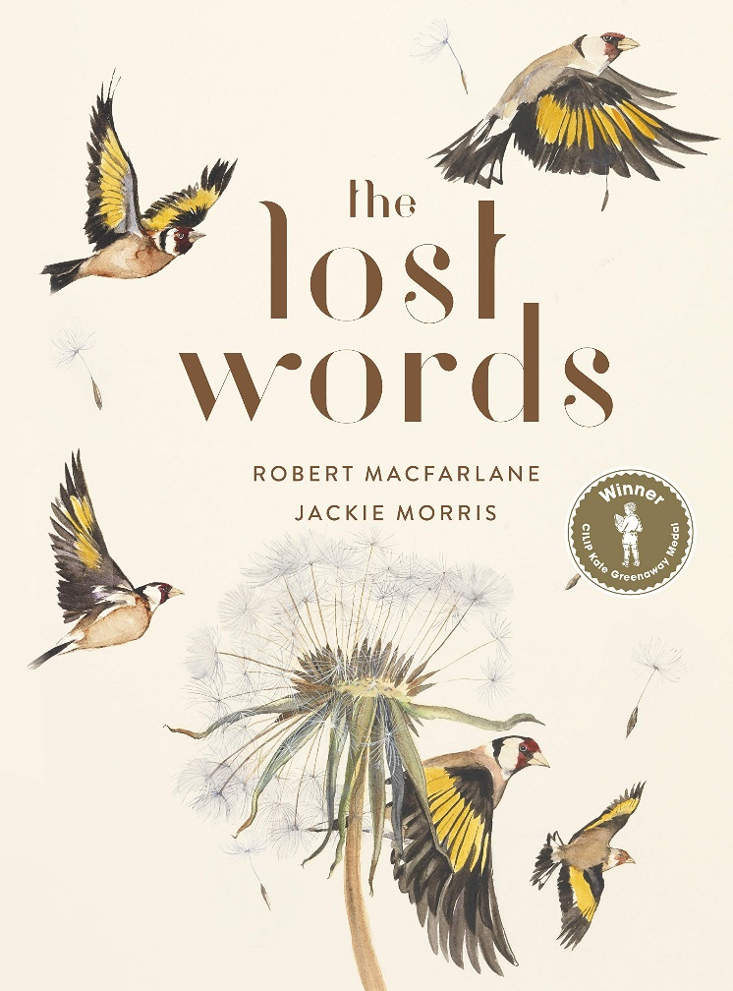
Week Two: Wednesday

Slide 2
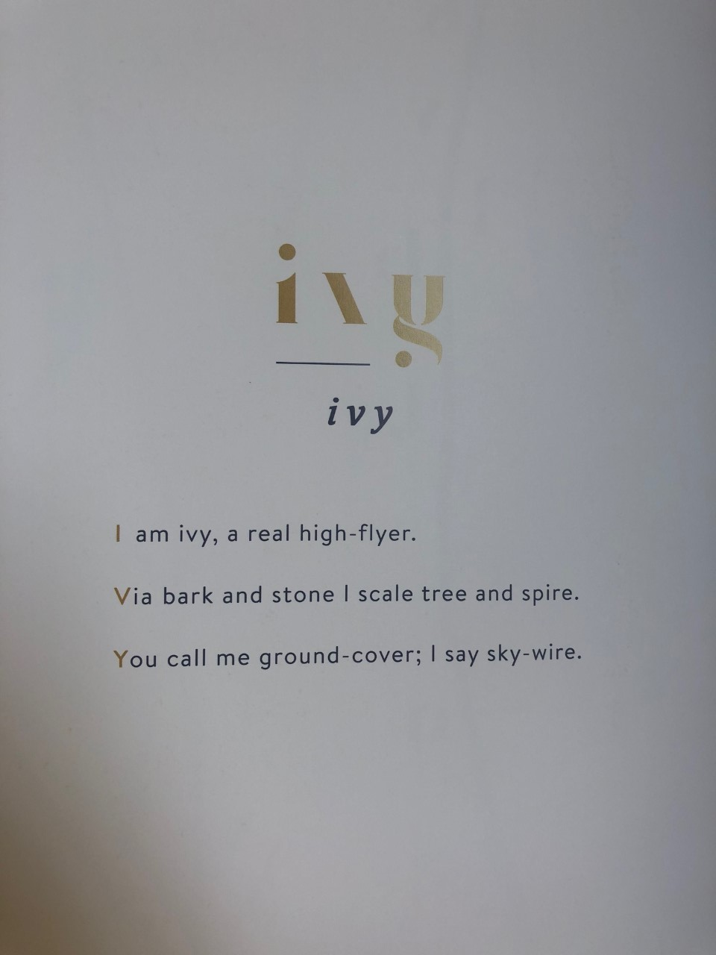
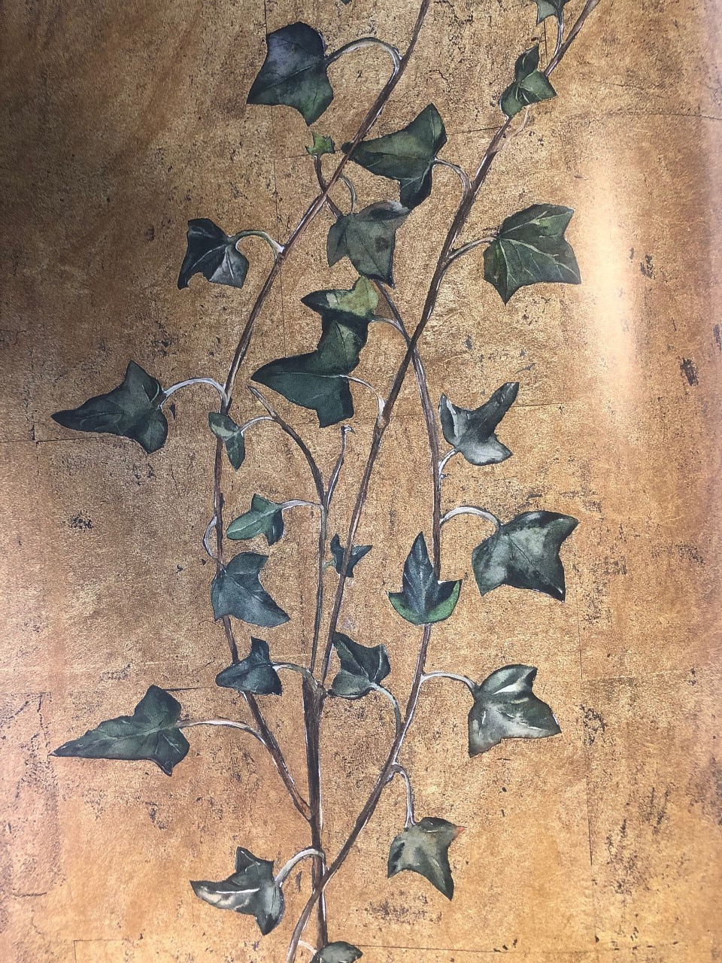
Read the poem:

Slide 3
How are the poems structured?
An acrostic poem is a poem where the first letter of each line (or the last letter of each line) spells out a specific word.

Slide 4
Your task today, is to write your own acrostic poem for one of the lost words.
Acorn
Adder
Bluebell
Bramble
Conker
Dandelion
Fern
Heather
Heron
Ivy
Kingfisher
Lark
Magpie
Newt
Otter
Raven
Starling
Weasel
Willow
Wren
Option 1: Choose a poem that we have already looked at and rewrite it with some of your own ideas
Option 2: Choose a word that we haven’t shared with you yet and write the poem from scratch.
Remember you can use a mixture of alliterations, metaphors, similes and personification – and it doesn’t have to rhyme!
There’s an example on the next page.
Remember to send us a copy – typed or handwritten is fine ☺

Slide 5
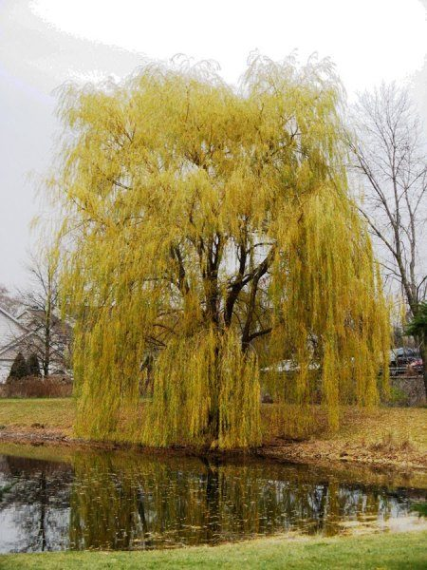
Willow example
Wind blowing the long waving branches, greeting the people passing by
If you whisper your secrets, the tree will hold those close to it’s heart
Listen to the rustle and press your ears against the bark
Linger amongst the drapes dancing through the sunshine
Open your heart to the gentle giant
Water surrounding this ancient tree.

