Slide 1
RE - Salvation
As you’ve seen, we have been reminding ourselves of the Easter story this week.
The concept we are thinking about is Salvation. For Christians, this means that by having faith in God, they will be saved from sin or evil.

Slide 2
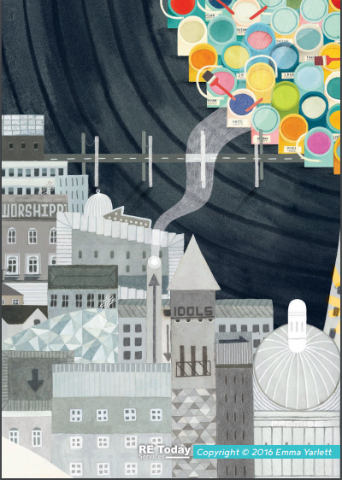
Challenge 1:
Have a look at this section of the frieze. Can you spot any links to Jesus or Christianity?
Feel free to just think about or discuss this with your family, but you can write things down if you like. We know some of you love a post-it note or two!

Slide 3
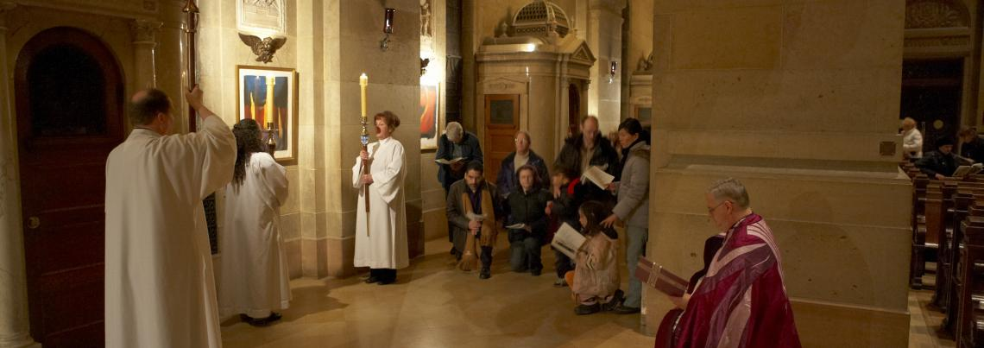
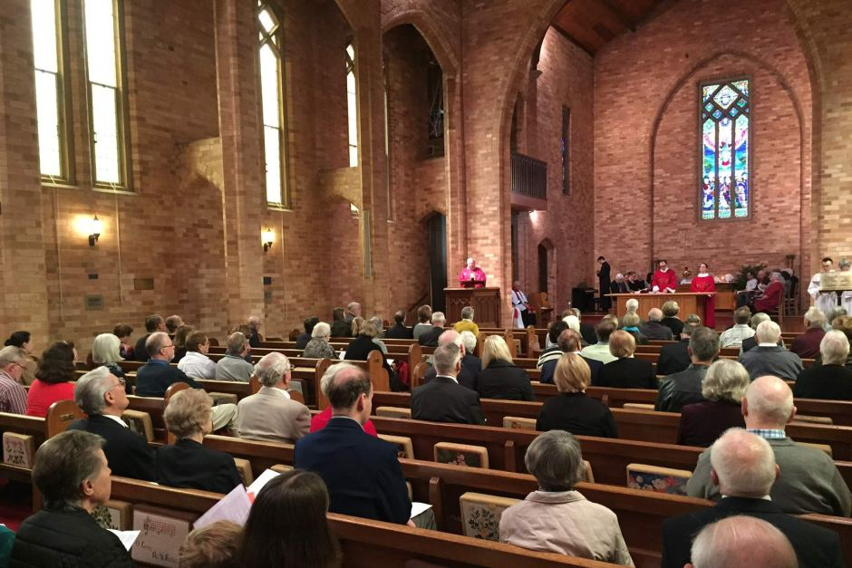
What happens in church on Good Friday?
Watch this video:
https://request.org.uk/festivals/holy-week-and-easter/how-is-good-friday-observed/
What did you notice about the church environment on this day?
Have a think before looking at the next slide…
Extra info worth a read here:
https://www.topmarks.co.uk/Easter/GoodFriday.aspx

Slide 4
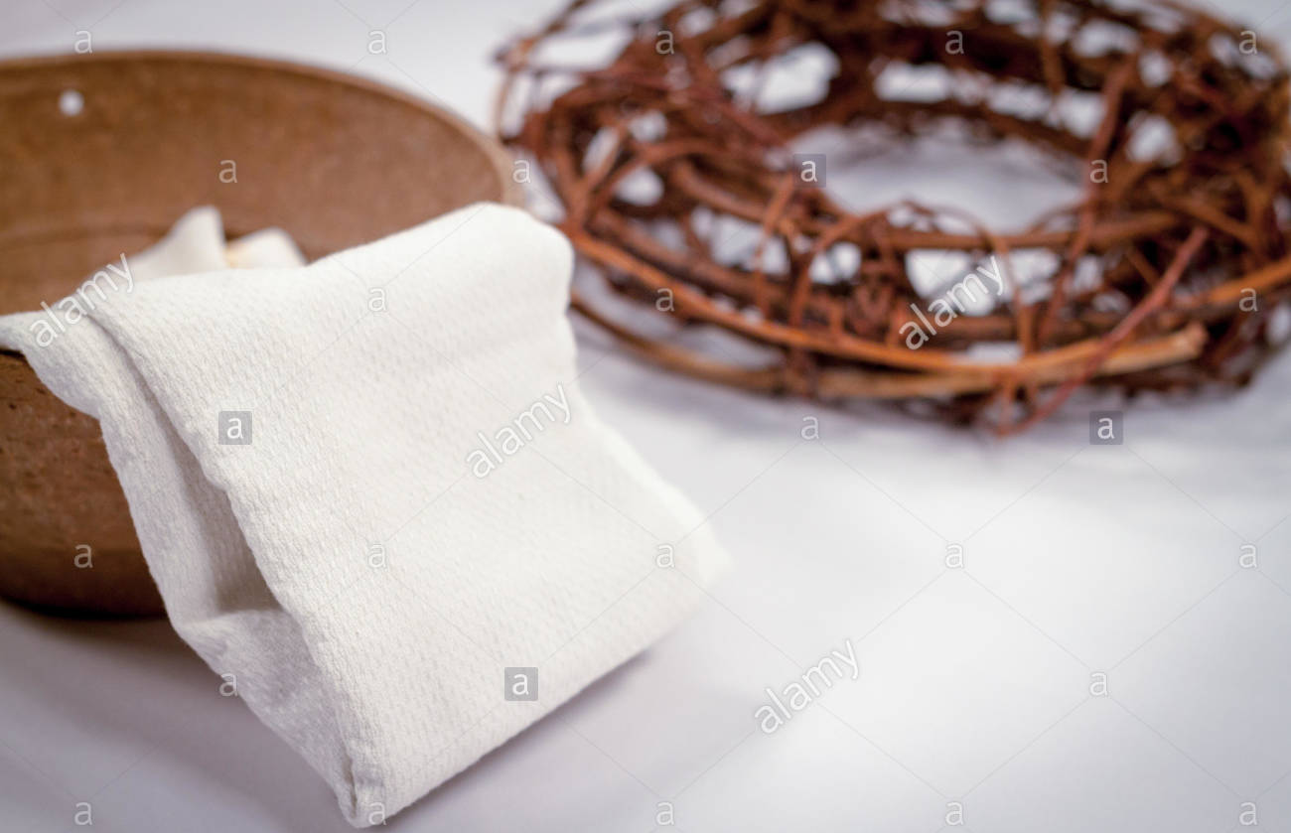
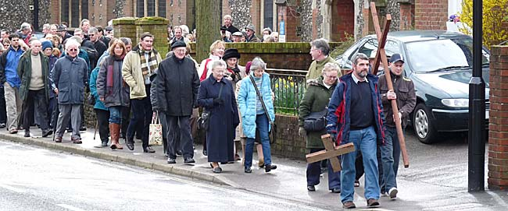
What happens in church on Good Friday?
It’s quite a sad day for Christians as this was the day Jesus was crucified.
The church service will be quite solemn – sad and not joyful
Most Christians will wear plain clothes
Some Christians will march through the streets with a cross (mainly a Catholic tradition). It’s a bit like a mini pilgrimage to recap the key events of the Easter story.
At the front in church will often be a crown of thorns as this was placed onto Jesus’ head during the events that lead to his crucifixion.
No flower displays and generally little colour.

Slide 5
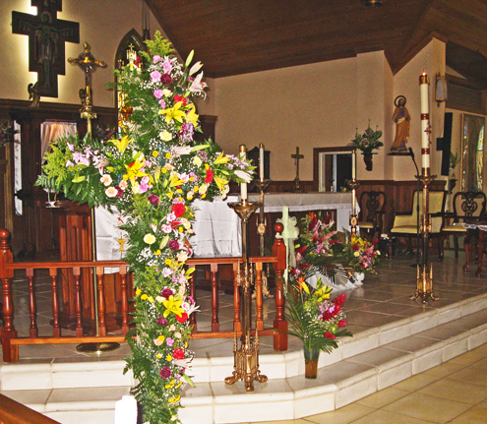
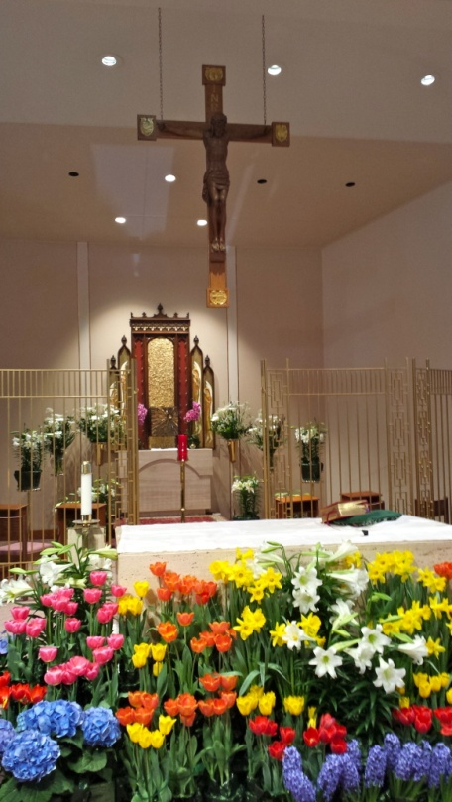
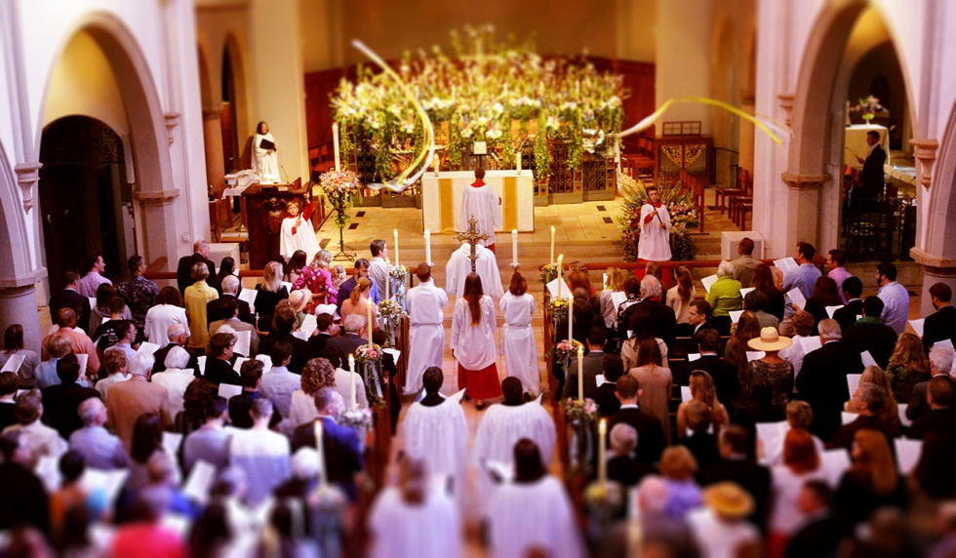
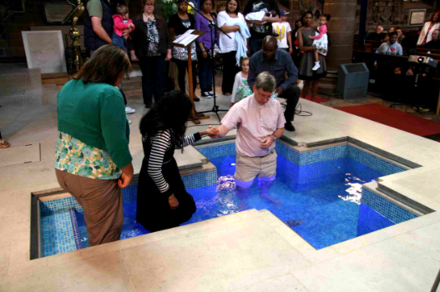
What happens in church on Easter Sunday?
https://www.bbc.co.uk/teach/class-clips-video/religious-studies-ks2-easter/znkngwx
Watch this video and look at the following information…
https://www.topmarks.co.uk/Easter/EasterSunday.aspx
How is the church environment different from Good Friday?
Look at these pictures to help you

Slide 6
What happens in church on Easter Sunday?
This day is a much happier one for Christians as it was the day Jesus was resurrected.
You’ll notice much more colour in the church – flowers, clothing etc.
Hymns that are sung are much happier as Christians are now celebrating
The service is also joyous
The cross is covered with flowers
Some Christians use this idea of a move from darkness to light to comfort them when they are facing problems.

Slide 7
Challenge 2: Split a page of your home book in half. Draw some pictures to show what happens on Good Friday on the left and Easter Sunday on the right. There should be a clear difference – sadness to happiness Use this as a starting point…
Good Friday
Easter Sunday
solemn service
lots of colour
colourful flowers
crown of thorns
plain clothes and little colour
celebration
sad hymns
happier hymns

Slide 8
A question to think about with your family…
How does believing in the resurrection of Jesus make a difference to how Christians live today?

Slide 9
One final thing…
C.S Lewis based the Lion, the Witch and the Wardrobe on the Christian story.
Aslan is a mythical Christ figure who plays a pivotal role in the story of Narnia, just as Jesus Christ is central to the Christian faith.
So sit back, put your feet up and get the popcorn out because if you can, RE also includes film time! Why not watch it with the family?
Have fun!

