Slide 1
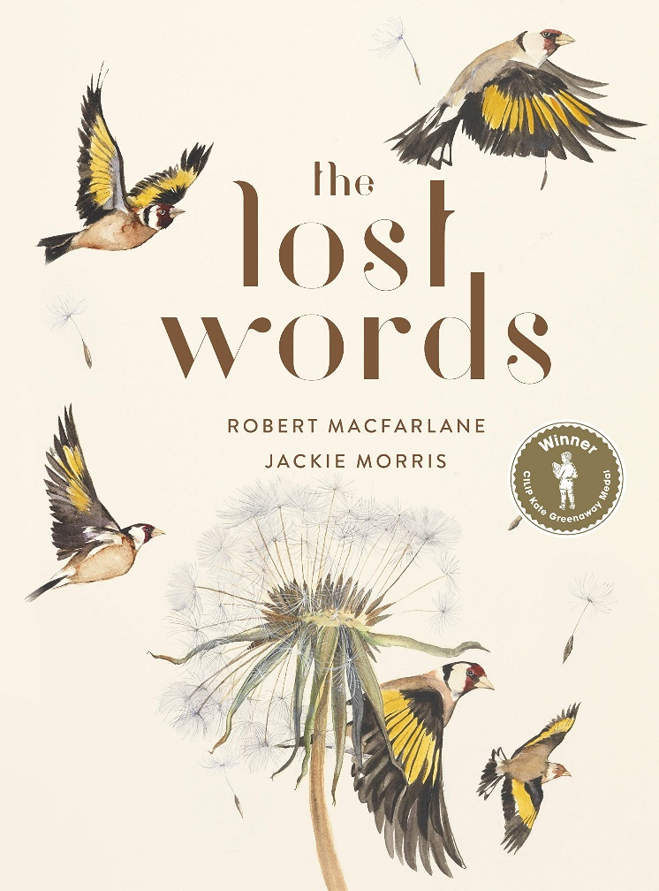
Week Two: Thursday

Slide 2
How did you get on writing your poems yesterday? We hope you’ve enjoyed this poetry unit of work. We will be starting something new next week.
Acorn
Adder
Bluebell
Bramble
Conker
Dandelion
Fern
Heather
Heron
Ivy
Kingfisher
Lark
Magpie
Newt
Otter
Raven
Starling
Weasel
Willow
Wren

Slide 3
Today, we would like you to do one more piece of work on your chosen Lost Word from yesterday.
Acorn
Adder
Bluebell
Bramble
Conker
Dandelion
Fern
Heather
Heron
Ivy
Kingfisher
Lark
Magpie
Newt
Otter
Raven
Starling
Weasel
Willow
Wren
We are going to produce a fact file about your Lost Word.

Slide 4
Step 1: Research (using the internet)
Tree height
Leaf colour
Location
Species
Lost Word – Ours is the Willow
Uses
Growth rate
Seasons
Colours

Slide 5
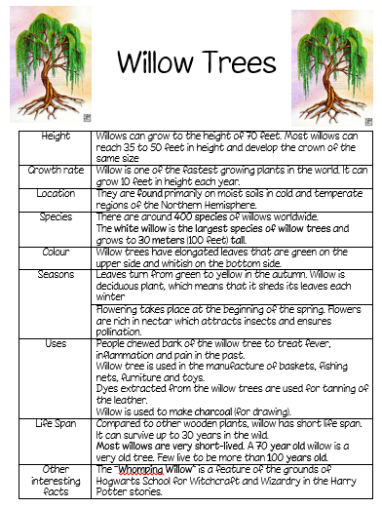
Step 2: Writing your fact file – this can be typed or handwritten Really think about your presentation. Please send us in a copy of your finished piece!

