Slide 1
Field Survey
Go out into your garden and collect as much evidence as possible of life, you might want to make a table like this
Plants/ flowers | Birds | Creatures | Seeds | Eggs | Other evidence

Slide 2
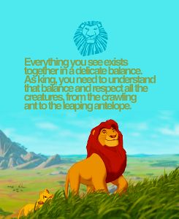
Food Chains
https://www.youtube.com/watch?v=bW7PlTaawfQ

Slide 3
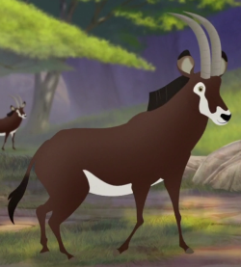
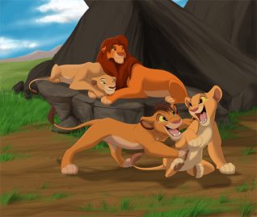
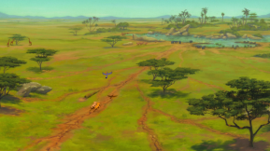
Mufasa’s Food chain
Can you name each of the living things?
But what about the Sun?
The Sun is the energy source that feeds the producer

Slide 4
What role do plants and animals provide in a food chain?
All food chains start with the sun, the energy source, this is at the bottom of the food chain.
The last creature in the chain is at the top of the food chain.
Mufasa’s Food chain
What is at the top
of the chain?

Slide 5
Food chain vocabulary
Plants and animals have different roles in the food chain.
Plants are producers and animals are consumers.
Some animals are not just consumers they are also eaten, these are known as prey.
Animals who eat other animals are called predators.

Slide 6
I can explain the roles of producers, predators and prey in a simple food chain.
Draw the food chain of your big cat neatly across a piece of paper.
Label the:
Energy Source
Prey
Producer
Predator
Consumer

