Slide 1
I can design and annotate a robot

Slide 2
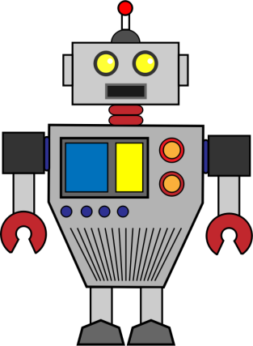
What are robots?
What are they used for?
What could robots be used for?

Slide 3
Challenge: this week you are going to design a robot and write a persuasive advert for it!
How will it positively impact our lives?
What will the robot’s purpose be?
Why should people buy your robot?
How will you persuade people to buy it?

Slide 4
MEET AMAZING ANDY-ROID 3000
He’s your new best friend!
Fed up and tired of using all of your spare time completing chores? Are you spending more time with the boring vacuum rather than your beloved friends and family? If so, you could do with the amazing Andy-Roid 3000 in your life to get a well-deserved break from that never-ending list of tasks! But what does he actually do?
The Andy-Roid 3000 is an innovative new robot who can be left alone in the house to deal with ALL of your household needs! With hardly any prompting, he will wash up, clean the windows, shampoo the carpets and sweep all of the floors! You don’t have to do a thing – just rest, relax and admire him from the comfort of your armchair.
This magnificent machine, which has been programmed with the latest software, has many incredible features including:
Its impressive collection of six arms (Andy-Roid can complete several tasks at once – all the housework will be done in the blink of an eye);
The ability to glide seamlessly from one room to another (this innovative invention will be unable to bump into anything as its smooth sensors will detect hazards instantly);
An integration of soundless technology (Andy-Roid 3000 will allow you to get that peace and quiet which you constantly crave for by completing all tasks silently);
The most up-to-date voice recognition technology (your responsible robot will remember up to 40 commands from 8 different voices – amazing!)
You will not go wrong by purchasing the amazing Andy-Roid 3000 today! He even has a lifetime guarantee – we will replace his mechanical parts instantly at the slightest of technical faults. You can experience this perfect piece of machinery on a FREE trial basis for one month. Just call the number below and leave your housework woes behind!
ONLY
£2000
VOTED BEST NEW ROBOT 2019
CALL TODAY 0800 182 427

Slide 5
Get creative. Get inventive!
In the middle of your page carefully draw your robot.
Give it a catchy name.
Think carefully about what features it will have to ensure it will be able to carry out the jobs you want it to. Perhaps it’s a bedroom tidier? Maybe it’s a homework helper? Possibly your new best friend who is trained to play football with you?!
Annotate (label) detailed notes around your picture to explain what these functions do.
Use the pictures on the next slide to inspire you if you like…

Slide 6
