Slide 1
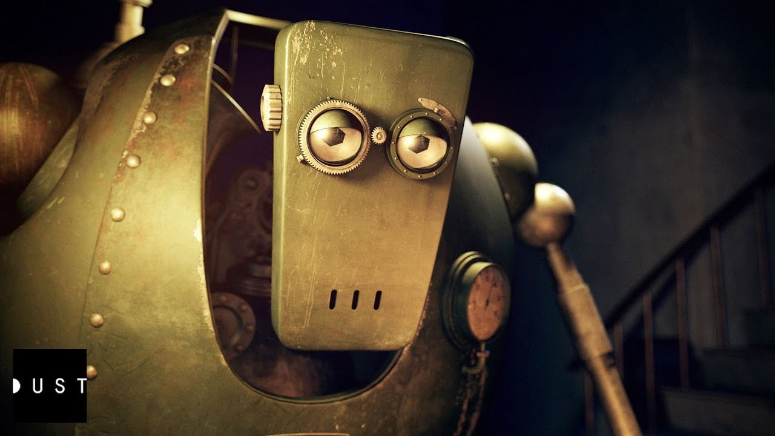
I can portray the emotion in a story retell

Slide 2
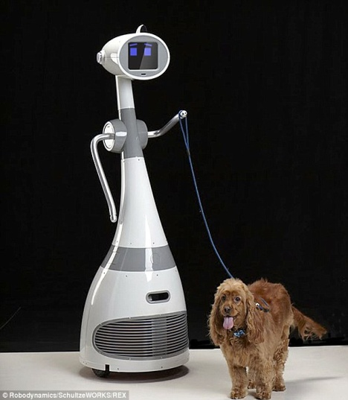
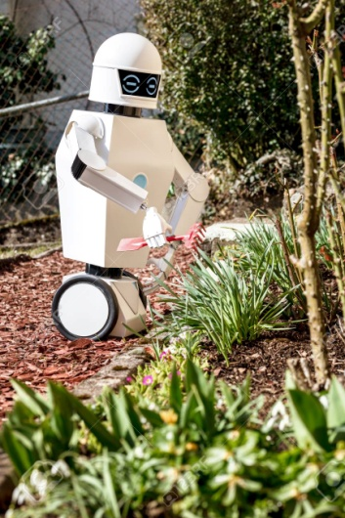
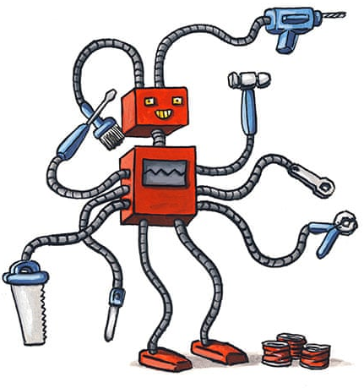
If you had the chance for the robot that you designed to be produced, how long would you want it to be around for?
A warranty is a written promise to ensure a product will always be repaired or replaced if it or any of its parts are defective.
If we really wanted to persuade our buyers, how long might we say our robot has a warranty for?

Slide 3
Meet Bibo…
‘It is not just a machine...
He is different'
Bibo is a robot who has a
warranty for 10,000 years.
Sounds brilliant?
But what happens when a robot outlives the humans it was built to love?
It’s now time to watch the film. You’ll find the link on the Y6 page.
As you watch, jot down notes of things you see and sounds that you can hear.

Slide 4
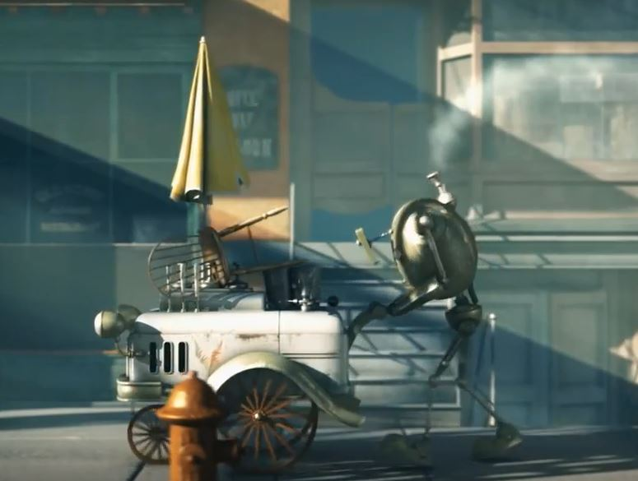
Bibo the Robot
What is the general feel/mood
of this film?
What could have happened to the
town?
Why is he the only one ‘alive’?
How do you think he feels?
You might want to watch the film again.
Can you identify the significant events in the film as well as how Bibo might be feeling at each point.

Slide 5
Did you manage to identify these events?

Slide 6
I can portray the emotion in a story retell
Next to each picture, describe the scene, as well as Bibo’s emotions at that point. You will have to use your imagination at certain points to help you to infer what is going on – that is okay!
Think about your use of vocabulary. Here is a starting point…
Every day, Bibo wanders the same old street with his ice-cream truck; he is hopeful his friends will return to bring the gleaming smile back to his face.
Can you use semi-colons and colons within your writing today?

