Slide 1
Read chapter 9 or listen to Mrs Alsey read it.

Slide 2
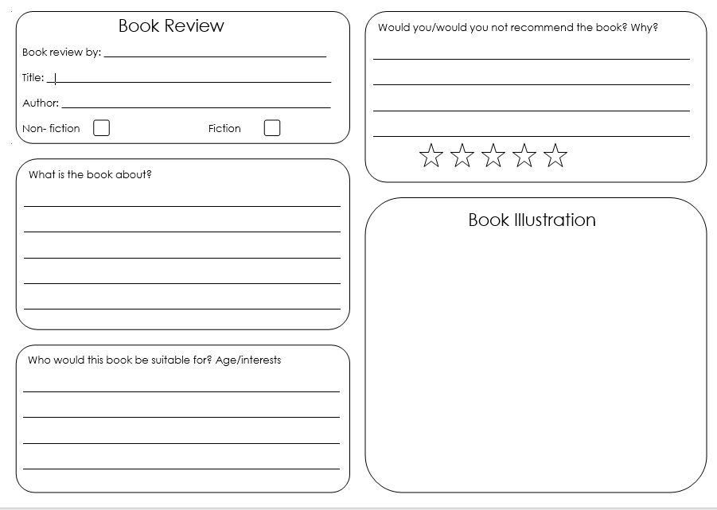
Complete a book review about the Hodgeheg.
You can download the template to use or design your own.
Don’t forget to use your neatest handwriting and capital letters and fullstops correctly.

