Slide 1
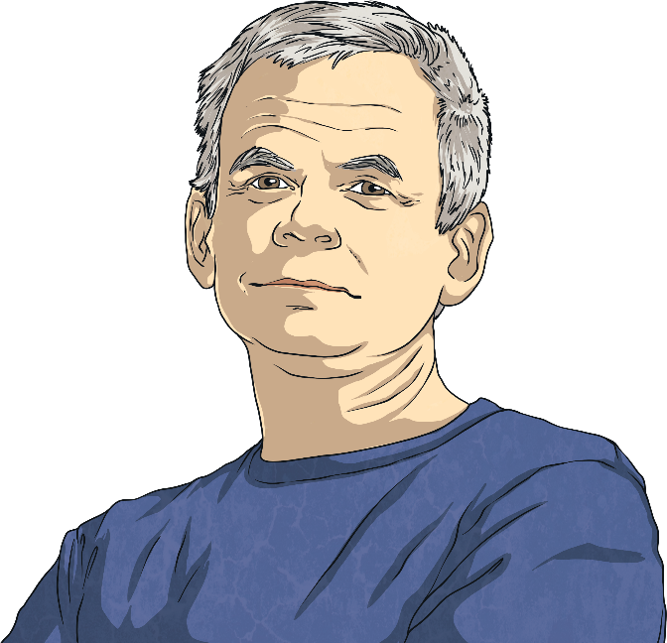
Andy Goldsworthy
Andy Goldsworthy is a British artist. He is known for his work in sculpture and photography. Andy is an environmentalist and this is reflected in the nature-based aspect of much of his work.
Andy was born on 25th July 1956 in Cheshire. When Andy was 13, he got a job as a labourer on a farm.
He studied fine art at Bradford College of Art. Fine art is often described as ‘art for art’s sake’; drawings, sculptures and paintings that have no use other than being beautiful.
Did You Know?
Andy said his work on the farm helped prepare him for creating sculptures later in life. He said, “A lot of my work is like picking potatoes; you have to get into the rhythm of it.”

Slide 2
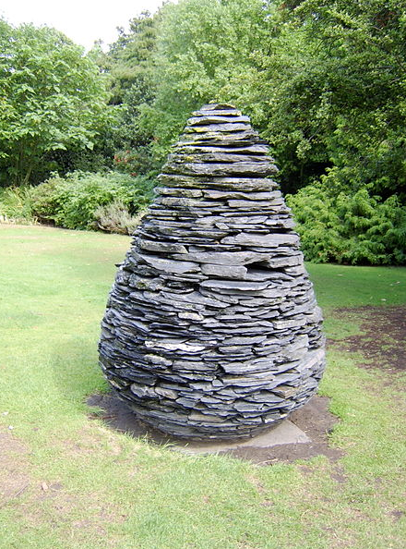
Nature
Andy describes his art as working “with nature as a whole”. His sculptures are often made up of stones, twigs, flowers, mud, snow and icicles. Many of Andy’s sculptures are created on the site where the objects are found. This is called land art or environmental art.
This is one of Andy’s slate cone sculptures. Andy cut different shapes of slate and put them together in the shape of a pine cone. There are several versions of this sculpture across the world. This one is in the Botanical Gardens in Edinburgh.
“Slate Cone” by Wolfgobbler is licensed under FAL

Slide 3
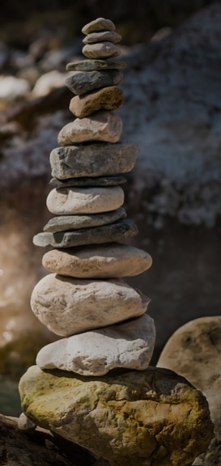
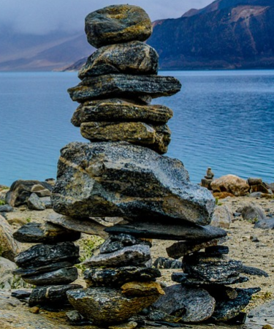
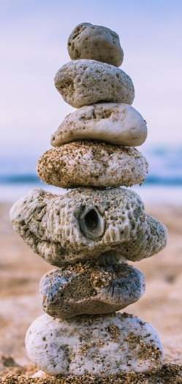
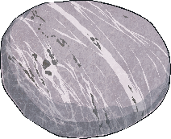
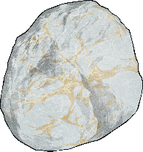
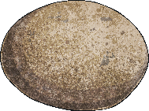
Rock Balancing
Andy has made rock balancing popular. Rock balancing is a form of art where rocks and pebbles are balanced on each other without using glue, wires or anything else to keep them together. It can be done on a small or large scale. Here are some examples of rock-balancing sculptures that people have made.

Slide 4
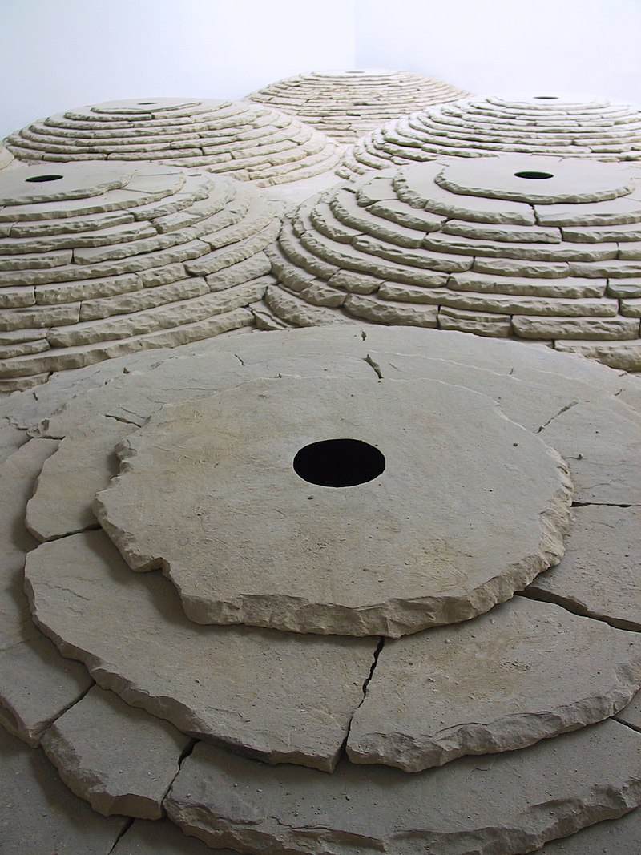
Life As An Artist
Andy now lives in Dumfries and Galloway, Scotland. In 2000, he was given a special award called the OBE (Order of the British Empire) by The Queen. This means his full title is Andy Goldsworthy, OBE.
A director named Thomas Riedelsheimer has made two films about Andy’s life, called ‘Rivers and Tides’ and ‘Leaning into the Wind’.
Andy continues to travel the world building on-site sculptures.

Slide 5
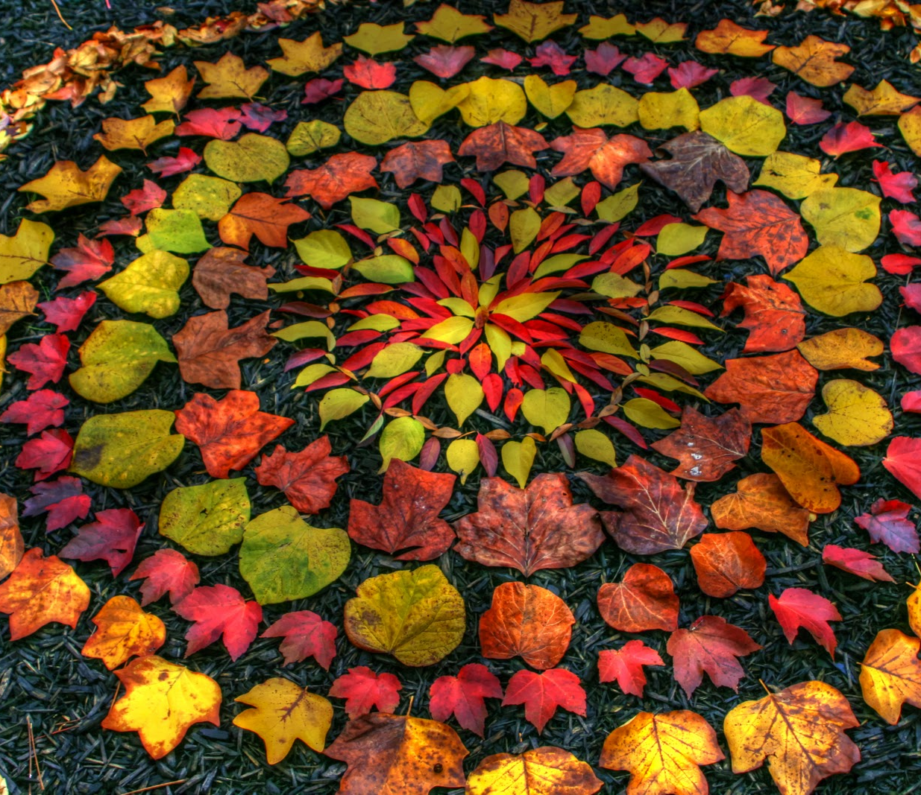
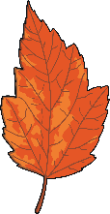
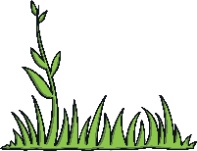
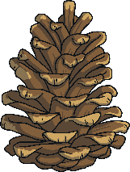
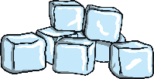
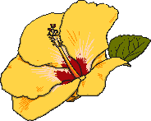
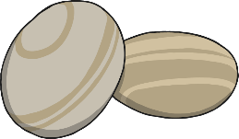
Land Art
Andy makes sculptures with natural materials on sites in the UK and around the world. He has made them in forests, fields, cities, lakes and fields. They are known as land art.
Which natural materials can
you think of that he could use
to make sculptures?
leaves
twigs
pebbles
rocks
ice
flowers
grass
pine cones
Did You Know?
Andy has even used human hair and cow dung in his work!

Slide 6
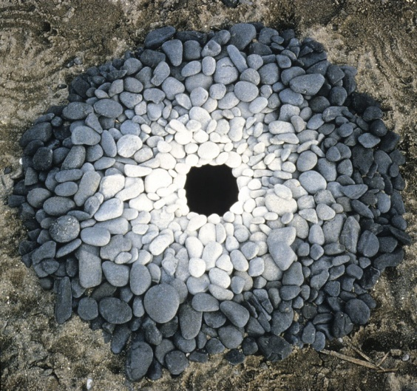
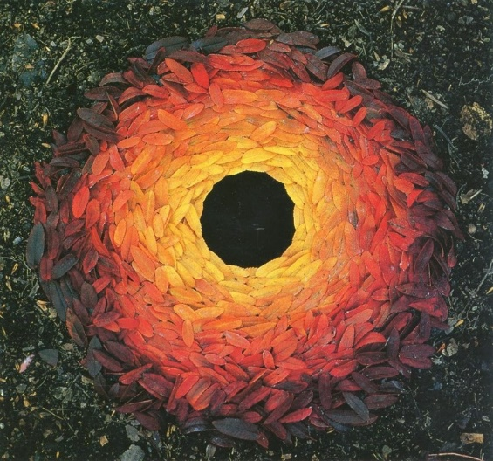
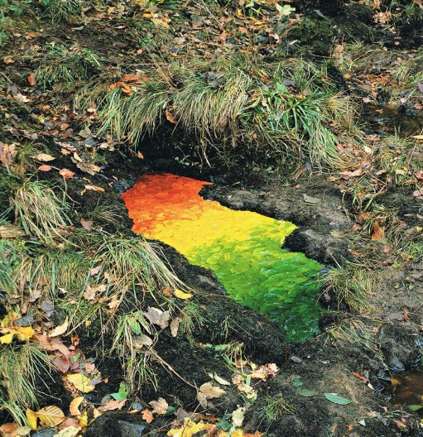
Try it yourself!
When you go on your walk today or in your garden, create your own natural land mark picture. Take a picture and email it to us.
It reminds us of our connection to nature.

