Slide 1
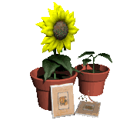
What Plants Need

Slide 2
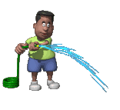
What do plants need to grow ?
Water
Plants need water to help them grow. Without water they will dry up and die.

Slide 3
Light
Green plants need sunlight so that they can make their own food.

Slide 4
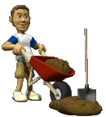
Nutrients
Plants need the good food found in soil for healthy growth.

Slide 5
Warmth
The sun gives warmth as well as light. Plants grow best in the right conditions.
The plant will not grow properly if it is too hot or too cold.

Slide 6
Let’s take a closer look at how plants use water.

Slide 7
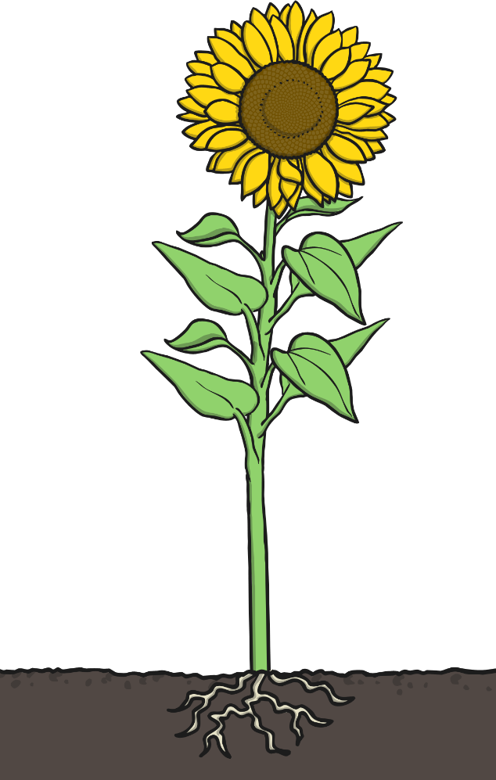
The process of water transportation is the way water moves through a plant.
The roots absorb water from the soil.
The stem transports water to the leaves.
Water evaporates from the leaves.
This evaporation causes more water to be sucked up the stem.
The water is sucked up the stem like water being sucked up through a straw.

Slide 8
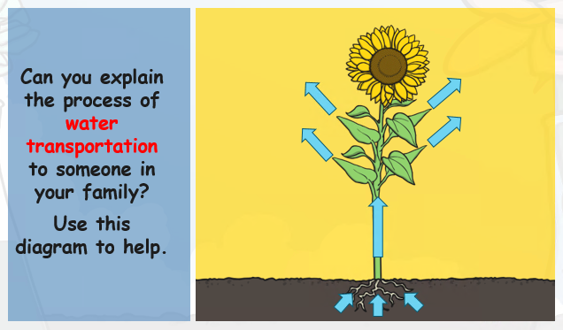

Slide 9
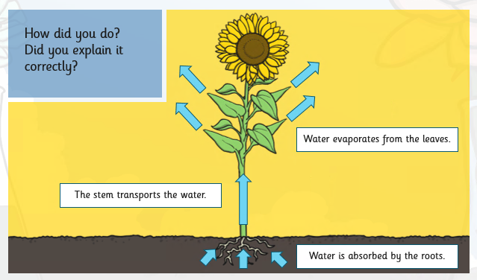

Slide 12
We’d love to see any photos of the experiments you carry out or pictures you have drawn. Have fun!

