Slide 1
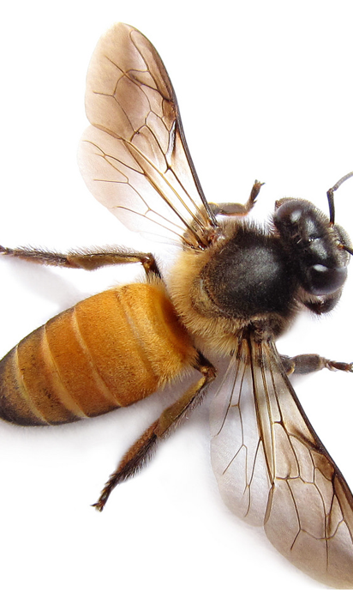
Bee Homes

Slide 2
Last week we found out how important bees are. Today we are going to look at where Bees live.

Slide 3
Most species of bumblebee prefer dark, dry cavities for their nest site
Photo: Brian Tomlinson

Slide 4
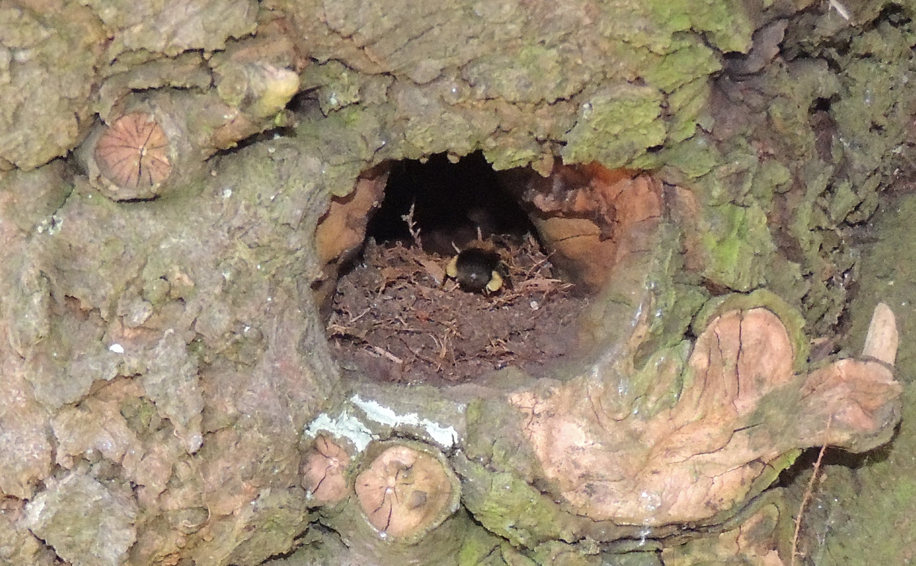
Bumblebees often make nests in trees. Or they may choose a bird box, thick grass, a compost heap, an abandoned rodent hole or under a garden shed

Slide 5
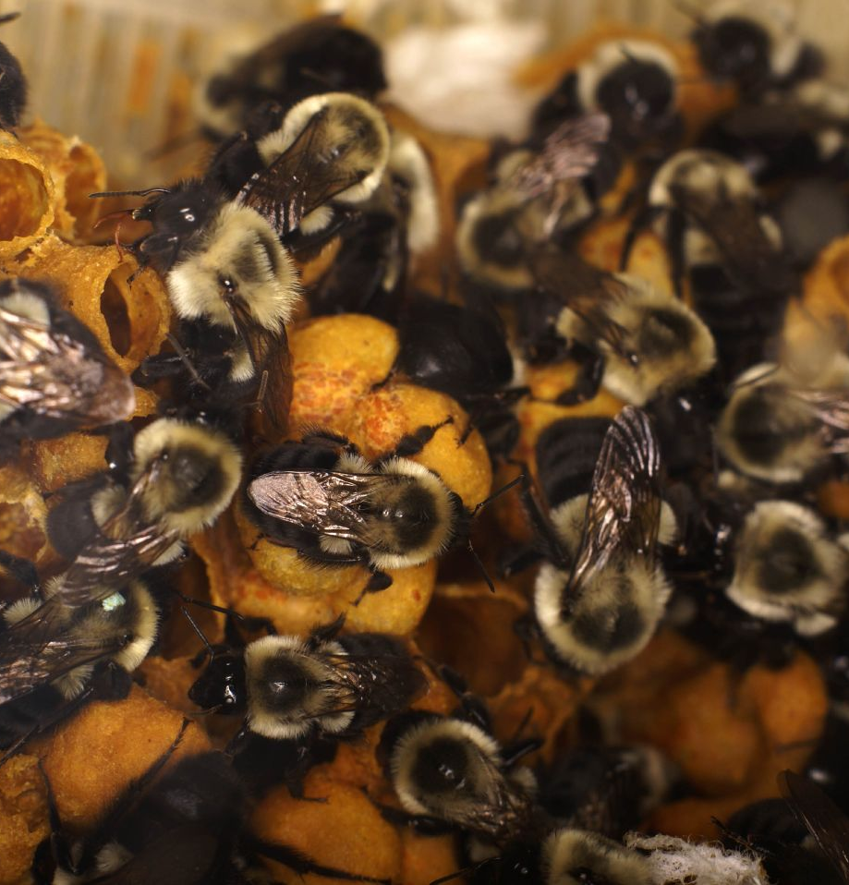
Bumblebees live in nests with 50 - 400 bees. There are lots of wax balls with baby bees growing inside and little wax pots filled with nectar.

Slide 6
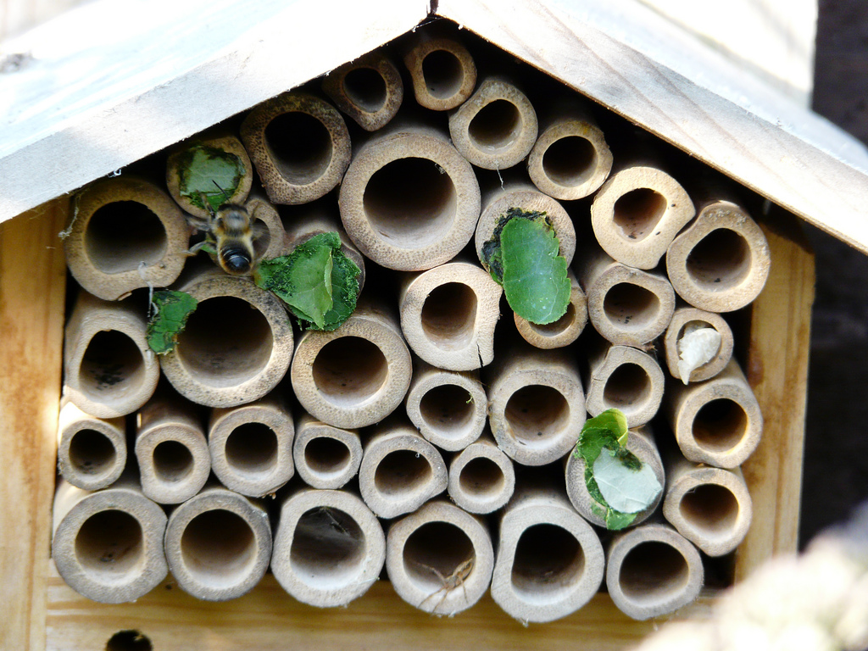
Some bees are solitary and like to live on their own like leaf cutter bees. Leaf cutter bees nesting in a house of bamboo canes.
Photo: Chris Worden

Slide 7
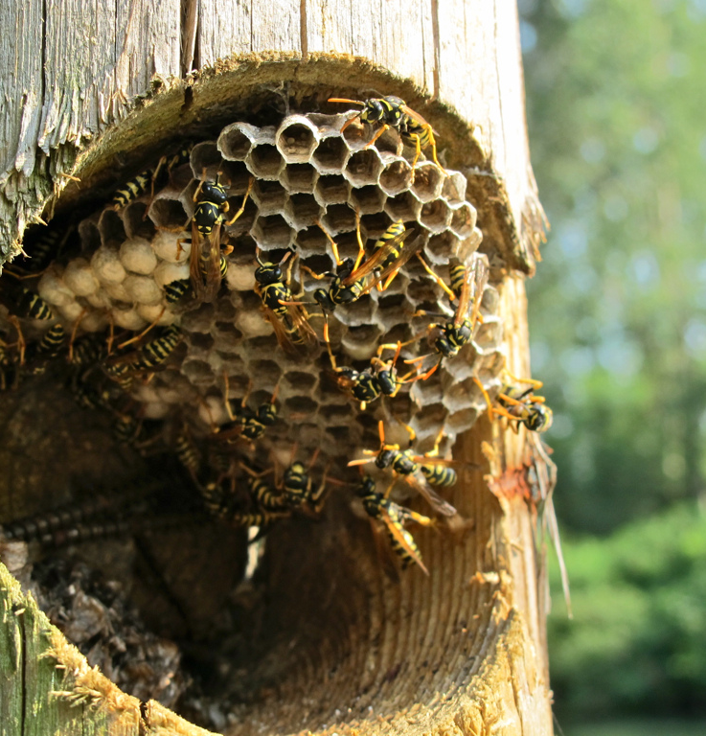
In the wild honey bees make their nests in places such as hollow trees and holes in rocks

Slide 8
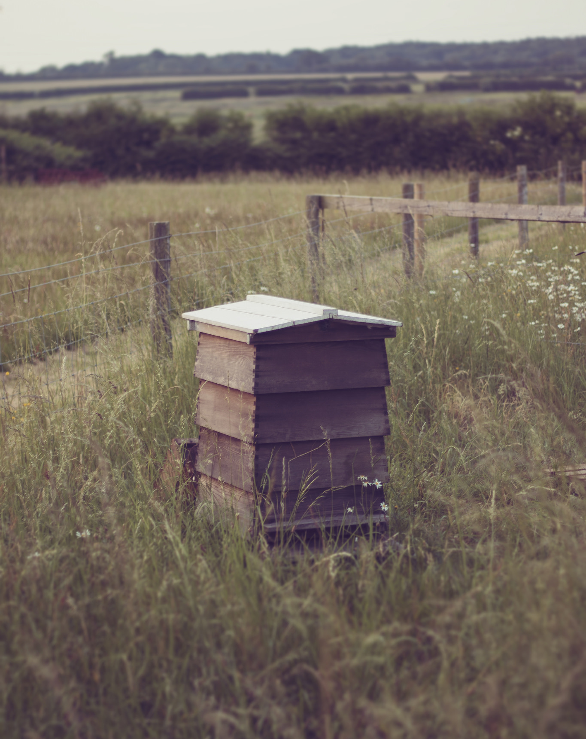
Humans have domesticated honey bees. Hives make it easier to manage a colony of bees and collect honey
Photo: COD Newsroom
Photo: Barry Chignell

Slide 9
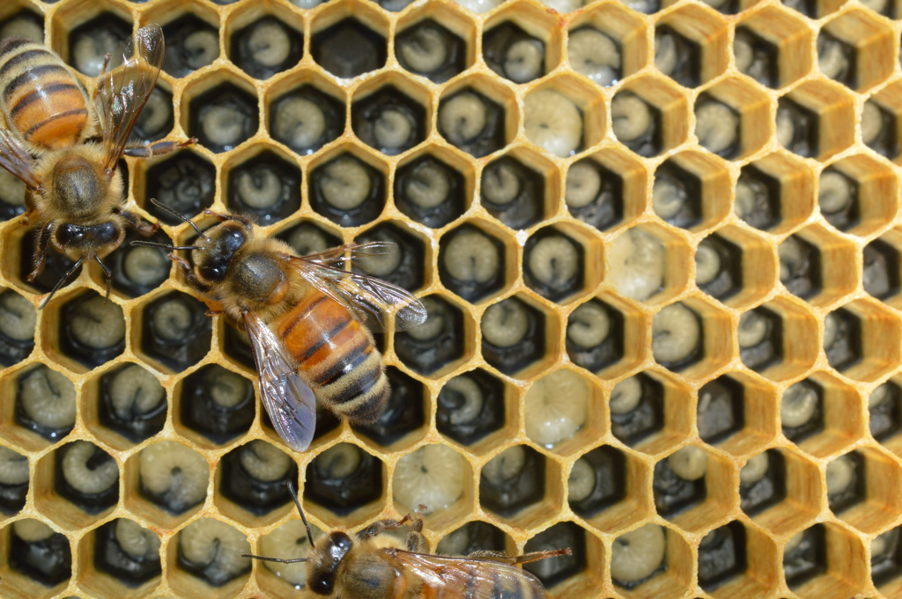
Inside the hive – Look at the shapes you can see inside the bees home.

Slide 10
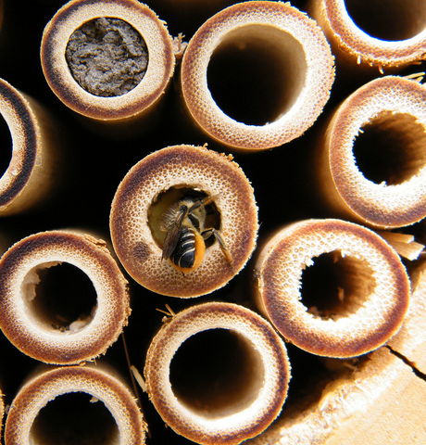
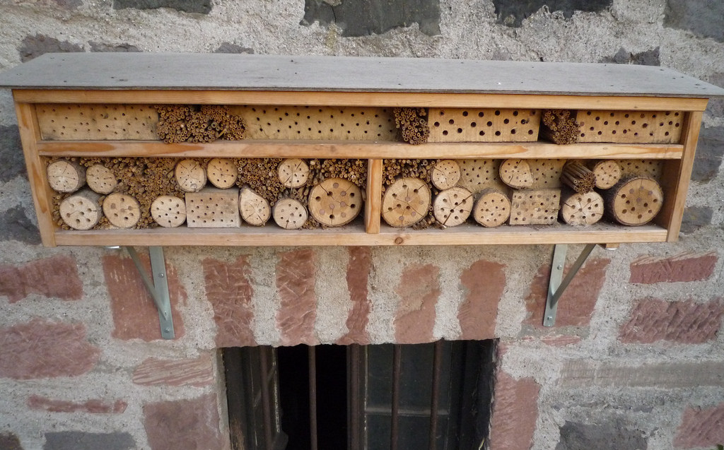
Here are some man- made bee homes.
Photo: storebukkebruse
We know bees like small dark spaces to live in..
Photo: Picture Esk
Photo: Moira Dunworth

Slide 11
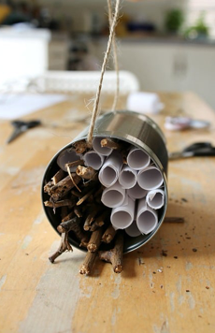
Here are some bee homes made from things you might have around your home.
This is made from a tin with rolled up paper inside.
This is an old tin with rolled up paper and twigs inside.

Slide 12
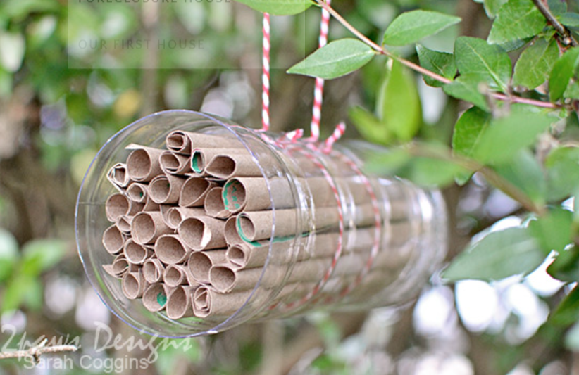
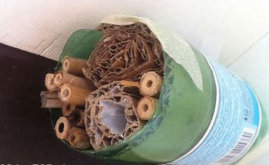
Here are some bee homes made from things you might have around your home.
This is made from a cut off plastic bottle with some rolled up cardboard.
This is made form a plastic bottle with the top cut off and rolled up paper.

Slide 13
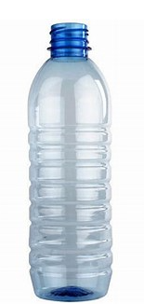
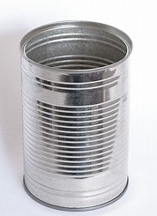
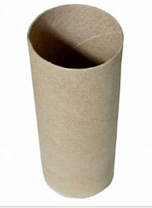
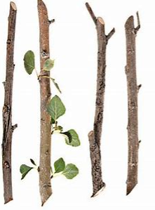
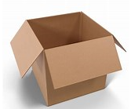
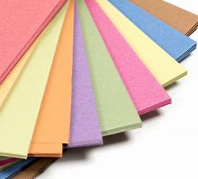
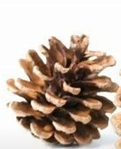
Time to design your own bee home.
Step 1 - Look around your home or garden for things you think you could use to make a bee home. You could even find something on your daily walk.

Slide 14
Time to design your own bee home.
Step 2 -Draw a picture of what you would like your bee home to look like. Remember they like small dark spaces to live in.
Label the picture with the resources you will use.
Twigs
Rolled up cardboard
Rolled up paper
Tin can
Step 3 -Collect the things you need over the week ready to start making your bee home next week.

