Slide 1
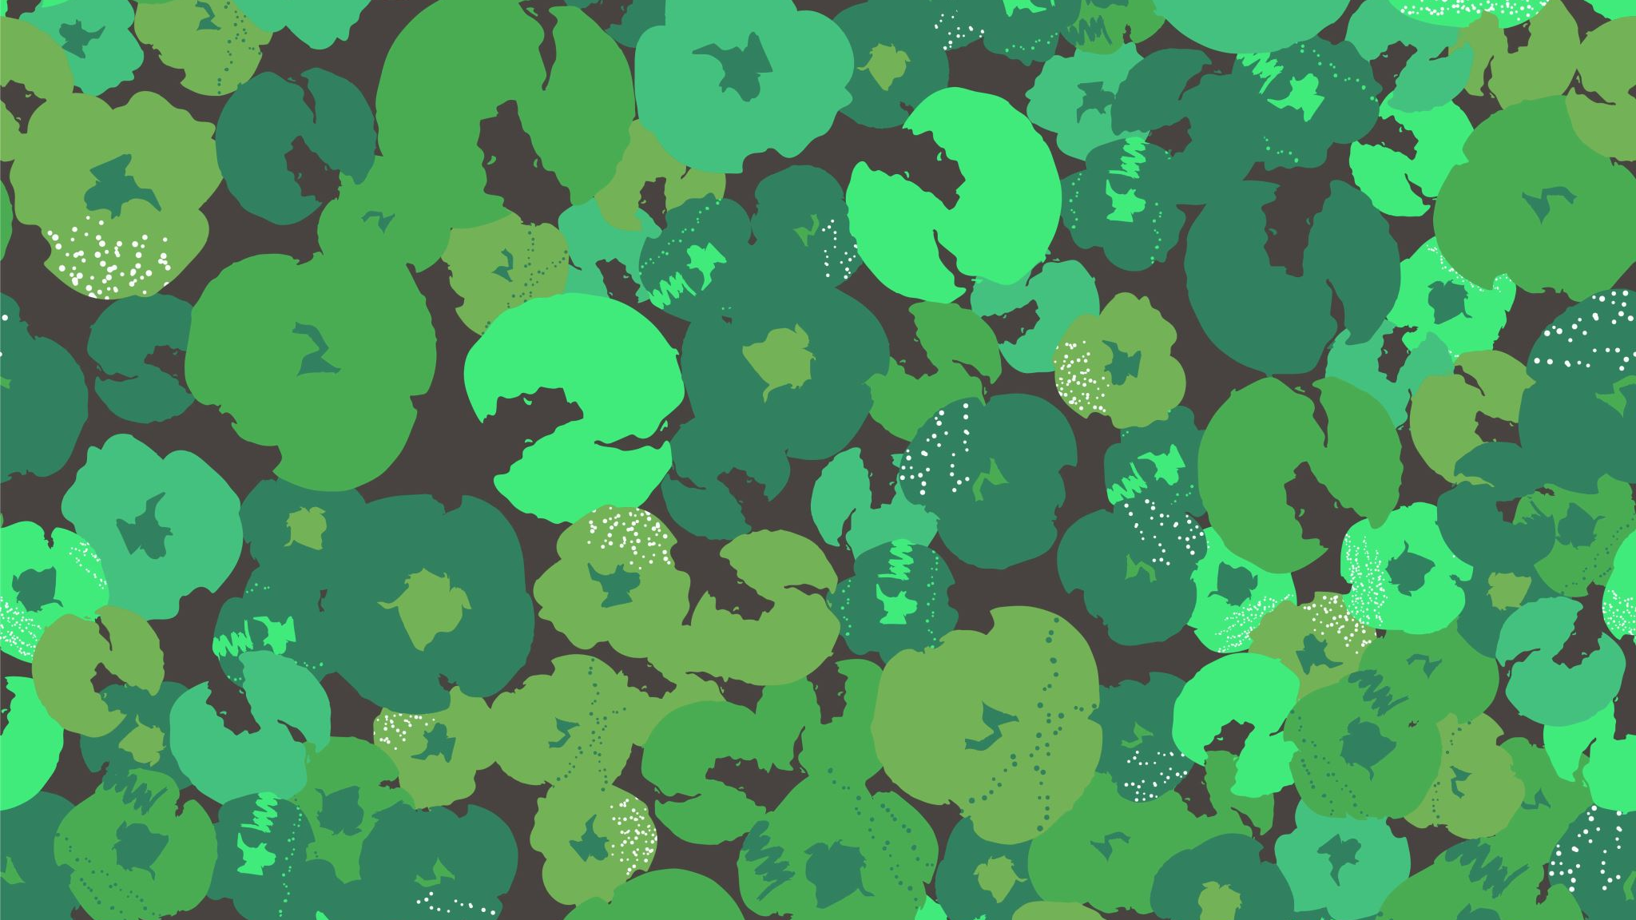
Geography
The world around us
Our geography this term will be all about
Using and making maps and
Understanding land use

Slide 2
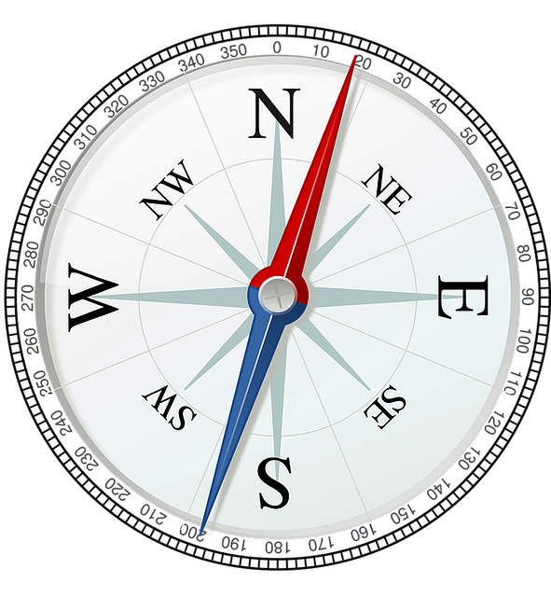
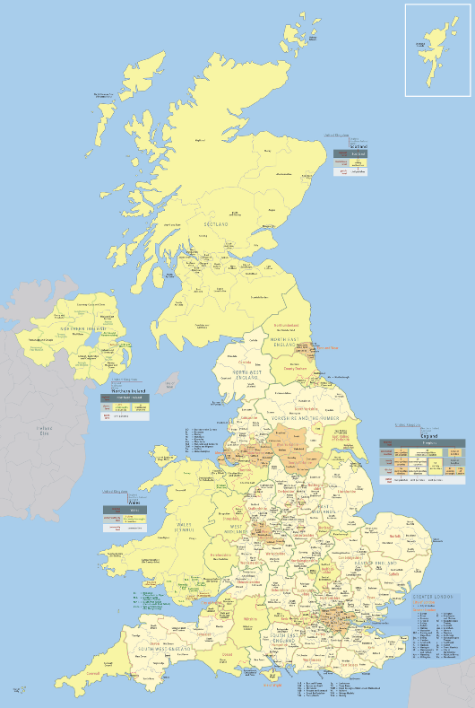
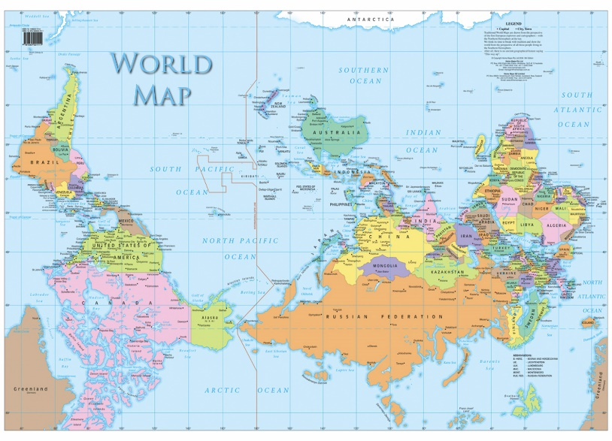
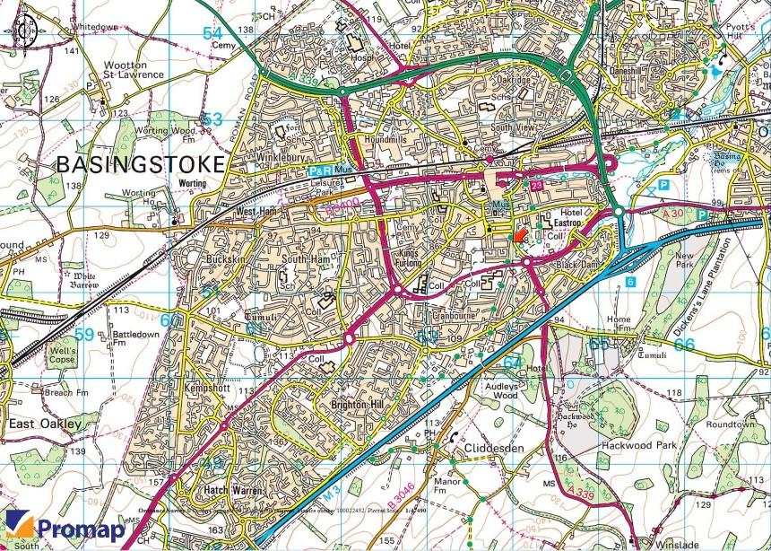
Let’s remind ourselves of some of the things we know already
There are 4 cardinal compass points – North, South, East and West.
Maps show us where things are in our world
There are lots of different types of maps such as:
  A world map – this show us where countries & main cities are
  A map of the UK – this show us where towns and cities are
  A local map – this might show us the names of roads in our area and where shops, schools and parks are.

Slide 3


Compass Points
We can use a Mnemonic to remember the cardinal compass points
Never Eat Shredded Wheat
Never Eat Slimy Worms
Naughty Elephants Spray Water
CHALLENGE:
Can you think of your own Mnemonic phrase to remember the main points of a compass?
A Mnemonic is a memory aid. It can be a rhyme, a picture, or anything else that helps you remember something.

Slide 4
I wonder what we can see from our house using the four cardinal compass points?
Today’s task is to make your own compass panorama.
You will need:
A square piece of paper
A pencil
Colouring pencils
Great observing eyes!

Slide 5
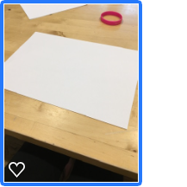
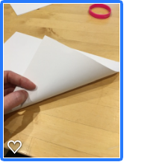
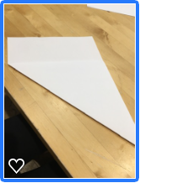
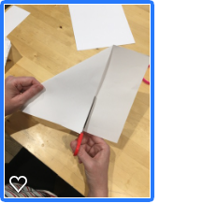
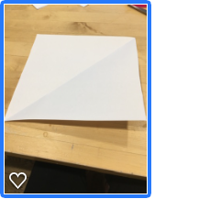
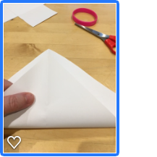
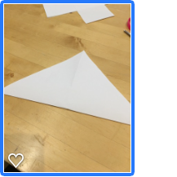
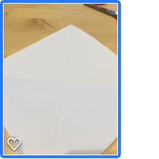
Instructions
First, make your paper a square. Fold the paper as shown in the picture and cut off the extra piece. When you open the paper out, it will be a square.
Next, fold the paper into a triangle again using the opposite side. Open this out and where the four folds meet is the centre point of your square.

Slide 6
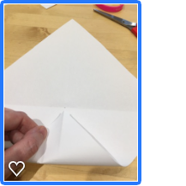
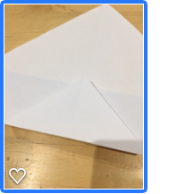
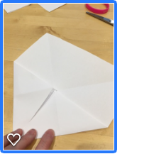
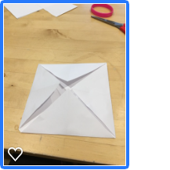
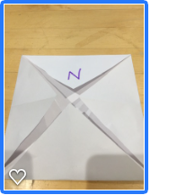
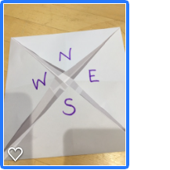
Instructions
Now fold each corner to this middle point as shown in the pictures until you have folded all the corners!
Finally mark each corner with the letters to show North, East, South and West.
You are now ready to draw your panorama compass!

Slide 7
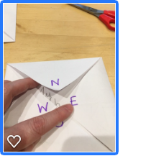
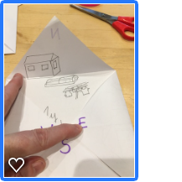
How to draw your panorama compass
Remember this is all about using your eyes! Ask an adult to tell you which way is North. Find a window or go into the garden – what do you see? Draw this in the North part of your compass. Here is mine: (it’s not very good drawing!)
You can colour yours in, which would look much better! I could see my shed, a washing line and a vegetable patch.

Slide 8
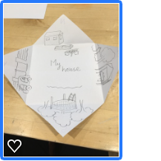
The final Panorama compass
Here is my finished version – I didn’t have any colouring pencils for mine but you can colour yours in and decorate the outside as well if you want to!
I could see:
My son’s trampoline South of my house
My car is West of my house
And my table and chairs under my gazebo are East of my house
You might see the things in your garden, other houses, cars in the road, trees, someone having their daily walk. Do send us pictures to our Year 3 email address – we would love to see them!
In our next Geography lesson we are going to think about how we can use maps! Look out for it next week!

