Slide 1
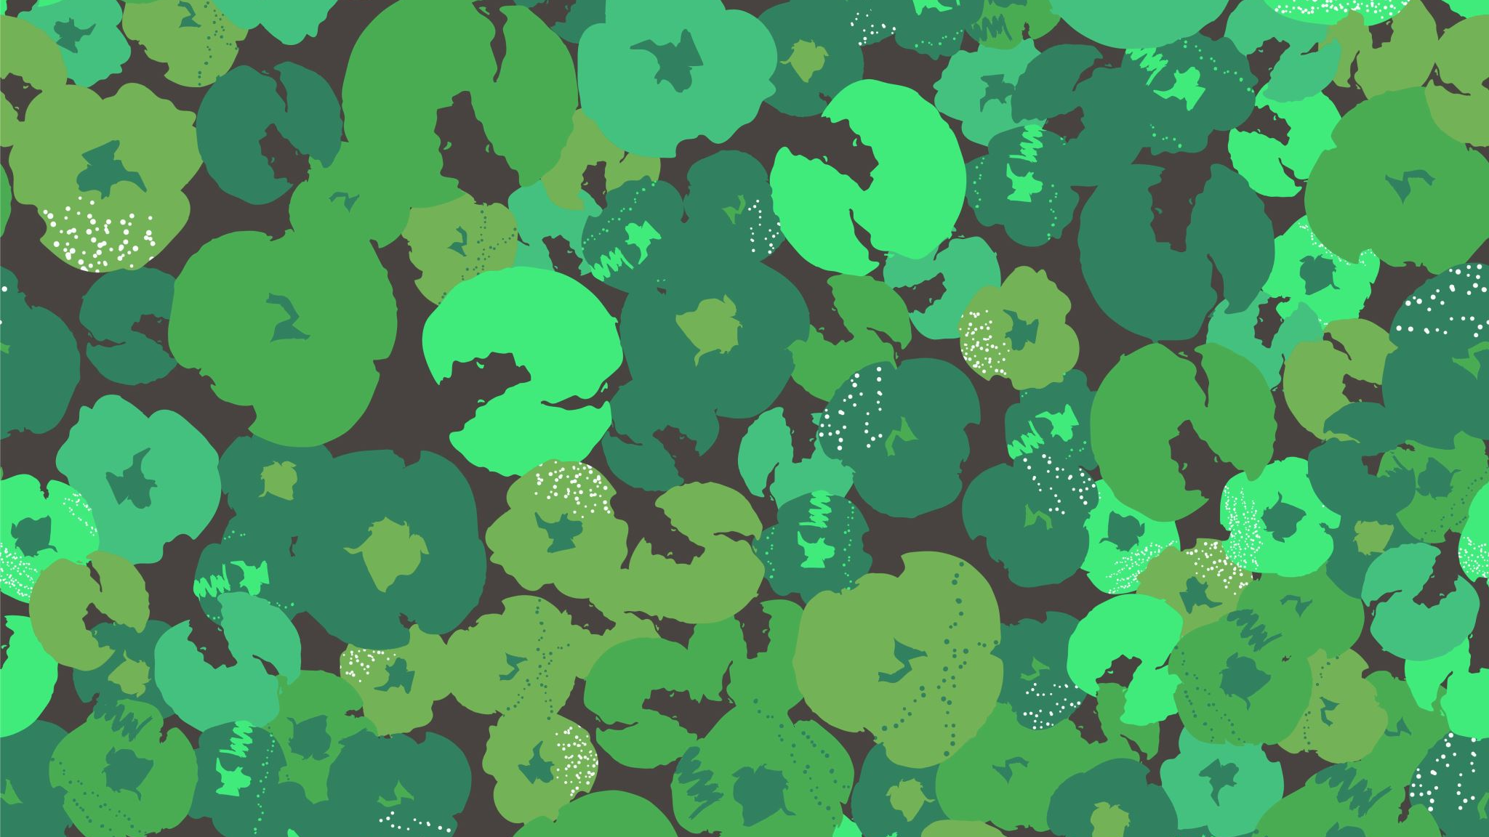
Geography
The world around us
Our geography this term will be all about
Using and making maps and
Understanding land use

Slide 2
Let’s have a quick quiz to see what we can remember from last week!
Name the four cardinal points on a compass?
What does a map show us?
Which type of map would show us all the towns and counties in our country?
Give one example of a mnemonic you could use to remember the four cardinal points on a compass.

Slide 3
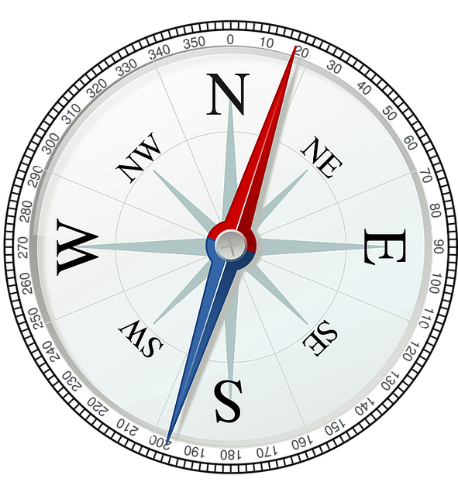
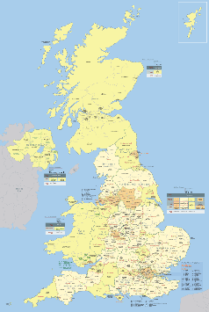
Let’s have a quick quiz to see what we can remember from last week!
Name the four cardinal points on a compass?
North, South, East and West (in any order)
What does a map show us?
Where places and things are.
Which type of map would show us all the towns and counties in our country?
A UK map
Give one example of a mnemonic you could use to remember the four cardinal points on a compass.
Never Eat Shredded Wheat (North, East, South, West)

Slide 4
Today we are going to learn about using a grid – this will help us use maps successfully!
How are grid squares on a map useful?
You could talk to your adult, brother, sister, the dog, the cat and come up with some ideas!

Slide 5
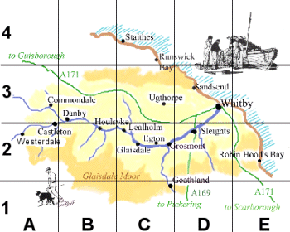
How are grid squares on a map useful?
They help us locate (find) places and things on a map.
We can use them to tell others how to find a place or thing on a map.
What else did you come up with?

Slide 6
Today we are going to use a grid to play a game - Battleships
You will need:
Two pieces of paper
A ruler or a book with a straight edge you can use as a ruler!
A pencil
6 small objects from around your house – like a paperclip, a rubber, a pencil etc
A large book that can stand up between you and your partner
A partner – someone to play your game with!

Slide 7
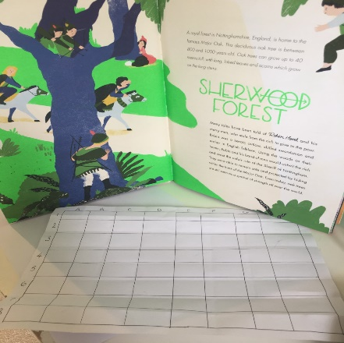
Instructions:
First draw a grid on each piece of paper. It needs to be an 8x8 grid – you may need to get a grown-up to help you. (Don’t worry if the grid boxes are not quite the same size, just try your best!)
Next label the columns A – H & and the rows 1- 8.
Make sure you are sitting opposite your partner and place a book between the two grids so you can’t see each other’s grids. Now collect up your 6 objects. You are ready to play!

Slide 8
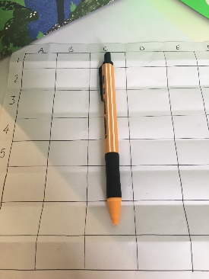
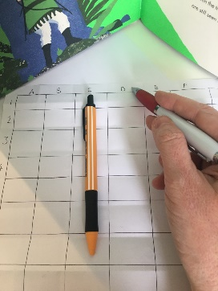
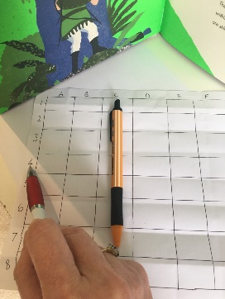
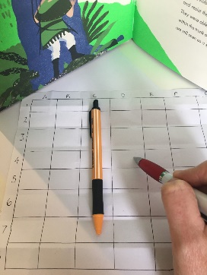
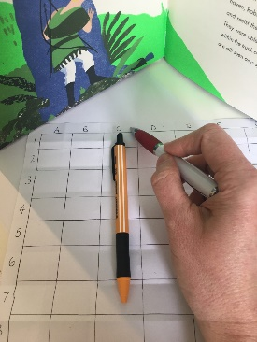
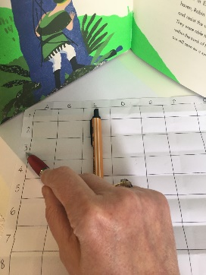
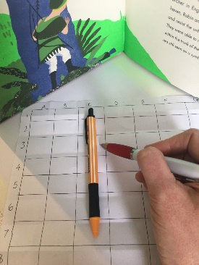
Playing Battleships!
Next week we will make our own maps!
Decide who is player 1.
Player 1 needs to arrange the 6 objects on their grid.
Player 2 now has 12 guesses to find where the objects are on your grid to get a ‘hit’.
Once the 12 guesses are up, swap roles and play again!
How to make a guess!
D
4
D4
Player 2 says
I think an object is on D4
Here is my pen on my board
This is a MISS!
Player 2 says
I think an object is on C3
C3
3
C
This is a HIT!

