Slide 1
Art – Caribbean Landscapes

Slide 2
Caribbean Art
Art in the Caribbean reflects thousands of years of habitation by artists with heritage from countries all around the world (including countries in the African continent). The nature of Caribbean art reflects these diverse origins, as artists have taken their traditions and adapted these influences to reflect the reality of their lives in the Caribbean.

Slide 3
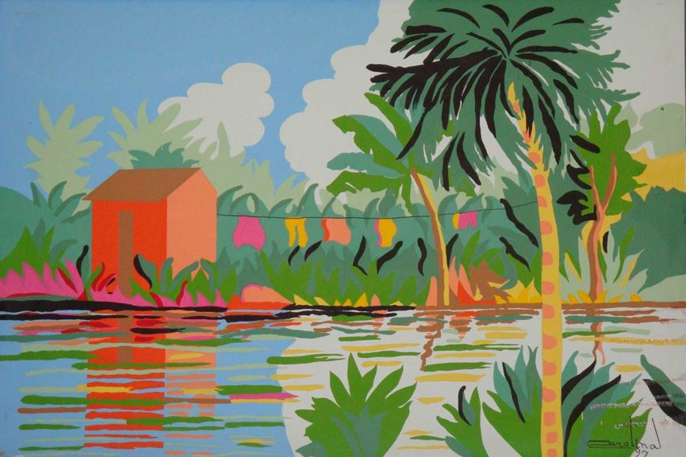

Slide 4
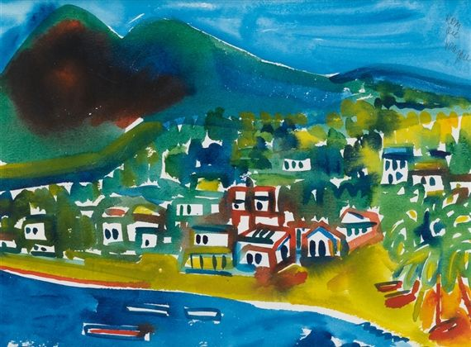

Slide 5
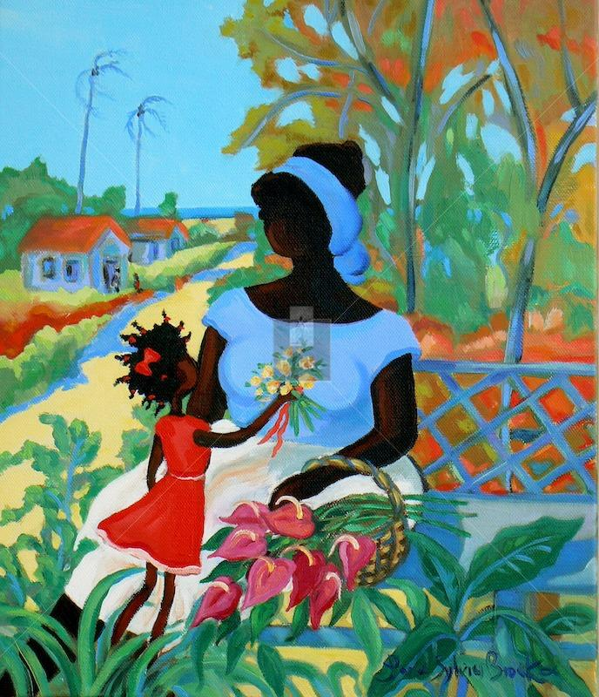

Slide 6
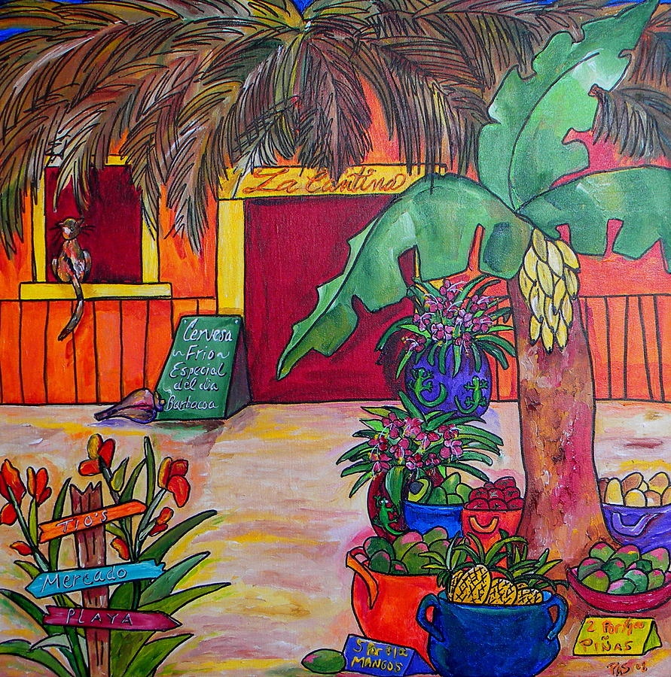

Slide 7
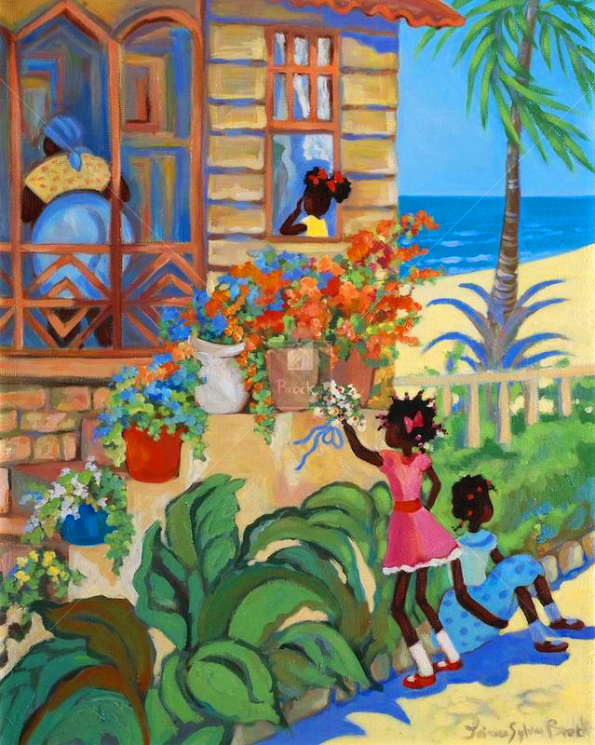

Slide 8
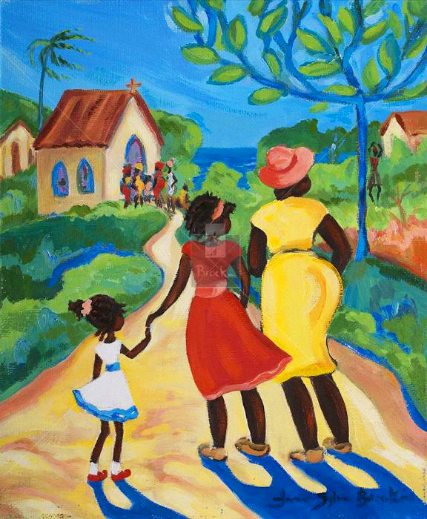

Slide 9
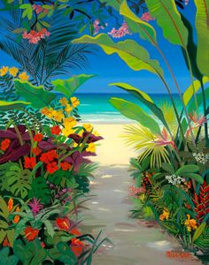

Slide 10
Today you are going to be having a go at creating your own Caribbean Landscape Art.
Use the images that you have just seen to have a go at your own art work of a Caribbean landscape.
It can have whatever you like
in it as long as it is colourful
and full of plants.

