Slide 1
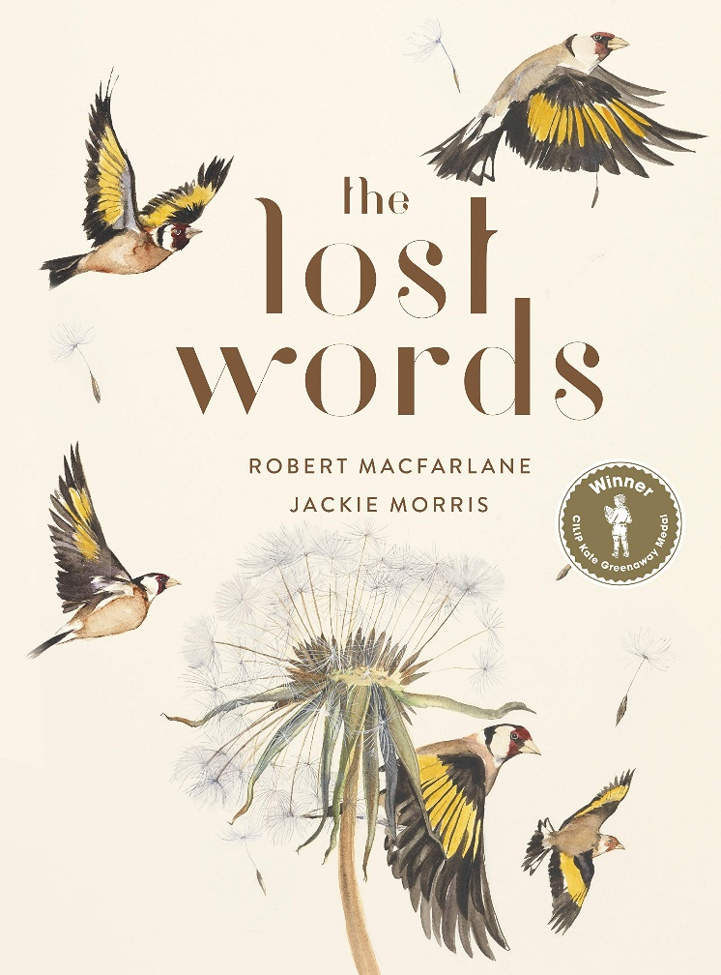
Week One: Tuesday

Slide 2
Did you enjoy making your visual dictionary yesterday? Did you learn any new ‘nature’ words?
Key Question: Do you think these 20 words should be put back into the Junior Dictionary? Why might it be important?

Slide 3
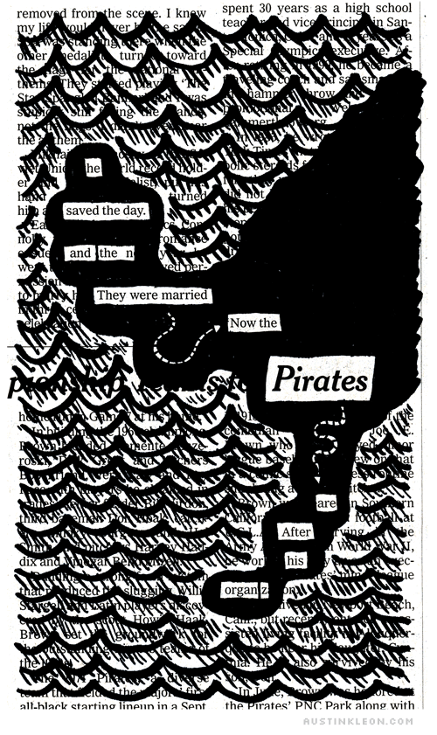
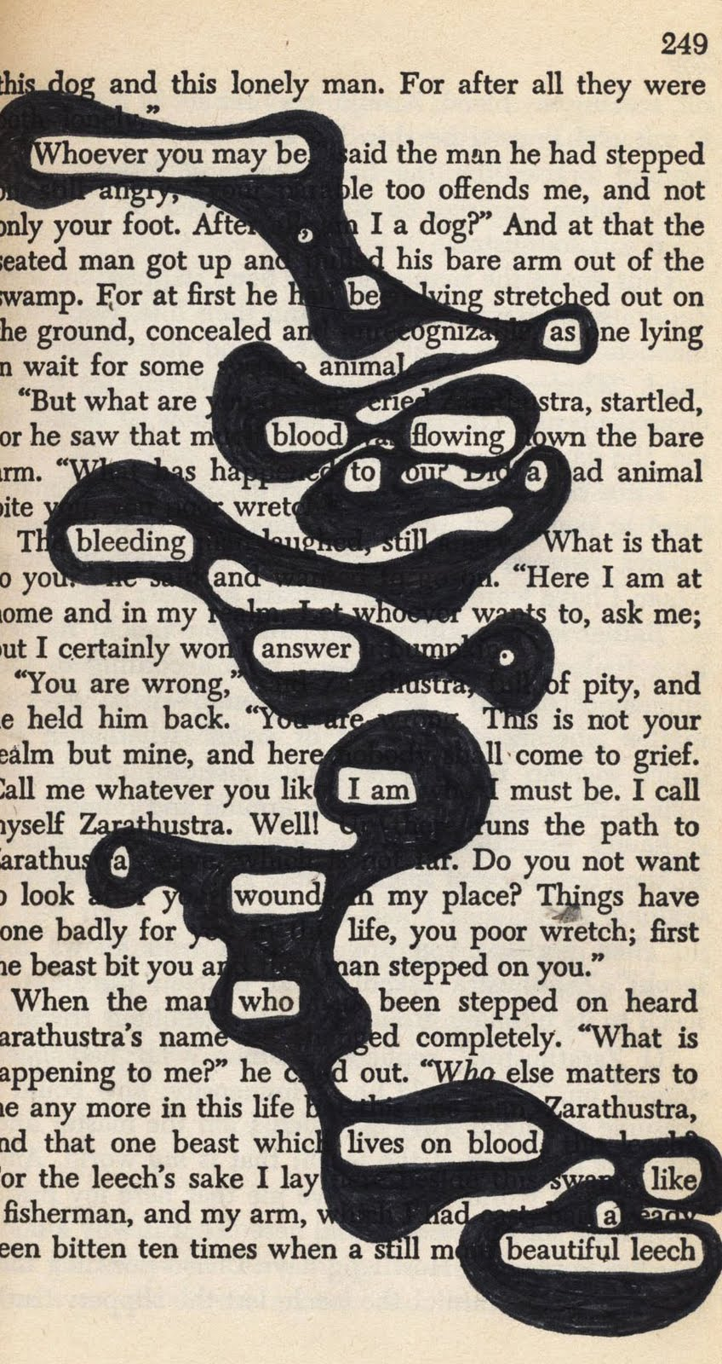
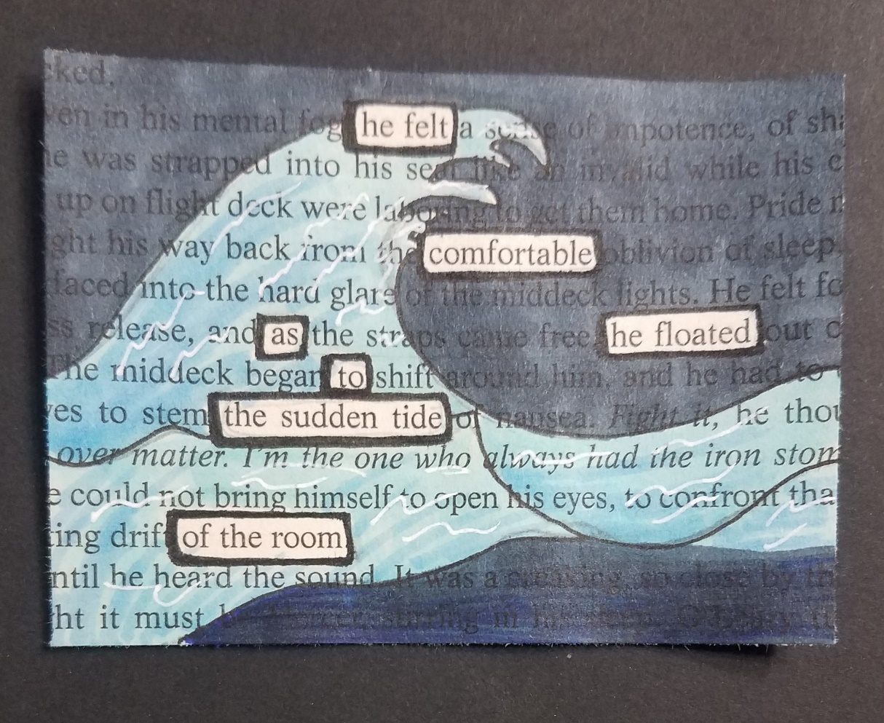
Black Out Poetry
Today you are going to have a go at some black out poetry. It’s where you draw over a piece of writing to create a new meaning. Here are a few examples…

Slide 4
Please begin by reading the introduction to our book.

Slide 5
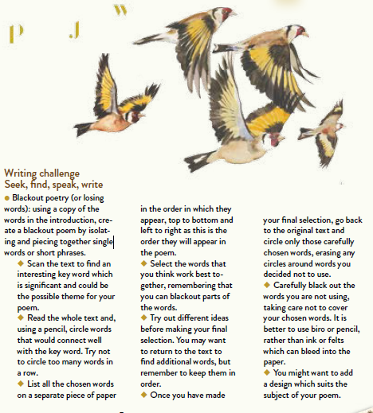
A guide to black out poetry… You can either copy and paste the introduction into word or paint and create this on your computer. Or you can print off the copy of the introduction and complete it by hand…

Slide 6
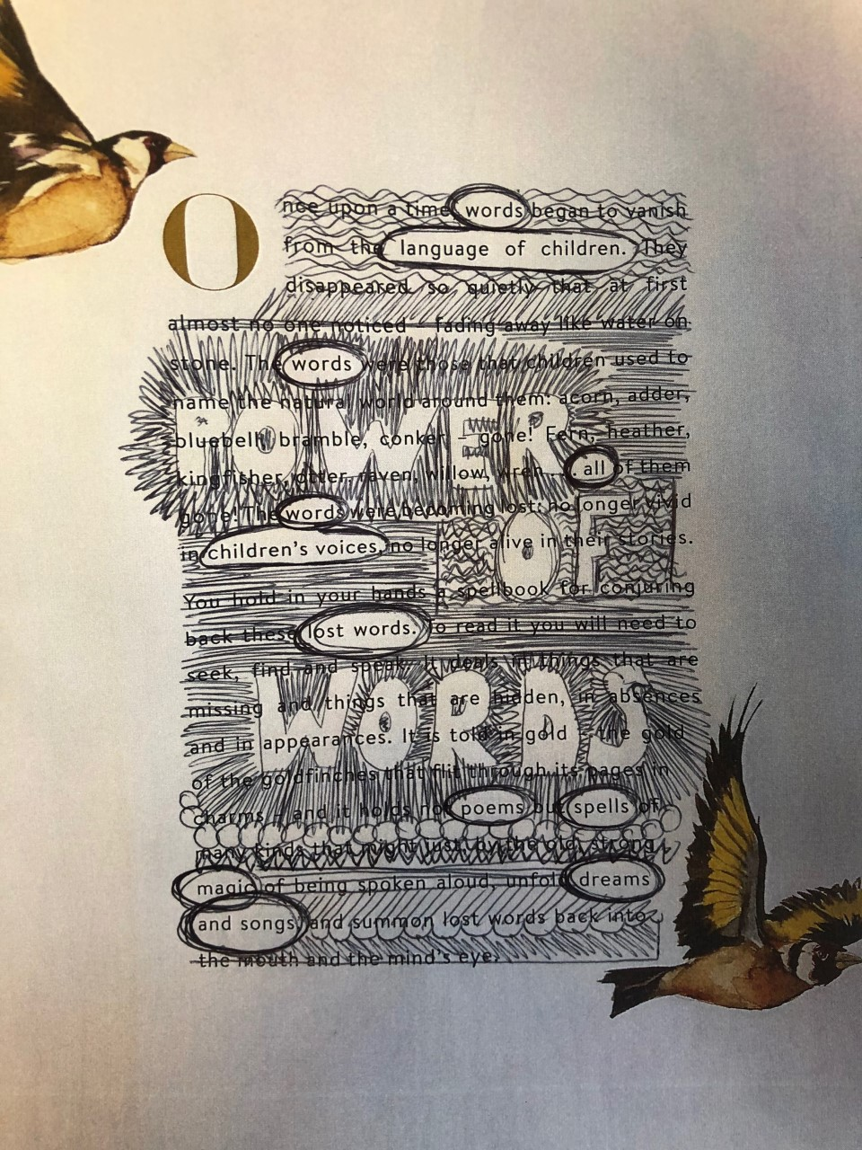
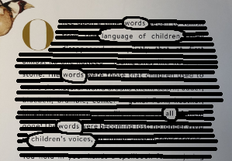
Copied into Microsoft word with black rectangles drawn over the top.
Printed out and drawn over.
We chose language as our focus.
Copied into paint and lines drawn over the top.

Slide 7
Have a go at your own black out poem and email your results over to us ☺

