Slide 1
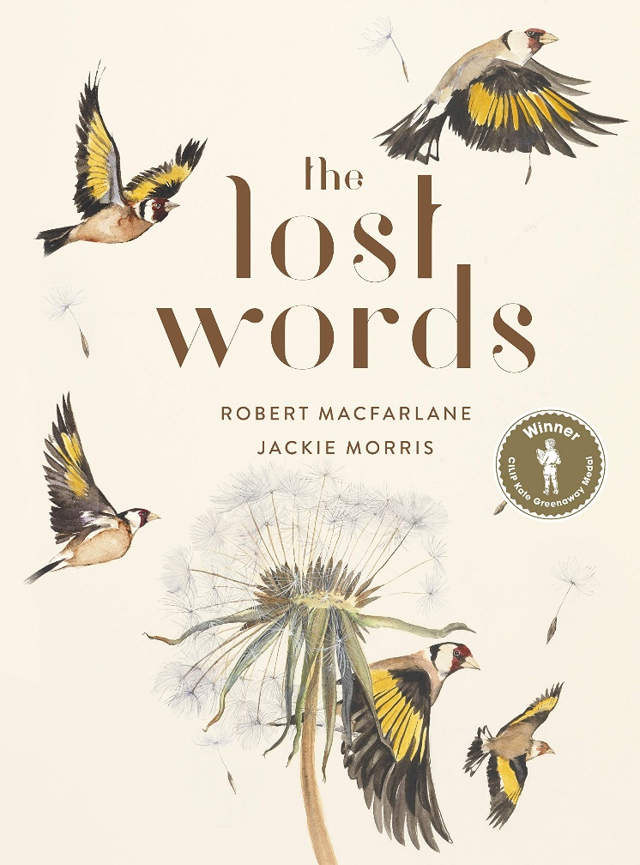
Week Two: Monday

Slide 3
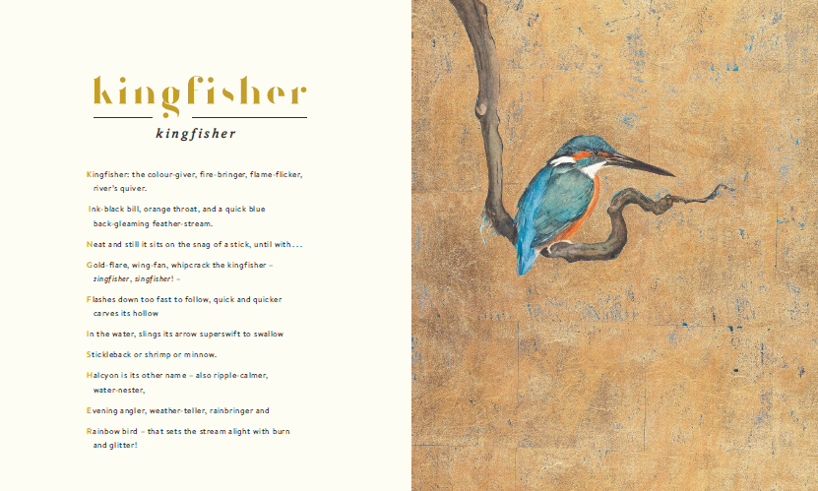
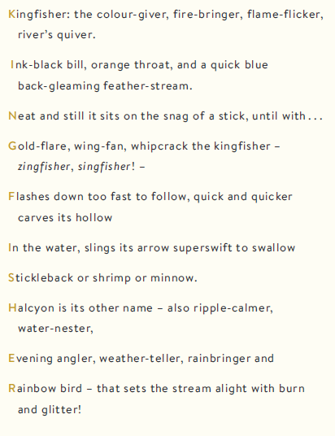
Read the poem:

Slide 4
Can you spot any kenning style phrases e.g. colour-giver?

Slide 5
Did you spot them all?

Slide 6
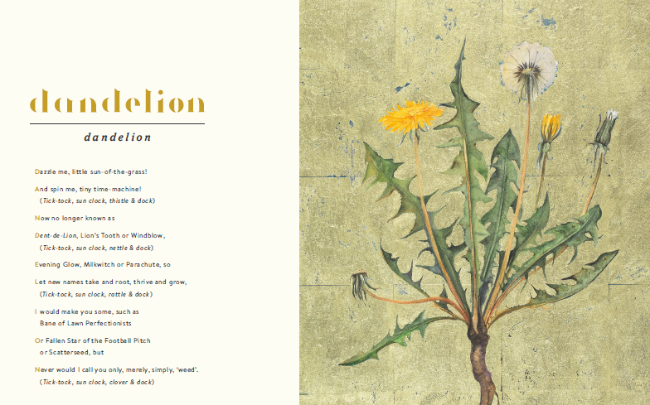
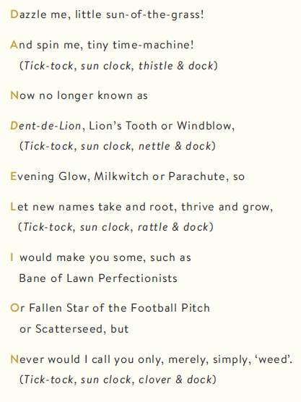
Read the poem:

Slide 7
Now, have a go at writing your own kenning poem about a dandelion, like the phrases in the kingfisher poem.
Remember each line should normally be two words long, and end in the –er letters.
Grass sprouter
Yellow projector
Bee feeder…
Send us in copies of your work – typed or handwritten is fine ☺

