Slide 1
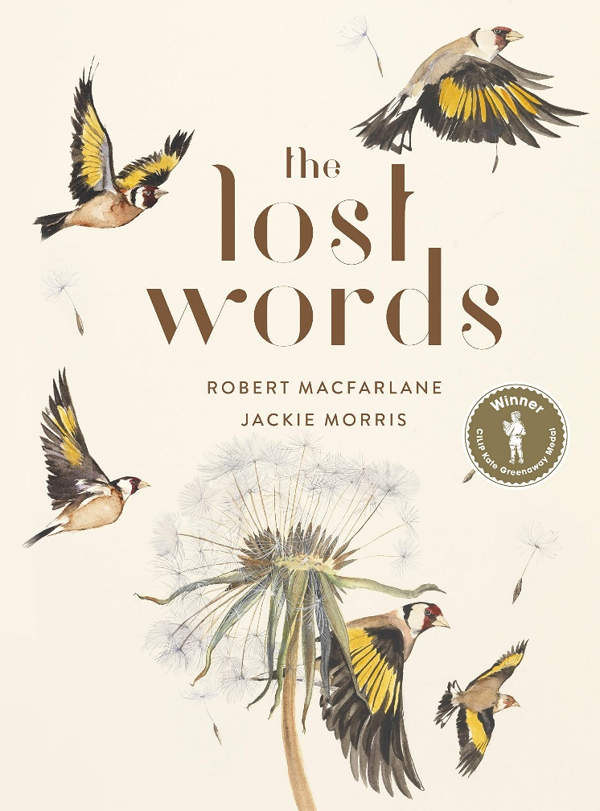
Week One: Thursday

Slide 2
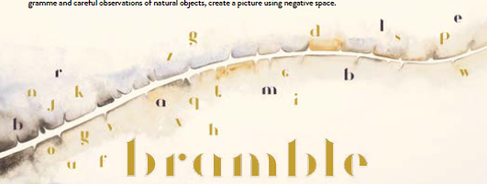
Can you use the picture clue and the purple letters to work out what today’s poem is about?

Slide 3
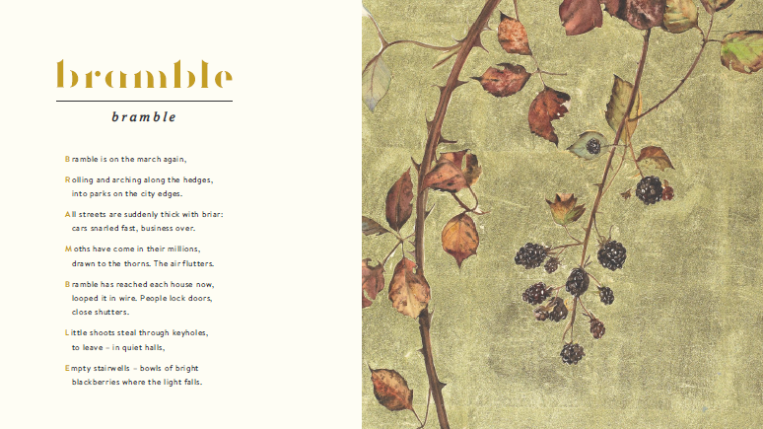
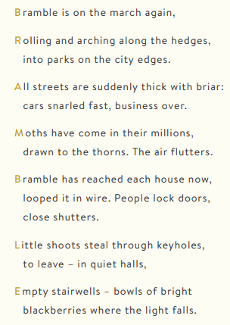
Read the poem:

Slide 4
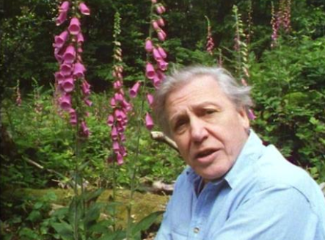
Watch the time lapse video of a bramble growing and take notes of some of the amazing vocabulary that David Attenborough uses – you might need to watch it a few times!
http://www.bbc.com/earth/story/20170314-time-lapse-footage-reveals-a-bramble-crawling

Slide 5
What language did you come up with? Here are our favourites! There’s so much personification.
Aggressive shoots wave side to side
It was feeling for the best way forward
Invading stems
The strength to climb
A shoot thrusts ahead relentlessly
New territory annexed for the bramble’s empire

Slide 6
Use these ideas (and some of your own) to write your own description of a bramble using lots of language play. You can type or handwrite this but please send you work in for us to see.
Here’s an example to get you started:
The spiny snake slithered it’s way through the undergrowth with it’s aggressive shoots waving side to side through out it’s journey.
metaphor and alliteration
personification

