Slide 1
Week One: Wednesday

Slide 2
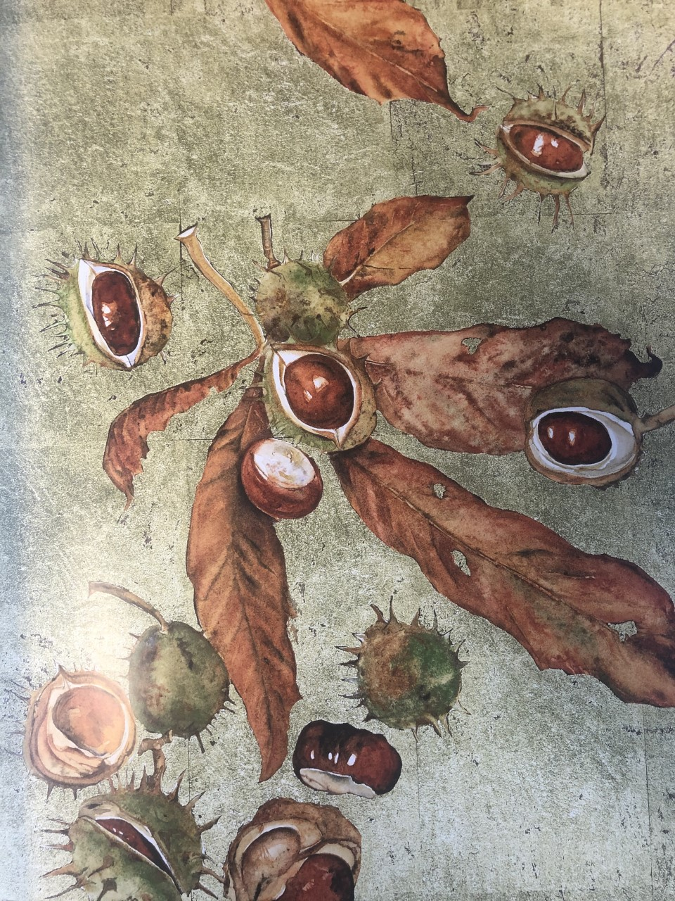
What might this poem be about? What time of year could this poem be set and why? What proof do you have?

Slide 3
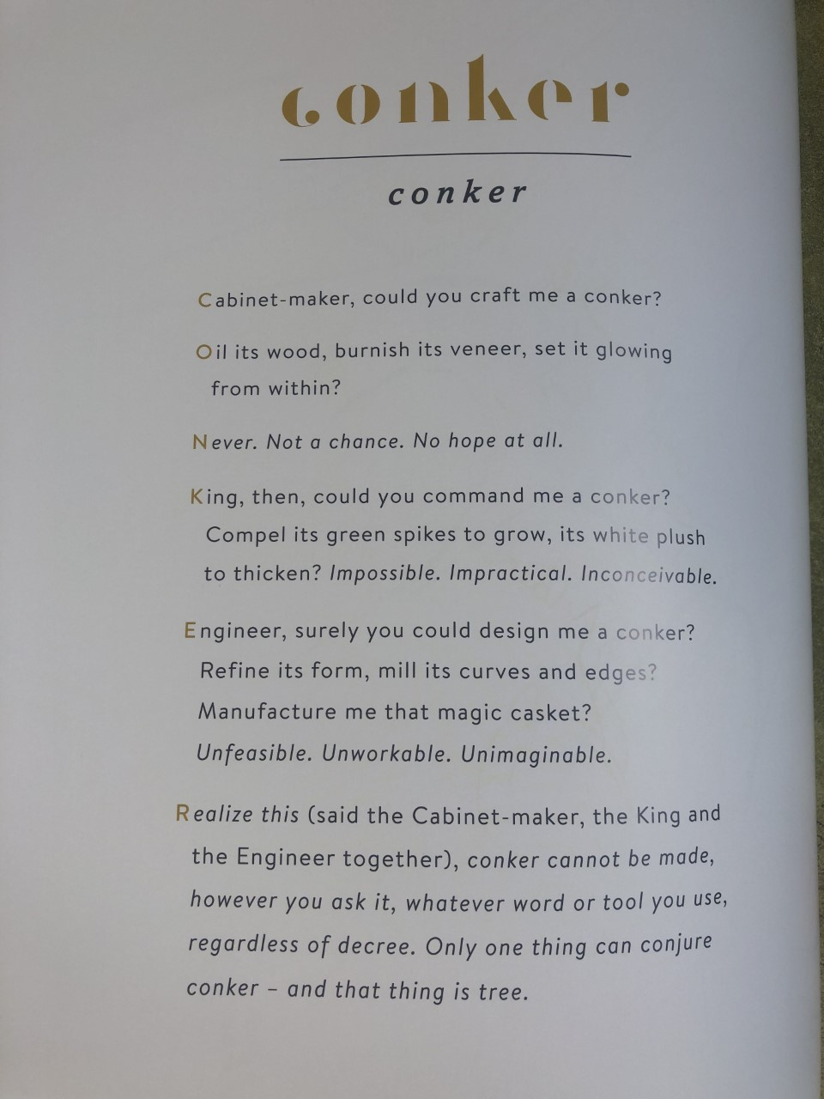
Read this poem (it’s a little larger across the next two slides)

Slide 6
Answer the questions about this poem on the separate document.

