Slide 1
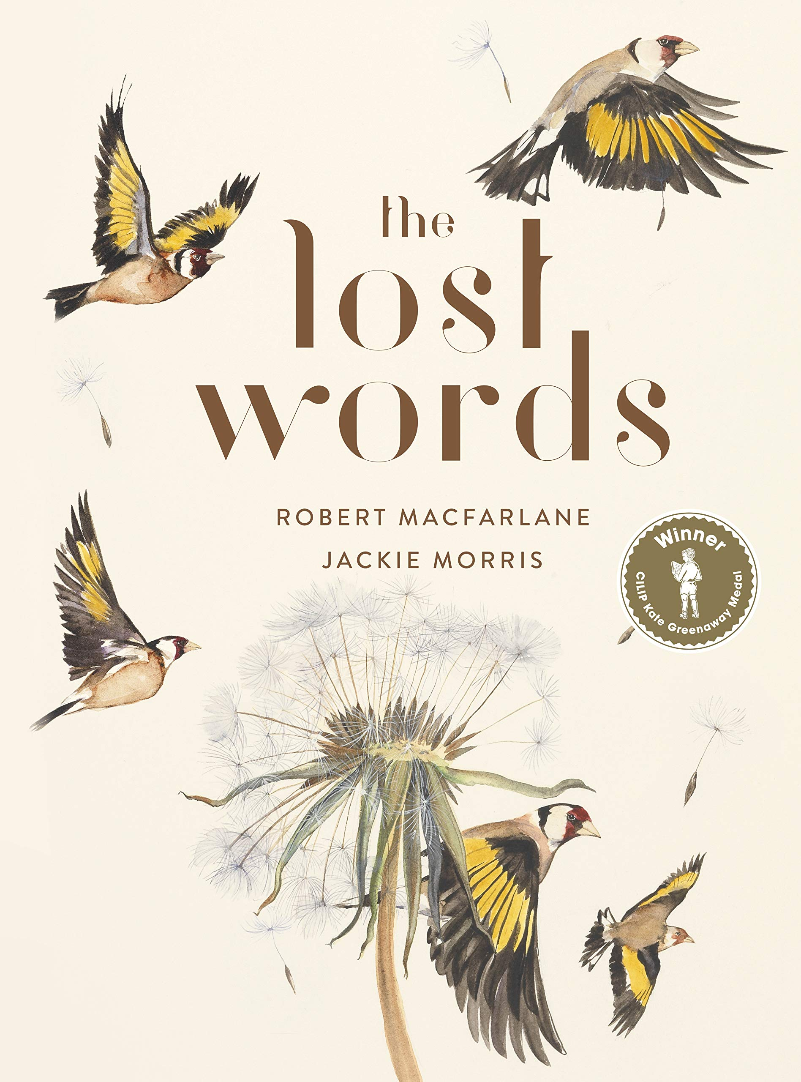

Slide 2
Week One: Monday

Slide 3
In English, we are going to be doing some work based on this new book. It’s full of acrostic poems and beautiful illustrations. It links to our Science over the Summer term as we’re thinking about lifecycles of plants and animals.

Slide 4
Robert MacFarlane and Jackie Morris created this book when they found out that lots of ‘nature’ words had been removed from the Oxford Junior Dictionary. They dropped some key ‘nature’ words in favour of new technical words such as ‘broadband’.
How do you feel about this? Is this OK? Should technology be replacing nature in our children’s dictionaries?

Slide 5
Today your job is to create a visual dictionary of the 20 lost words. On a piece of plain paper, write each word out (be as creative as you can) and then use the internet to find a picture to copy of each one. Have a look at our example for ideas…
Acorn
Adder
Bluebell
Bramble
Conker
Dandelion
Fern
Heather
Heron
Ivy
Kingfisher
Lark
Magpie
Newt
Otter
Raven
Starling
Weasel
Willow
Wren

Slide 6
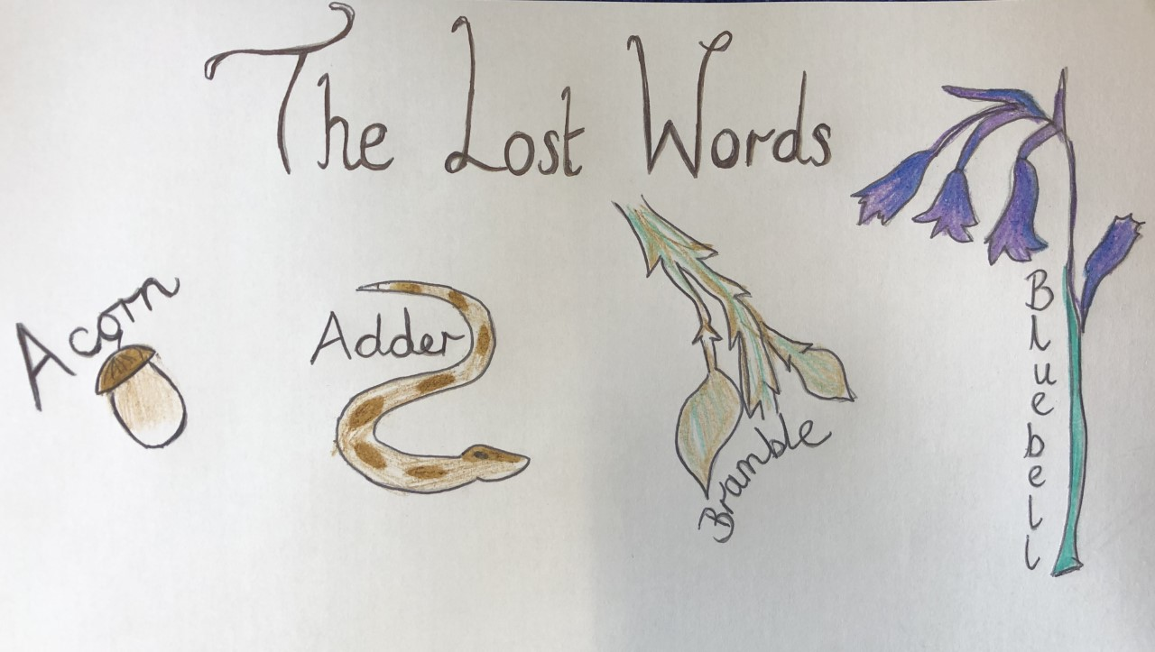
Please send your visual dictionaries in for us to see!

