Slide 1
Famous Naturalists

Slide 2
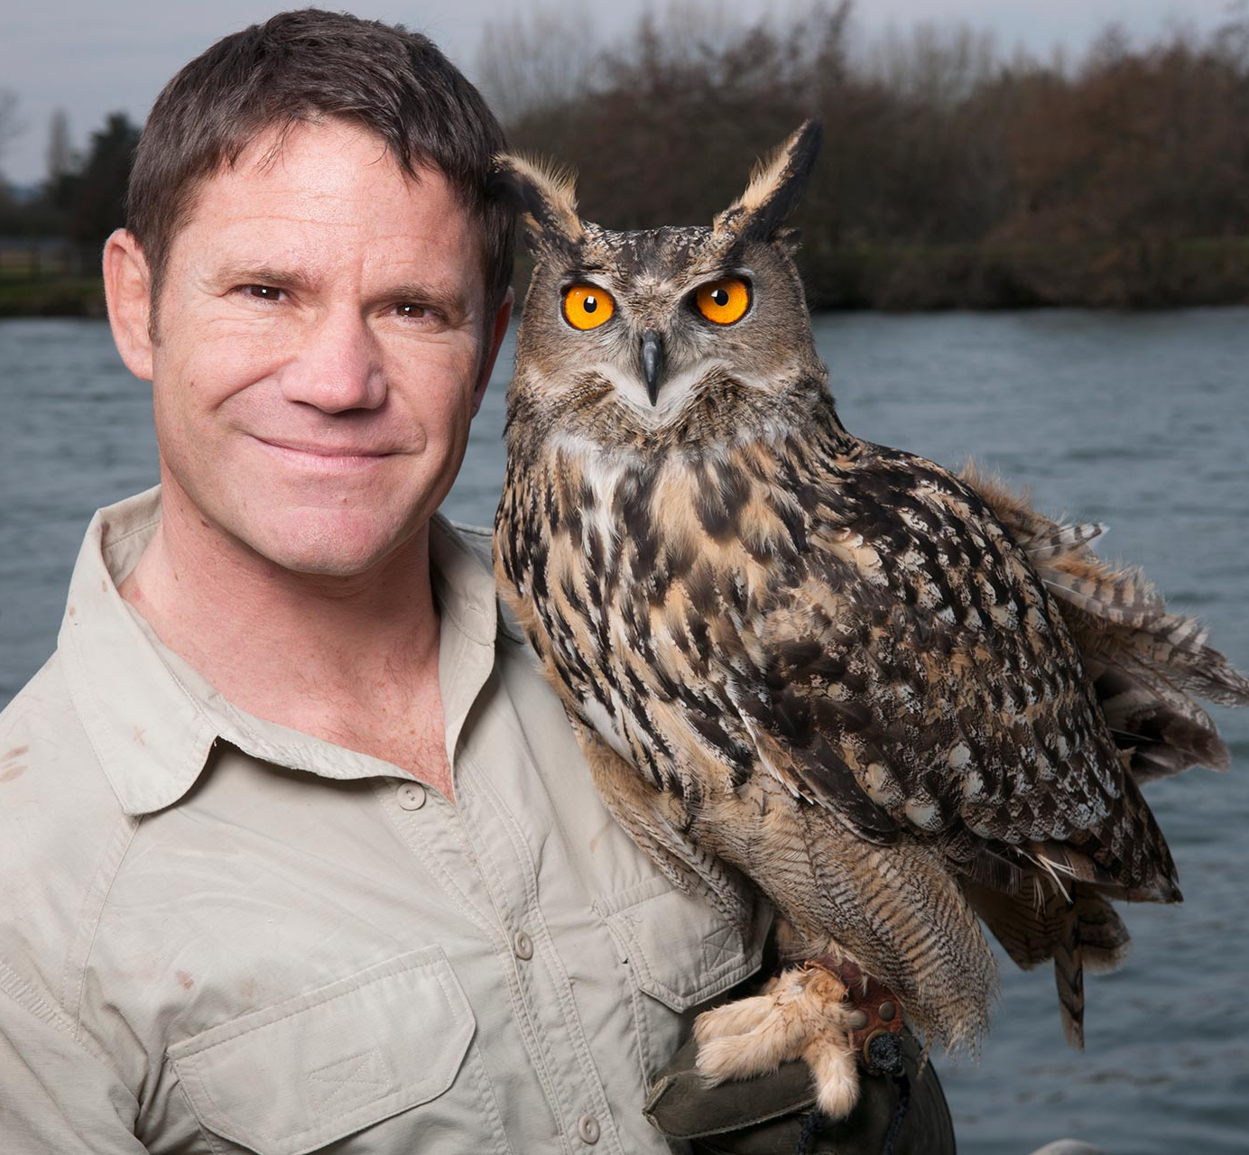
Famous Naturalists
Who is this?

Slide 3
Steve Backshall
TV programmes, e.g. Deadly 60
Writer of 3 children’s stories and lots of non-fiction books
https://www.youtube.com/watch?v=ZfE5E1NLWoY

Slide 4
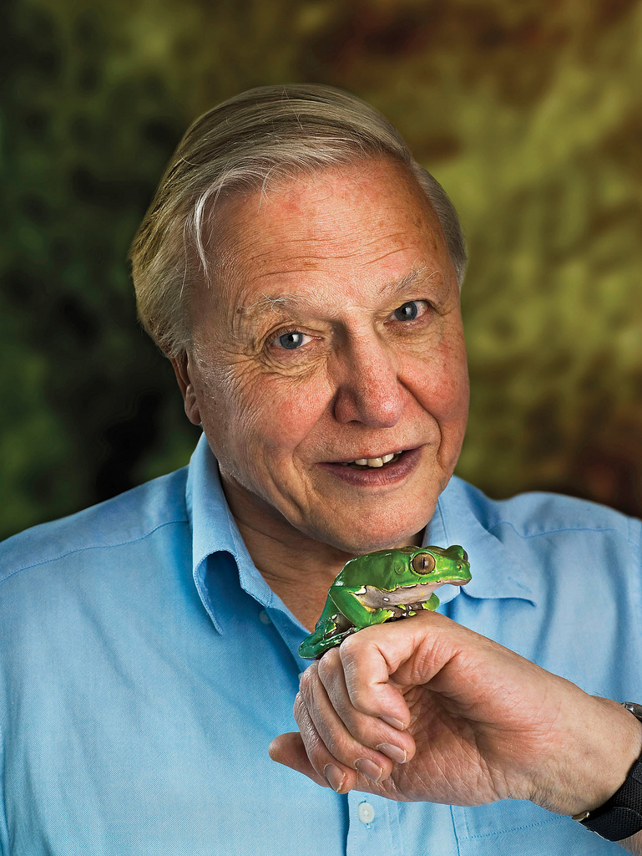
Famous Naturalists
Who is this?

Slide 5
David Attenborough
93 Years Old
Narrates documentaries about nature and animals e.g. Planet Earth
https://www.youtube.com/watch?v=ndMKTnSRsKM

Slide 6
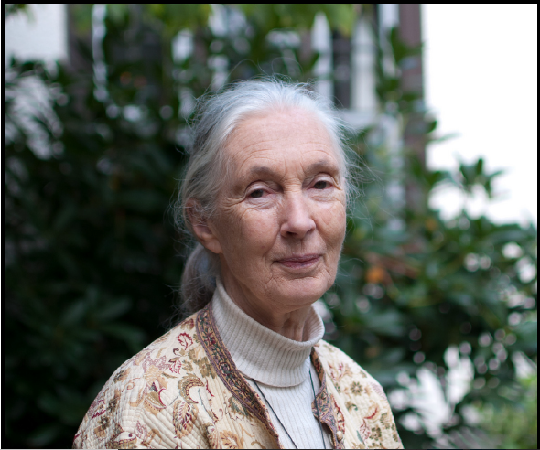
Famous Naturalists
Who is this?

Slide 7
Jane Goodall
World’s foremost expert on chimpanzees
55 year study of family interactions of wild chimps
https://www.youtube.com/watch?v=bCVmfDuRpBc

Slide 8
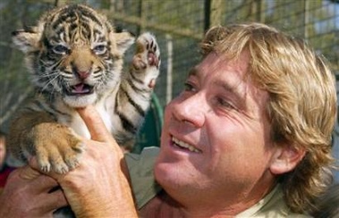
Famous Naturalists
Who is this?

Slide 9
Steve Irwin
Nicknamed ‘The Crocodile Hunter’
From Australia
Zookeeper, Conservationist and TV Presenter
Died whilst filming a TV programme about Sting Rays
https://www.youtube.com/watch?v=ORIFhImbRjo

Slide 10
I can understand the importance of naturalists.
Pretend that you are one of these 4 people. Write a diary entry talking about how you felt after you had just filmed the video.
Also mention:
Why do you think your job is important?
What do you enjoy about your job?
What might be hard about your job?

