Slide 1
Today you are going to finish your persuasive advert!
Yesterday you should have completed a really persuasive introduction using questions to engage your reader.
Focus today on persuasive descriptions of the features of your robot to make it seem irresistible….

Slide 2
MEET AMAZING ANDY-ROID 3000
He’s your new best friend!
List of descriptive features…
Fed up and tired of using all of your spare time completing chores? Are you spending more time with the boring vacuum rather than your beloved friends and family? If so, you could do with the amazing Andy-Roid 3000 in your life to get a well-deserved break from that never-ending list of tasks! But what does he actually do?
The Andy-Roid 3000 is an innovative new robot who can be left alone in the house to deal with ALL of your household needs! With hardly any prompting, he will wash up, clean the windows, shampoo the carpets and sweep all of the floors! You don’t have to do a thing – just rest, relax and admire him from the comfort of your armchair.
This magnificent machine, which has been programmed with the latest software, has many incredible features including:
Its impressive collection of six arms (Andy-Roid can complete several tasks at once – all the housework will be done in the blink of an eye);
The ability to glide seamlessly from one room to another (this innovative invention will be unable to bump into anything as its smooth sensors will detect hazards instantly);
An integration of soundless technology (Andy-Roid 3000 will allow you to get that peace and quiet which you constantly crave for by completing all tasks silently);
The most up-to-date voice recognition technology (your responsible robot will remember up to 40 commands from 8 different voices – amazing!)
You will not go wrong by purchasing the amazing Andy-Roid 3000 today! He even has a lifetime guarantee – we will replace his mechanical parts instantly at the slightest of technical faults. You can experience this perfect piece of machinery on a FREE trial basis for one month. Just call the number below and leave your housework woes behind!
ONLY
£2000
VOTED BEST NEW ROBOT 2019
Look carefully at the punctuation.
Bullet point to start each one.
Brackets for extra information.
Semi-colon after each one.
CALL TODAY 0800 182 427

Slide 3
Off you go!
Reminder of what a persuasive advert should include...
Use persuasive techniques to encourage the reader to buy the new robot
Include a catchy name – alliterative, play on words, rhyme
Write in present tense
Use tempting descriptions – innovative, exceptionally easy, intelligent, impressive
Include intriguing questions – Fed up and tired of using all of your spare time completing chores? Are you spending more time with the vacuum instead of your friends and family?
Use exaggeration – He’s your new best friend, voted best new robot
Include appealing adjectives - well-deserved break, spectacular piece of automation, exceptionally simple

Slide 4
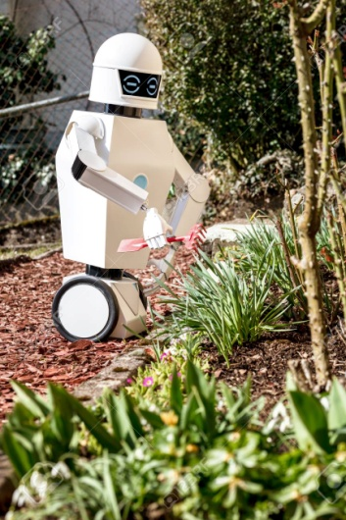
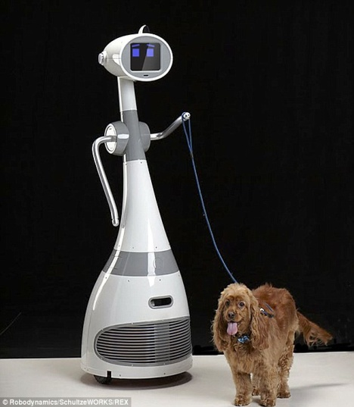
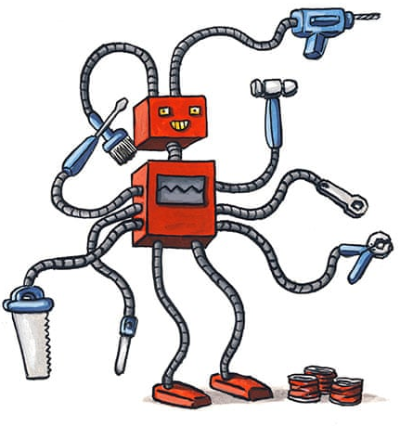
Do you think you’ve been persuasive enough?
When your parents/brothers/sisters are free, read your advert out loud to them to see if they are tempted to buy your new robot!
If you spot any errors, just use your purple pen to correct them.

