Slide 1
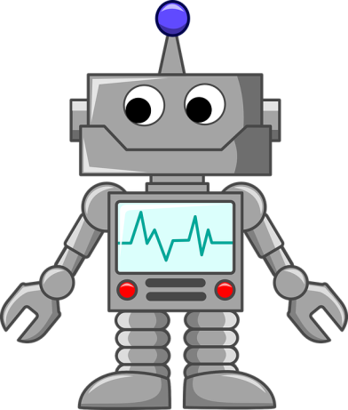
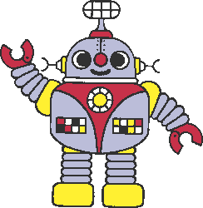
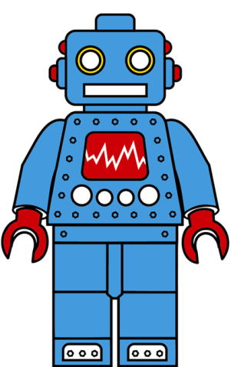
I can produce a persuasive advert for my new robot

Slide 2
CONGRATULATIONS!
Your design for a new robot has been carefully studied and we are pleased to inform you it can now be advertised to go to market!
Your job today is to create a persuasive advert for the nation. Who knows where it will end up! Maybe in the TV advert breaks between Britain’s Got Talent? Perhaps it will be plastered on the giant billboards in London!
Let’s have another look at what makes an advert so persuasive…

Slide 3
Mighty Monster Truck
2020!

Slide 4
Children, are you fed up with your toys breaking? Are you looking for a new fantastic unbreakable monster truck?
Well, look no further – help is here with the indestructible Mighty Monster Truck created just for YOU!
This terrific truck is like no other truck that has ever been seen before!
It has an all-new exceptional and electrifying design! This toy is for YOU; it will be a superb, special and sensational addition to YOUR toy collection!
The Mighty Monster Truck has many break-through and breath-taking features including:
- Its mind-bogglingly huge wheels (this monster truck will be able to go everywhere YOU go);
- Remarkably responsive, smooth suspension (your monster truck will not be damaged by any bumps);
- An everlasting body kit made out of robust rubber (your monster truck will survive any collision that
may occur);
- The most up-to-date voice recognition technology (this allows you to control your monster truck by
telling it where you want it to go as it responds to 25 programmable commands).
Let the marvellous Mighty Monster Truck join your toy box today and you will have the privilege of owning the most amazingly mind-blowing Monster Truck there ever will be!
Miss it! Miss out!

Slide 5
Children, are you fed up with your toys breaking? Are you looking for a new fantastic unbreakable monster truck?
Well, look no further – help is here with the indestructible Mighty Monster Truck created just for YOU!
This terrific truck is like no other truck that has ever been seen before!
It has an all-new exceptional and electrifying design! This toy is for YOU; it will be a superb, special and sensational addition to YOUR toy collection!
The Mighty Monster Truck has many break-through and breath-taking features including:
- Its mind-bogglingly huge wheels (this monster truck will be able to go everywhere YOU go);
- Remarkably responsive, smooth suspension (your monster truck will not be damaged by any bumps);
- An everlasting body kit made out of robust rubber (your monster truck will survive any collision that
may occur);
- The most up-to-date voice recognition technology (this allows you to control your monster truck by
telling it where you want it to go as it responds to 25 programmable commands).
Let the marvellous Mighty Monster Truck join your toy box today and you will have the privilege of owning the most amazingly mind-blowing Monster Truck there ever will be!
Miss it! Miss out!
What technique was used to make the reader really feel like this advert was aimed at them?
What words make this toy seem so irresistible?
Is it formal or informal?

Slide 6
Synonyms for ‘this robot’… (although some repetition of your robot’s name is effective in this genre)
Challenge: can you use some alliteration? E.g.
This magnificent machine…
How can we embed effective information alongside this?
This magnificent machine, which _____________, ___________________.

Slide 7
Get creative. Get persuasive!
Begin your persuasive advert.
Today, just focus on a really persuasive introduction using questions to engage you reader.
Tomorrow, you can explain its features in a detailed and descriptive list like in our WAGOLLS.
Friday you will have a chance to publish it properly!
Look at the WAGOLLs to help you if you need.
Check out some reminders for a persuasive advert on the next page…

Slide 8
What a persuasive advert should include...
Use persuasive techniques to encourage the reader to buy the new robot
Include a catchy name – alliterative, play on words, rhyme
Write in present tense
Include intriguing questions – Fed up and tired of using all of your spare time completing chores? Are you spending more time with the vacuum instead of your friends and family?
Use exaggeration – He’s your new best friend, voted best new robot
Use tempting and appealing adjectives – innovative, exceptionally easy, intelligent, impressive, well-deserved break, spectacular piece of automation, exceptionally simple

