Slide 1
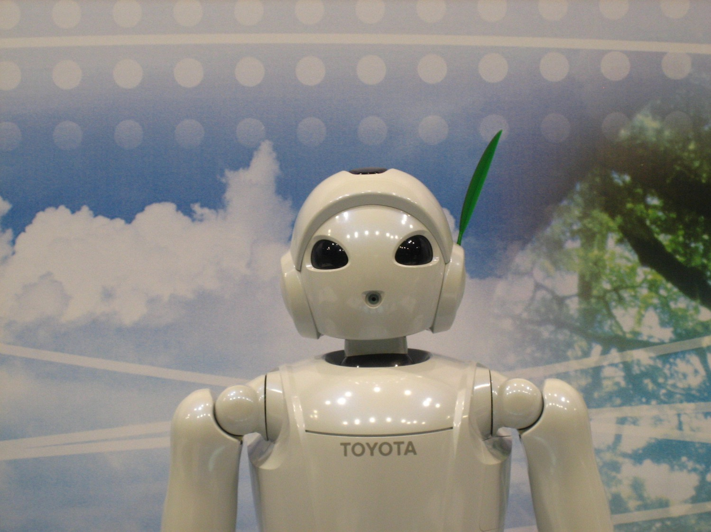
Robots
1. Coding exercise
This Photo by Unknown Author is licensed under CC BY-SA

Slide 2
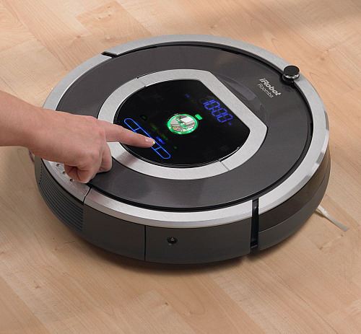
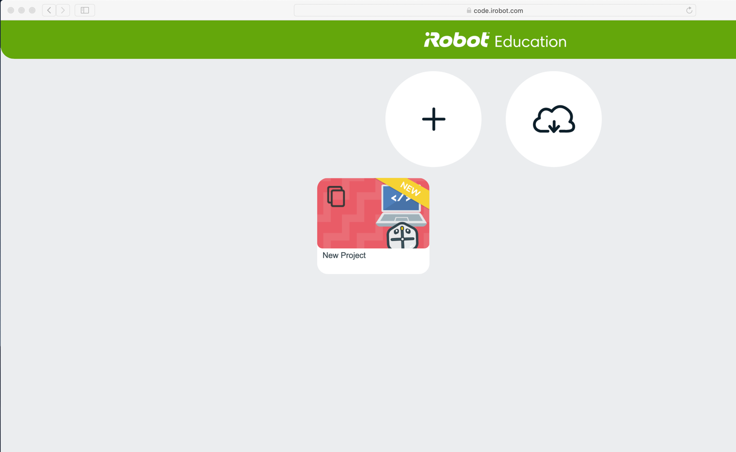
With a parents / carers permission, go to: https://code.irobot.com
iRobot make robotic vacuum cleaners, mops and lawn mowers.
They also have a website to help people learn about programming robots
On the website, click here to start a new project

Slide 3
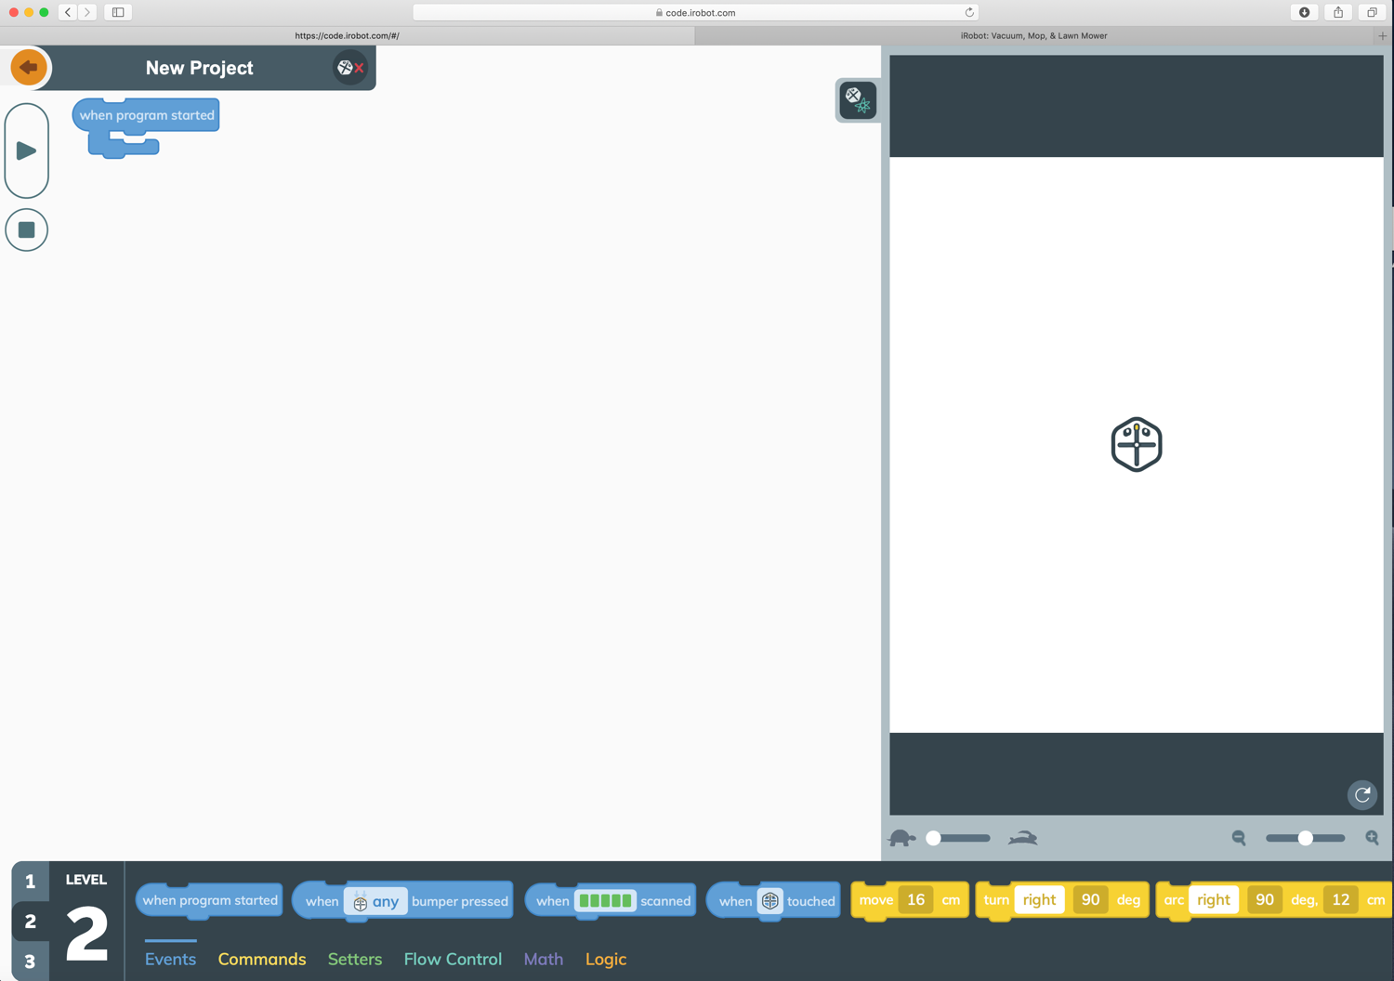
How to use the simulator
Robot simulator
This is where you will see your robot move around
This controls the speed of the simulation
Click here to reset your robot and clear what it has drawn
Select Level 2
You may have used Scratch in school. This works in a similar way, by putting blocks of code together

Slide 4
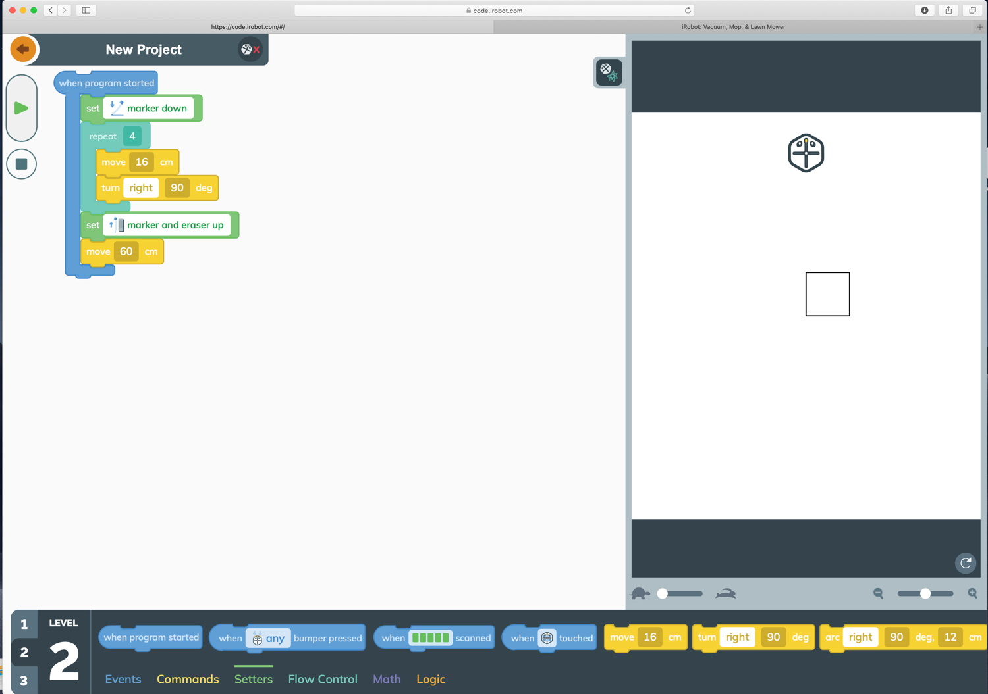
EXAMPLE
This program gets the robot to draw a square. Try it for yourself.
The robot has a pen – it needs to be down to draw
Lift the pen up and move the robot out of the way so you can see your drawing clearly
This starts the robot
This stops it
There are lots of code blocks you can use. Scroll across to see them and drag the ones you want into your program. Drag unwanted code blocks to the bottom of the screen – a bin will appear.

Slide 5
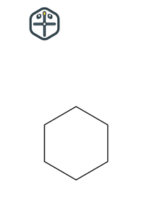
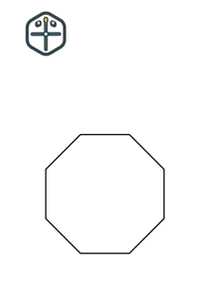
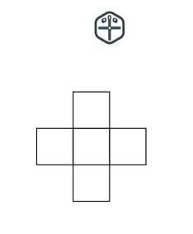
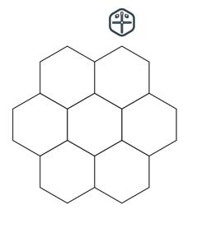
Challenges
In Maths you’ve been learning about polygons and angles. Looking at the code used to draw the square, can you use your knowledge to get the robot to draw the following?
If you want to:
Send your teachers a screenshot of your pictures and code to show how you’ve done it.
Have a play to see what other patterns you can draw.
Triangle
Hexagon
Octagon
Circle
Is it really a circle?
Extra challenge - Can you draw these?
Mega challenge
Can you get the robot to write a three-letter word?

