Slide 1


Slide 2
Something terrible has happened:
the amazing robot that you created has been STOLEN!

Slide 3
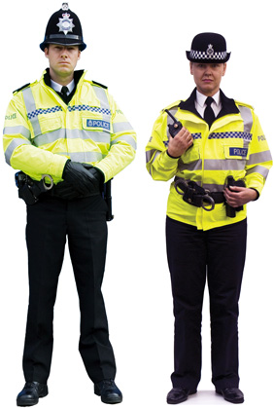
The theft of this brilliant robot has been discovered by the owner and reported to the police.

Slide 4
You are the police office called to the scene of the crime.
As a police officer it is your job to complete a crime report for this theft.
Look very carefully at the structure of the example given about the theft of a bicycle.
You will need to think carefully about the layout of the information on the form. The same type of information should be in each paragraph for your report but the bicycle idea will be replaced with the robot. The people involved will obviously all have different names to the example given.

Slide 5
You have two days to complete a detailed police report on the crime so do not rush! Also, do include as much detail as you can and be creative whilst following the given structure.
The next slides will show you, paragraph by paragraph, what type of information to include – remember you have to paragraph your work too. Read through and spot the technical language as well as the use of reported speech (told me, claimed etc).

Slide 6
Case Number: VT 04/05/20/3462
Incident: Bicycle Theft
Reporting Officer: Constable Shirley Pettitt
Date of Report: 04 May 2020
At 1040 hours on 4th May, 2020, I met with Mr William Silvester at 61 South Chorley Drive regarding a bicycle theft. Mr Silvester said he had locked the bicycle in the garage on the evening of 3rd May. When he awoke this morning, he heard a loud bang coming from outside his house. At 8am when he went to get his cycle to travel to work, he discovered his £660 bicycle was missing and the locked garage door had been forced open. No other items appear to have been taken from the property.

Slide 7
Mr Silvester described his bicycle as a 12 speed, metallic blue, Trek mountain bike 2018 model. It has a security tag number of B8973196 located under the cross bar.
Mr Silvester told me that the bike was left unlocked in the garage but he knew the garage door was locked securely before he went to bed on the night of May 3rd. Mr Silvester now believes that the bang he heard at approximately 6:45am was the sound of the thief breaking an entrance into the garage.

Slide 8
I conducted a survey of the crime scene and discovered that a heavy object has been used to ram through the locking mechanism of the garage door. I could see nothing on the garage floor or surrounding area which might be linked to the thief. I carried out a house-to-house enquiry with both his neighbours. There was no response from 59 South Chorley. Mrs Margaret Chapman of 63 South Chorley was unable to provide any more information claiming she had neither seen nor heard anything unusual that morning.

Slide 9
I obtained a sworn statement from Mr Silvester and provided him with the case number and Information Leaflet 18/07 ("Victim Support after a Burglary"). I told Mr Silvester that the police would keep him informed of any developments in the recovery of the cycle. I entered the bicycle into the station database as a stolen item. I also searched the local area but was unable to find the cycle.

Slide 10

Now it’s your turn to have a go. You are the police officer reporting on the crime of the theft of a robot.
Follow the structure but add lots of your own detail
Your robot might have been taken from the house not the garage – how did they get in? Describe and value (£) the robot.
Remember you have two days to complete this in full so you should only complete the first half today.
You must include technical/specific vocabulary and show you can use reported speech (not direct speech today)
Good luck and enjoy the task!

