Slide 1
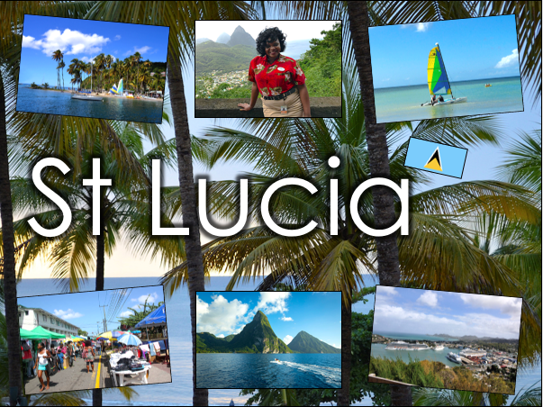

Slide 2
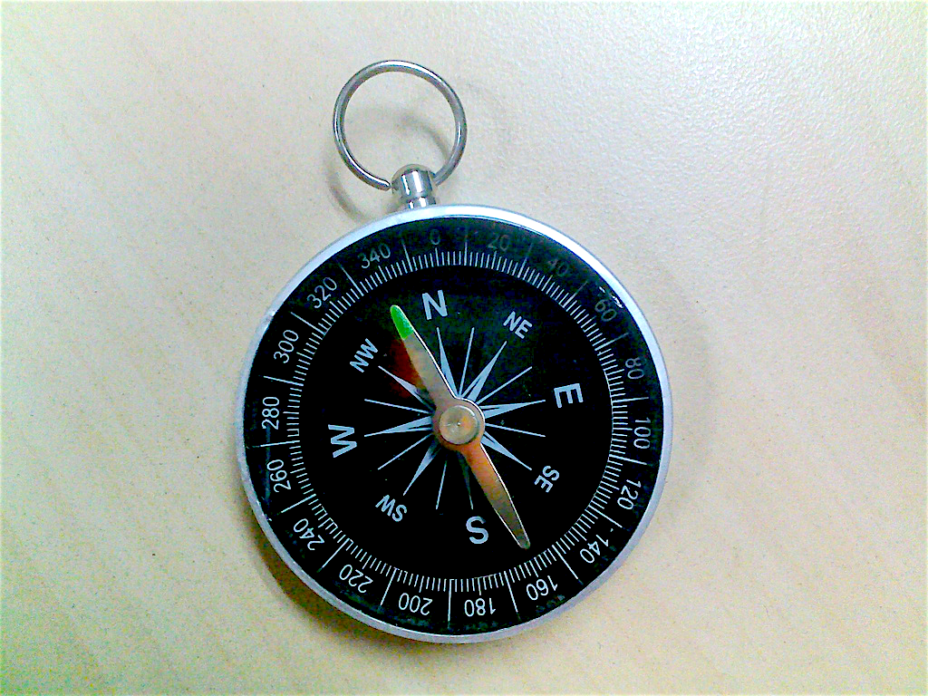
What is a compass?
A compass helps us find directions. When you lie it flat, the needle points north.
A handy way to remember the four points of the compass:
Naughty Elephants Squirt Water

Slide 3
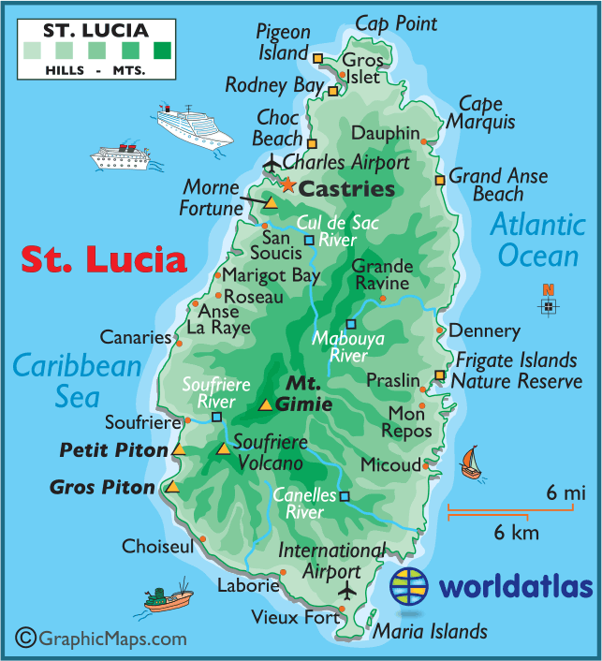
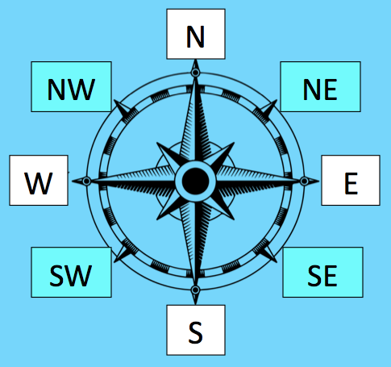
Look at the island of St Lucia.
In which part of the island is Cap Point -north, east, south or west?
Cap Point is in the north of St Lucia.
Notes:
St Lucia Map – www.worldatlas.com

Slide 4
In which part of St Lucia is Canaries -north, east, south or west?
Canaries is in the west of St Lucia.
Notes:
St Lucia Map – www.worldatlas.com

Slide 5
In which part of St Lucia are these places?
Vieux Fort
Gros Islet
Dennery
Notes:
Encourage children to answer in sentences:
Vieux Fort is in the south of St Lucia.
Gros Islet is in the north of St Lucia.
Dennery is a town in the east of the island.
St Lucia Map – www.worldatlas.com

Slide 6
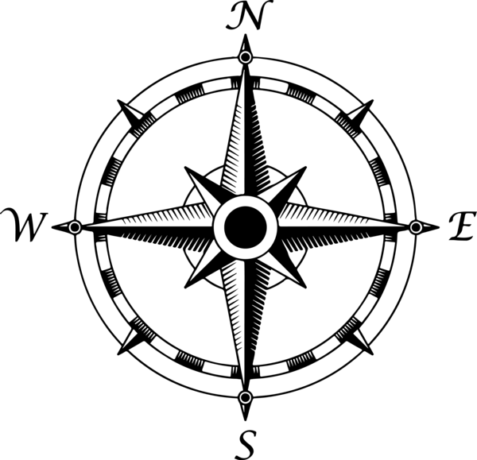
Recap The four main points of the compass are:
North
North-West
NW
NE
North-East
West
East
South-West
SW
SE
South-East
South
What are the other four directions?

Slide 7
In which part of St Lucia is Castries?
NE, SE, SW or NW?
Castries is in the north-west
of St Lucia.
Notes:
St Lucia Map – www.worldatlas.com

Slide 8
In which part of St Lucia is Choiseul?
NE, SE, SW or NW?
Choiseul is in the south-west
of St Lucia.
Notes:
St Lucia Map – www.worldatlas.com

Slide 9
In which part of St Lucia is Micoud?
NE, SE, SW or NW?
Micoud is in the south-east
of St Lucia.
Notes:
St Lucia Map – www.worldatlas.com

Slide 10
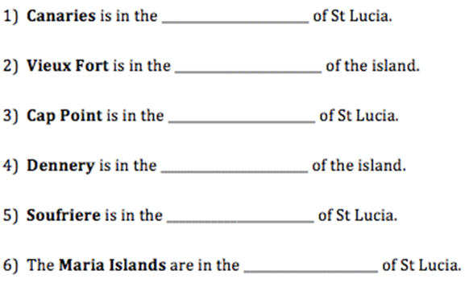
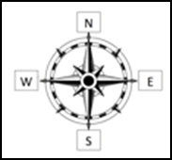
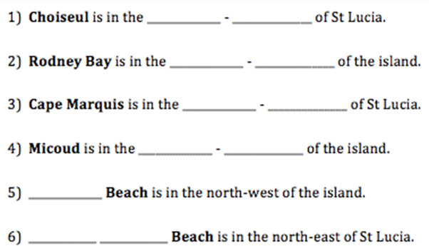
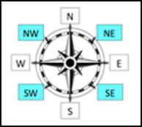
Can you complete these sentences?

Slide 11
Challenge: Can you write directions from one feature to another using the compass points?
For example: Start at Gros Piton. Travel one square North and two squares East.
End: Mount Gimie
Ask someone else in you house to work out where the end point are! (There might be more than one answer!)

