Slide 1
Week 3
Monday

Slide 2
Compère Lapin and the Good Sense
Key Question:
What is a ‘lapin’?
Think about your French lessons with Miss Stonehouse!

Slide 3
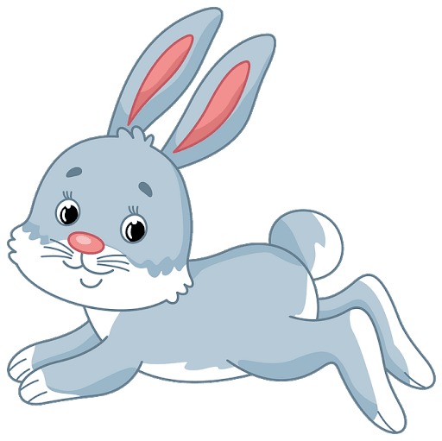
Lapin = A Rabbit! Did you get it right?

Slide 4
Compère Lapin and the Good Sense
Listen to Mrs Poole read you this Caribbean tale – it is based on a folk tale from St Lucia and Dominica.
The link is at the bottom of today’s post (you will need your usual password).
We have also attached a pdf copy of the chapter if you would like to read along or read it again.

Slide 5
Today’s Task: Please create a Role on the Wall for Compère Lapin
Remember to write characteristics to describe the characters personality in the middle of the outline and write the descriptions to describe their appearance around the outside of the outline.
(We don’t know what the rabbit looks like so you can use your imagination)

Slide 6
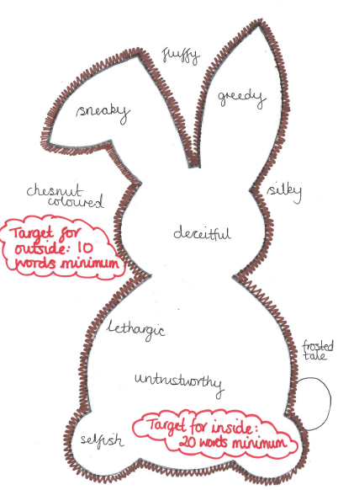
Today’s Task: Please create a Role on the Wall for Compère Lapin
You can either print off the rabbit outline or draw you own ☺
← Here is our example
Hint: use an online thesaurus to really push your vocabulary
Don’t forget to email in your work!

