Slide 1
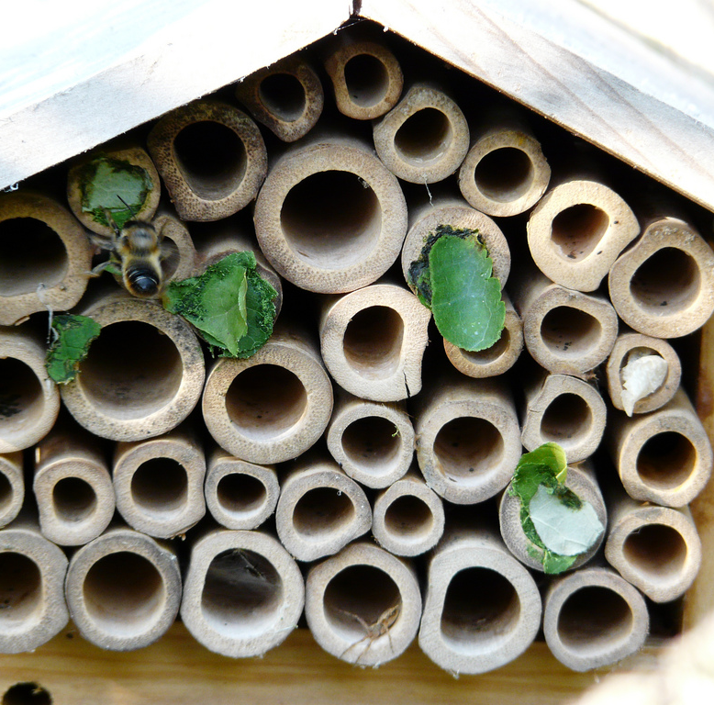
Making Our Bee Homes
Photo: Chris Worden

Slide 2
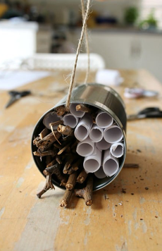
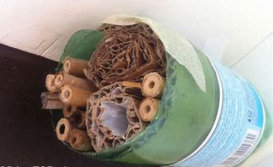
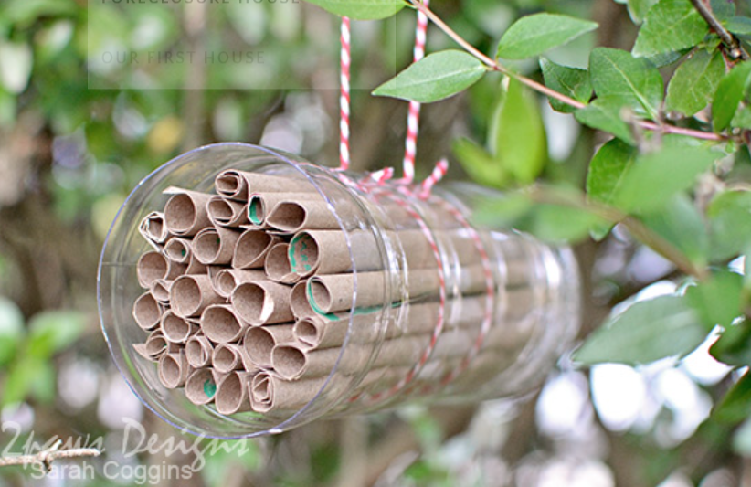
Today we are creating our bee home

Slide 3
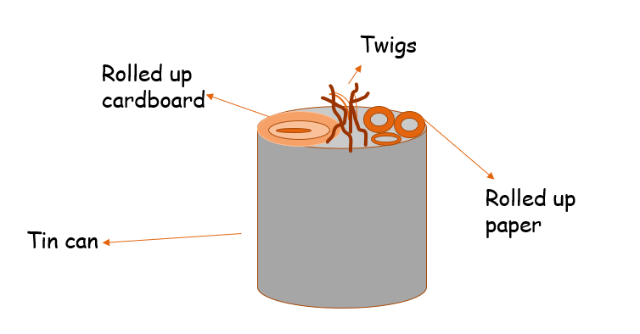
Look at your bee home design from last week
Remember bees like somewhere with small dark places to live.

Slide 4
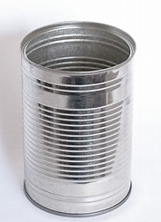
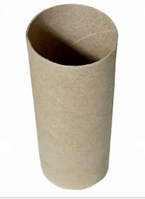
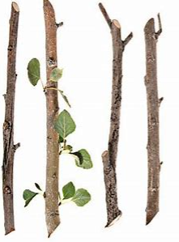
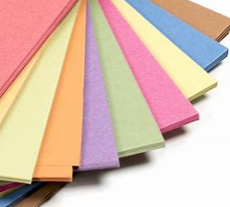
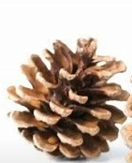
Hopefully you’ve been busy collecting resources
Gather the resources together you have decided to use for you bee home.

Slide 5
Have fun making your bee home!
Things to remember –
Try to follow your design.
Always ask permission from an adult before using items you have collected.
If you are using a tin can or cutting plastic, make sure an adult has checked the edges are not sharp.
Top Tip – Roll paper up around a pencil to keep it small. Then take the pencil out.

