Slide 1
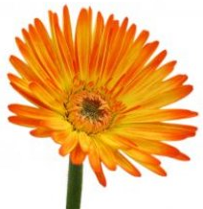
What plants need to
grow

Slide 2
We need to eat food and drink water to grow.

Slide 3
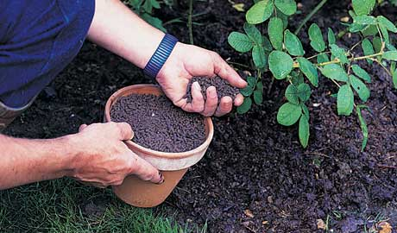
Plants need water too, just like us. But plants don’t eat anything. They make their own food.
?
So why do plants need fertiliser?

Slide 4
Fertilisers have nutrients in them. Plants use the nutrients to help them make their food.
Some of our parents, or maybe some of us, take supplements (extras) too, like vitamin tablets.

Slide 5
Let’s look at the things plants need in order to grow properly.

Slide 6
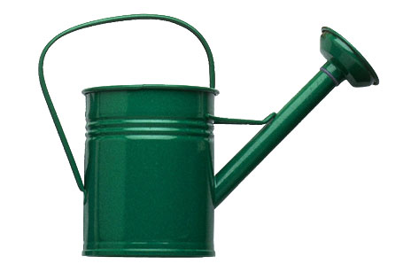
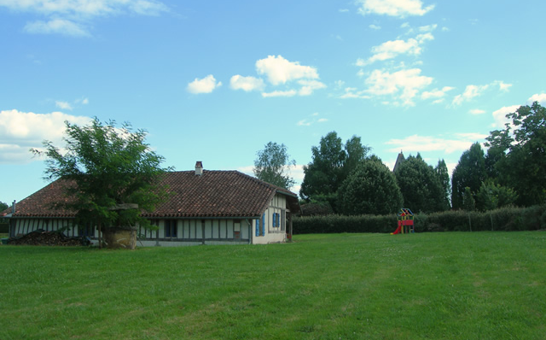
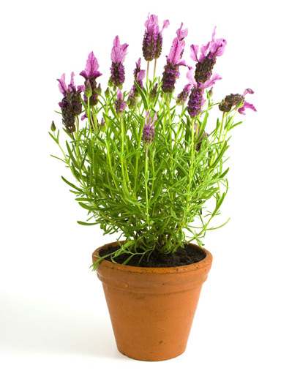
What can you
see here?
Water
Light
Warmth
Space
Nutrients

Slide 7
STOP AND
THINK
So, can you remember what it is plants need in order to grow properly?
Now let’s find out why they need those things.

Slide 8
Light
Plants use light to make their own food. When plants make their food, this is called photosynthesis.
Photo means light.
Synthesis means making.
So, plants make food by using light.

Slide 9
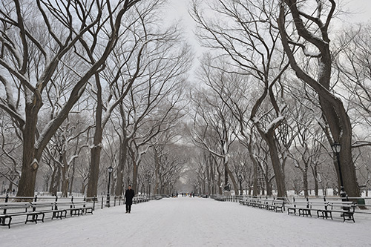
Warmth
Plants will die if the temperature is too low (if it’s too cold).
Think about what happens to plants and trees in the winter season.

Slide 10
Nutrients
Plants use nutrients to help them make their food. Fertiliser contains a lot of nutrients.
Different nutrients help the plant in different ways. Some help the roots grow. Some help the flowers grow.

Slide 11
Water
Plants need water for photosynthesis.
Who can remember what photosynthesis is?

Slide 12
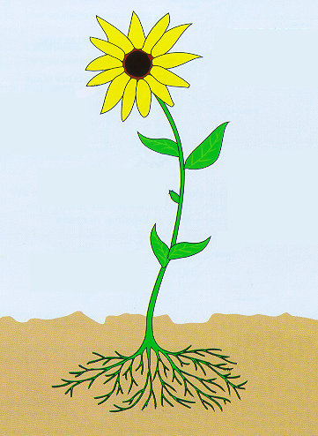
Water
The water also dissolves the nutrients so that they can be can
be taken into the plant by the roots.

Slide 13
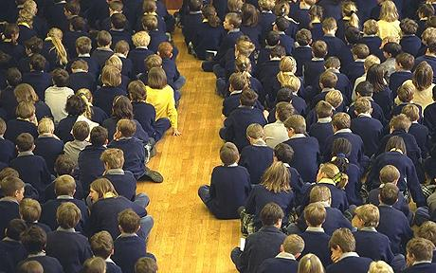
Space
Plants need space so that they have enough room to grow.
Who can think of examples of times when you were in a crowded place?
How did you feel?

Slide 14
OK, can you list the 5 things plants need to grow?
Light
Warmth
Water
Nutrients
Space

Slide 15
Activities
Choose a creative way to share your learning.
You could make a quiz for someone in your family using these facts.
You could make a poster to explain the 5 things plants need to grow.
You may have some ideas of your own!
Watch the 2 BBC Bitesize videos and answer the questions about what plants need to grow.
You will find the links for the website on back on today’s year 3 page.
We can’t wait to see what you come up with, have fun!

