Slide 1
Week 3
Tuesday

Slide 2
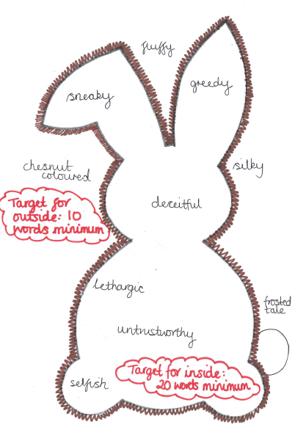
Compère Lapin
Yesterday you thought about this rabbit in our Caribbean tale.
Today, you are going to write a character description for us. This can be handwritten or typed.

Slide 3
Remember these sentence types from when we read Millions? How many can you include today?
2A sentences
2 pairs sentence
The more, the more sentence
3 bad dash Q sentence
Ad, same ad sentence
3ed sentence
Many Qs
Dashes for parenthesis
Brackets for parenthesis
Commas for parenthesis
Semi colon to join two clauses
Semi colons in a descriptive list
Relative clause
Language play (similes, metaphors, personification or alliteration)

Slide 4
Compère Lapin: Example Description. Your target: two paragraphs
2A sentences
2 pairs sentence
The more, the more sentence
3 bad dash Q sentence
Ad, same ad sentence
3ed sentence
Many Qs
Dashes for parenthesis
Brackets for parenthesis
Commas for parenthesis
Semi colon to join two clauses
Semi colons in a descriptive list
Relative clause
Language play (similes, metaphors, personification or alliteration)
The more the other animals got to know this mischevious rabbit, the more they began to dislike him. Compère Lapin simply could not be trusted. He was scheming, cheating and incredibly lazy – which one of these was his worst trait? The animals simply couldn’t decide. The forest, where most of the animals worked in synchronisation and unity, almost retreated into itself when Compère Lapin appeared. Trees would hide their faces behind their leaves as the rabbit would skip joyfully amongst their legs.
Don’t forget to email in your work!

