Slide 1
Science – Life Cycle of a Plant

Slide 2
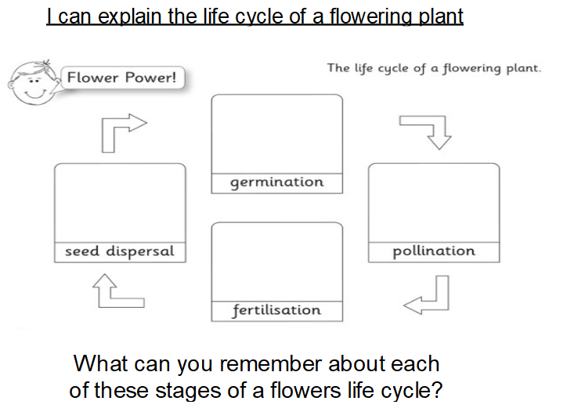

Slide 4
https://www.bbc.com/bitesize/clips/zb4rkqt

Slide 5
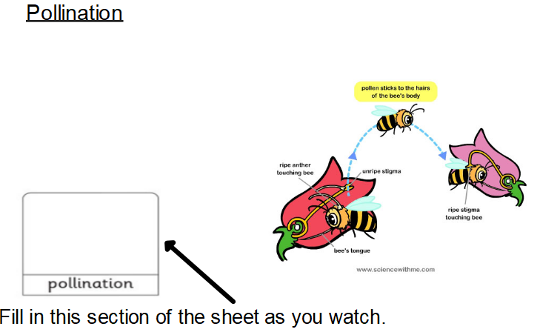
https://www.bbc.com/bitesize/articles/zqbcxfr

Slide 6
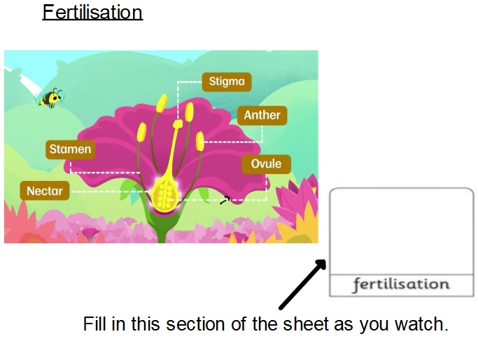
When the pollen reaches another flower, it travels to the ovary where it fertilises the egg cells to make seeds. This process is called fertilisation.

Slide 7
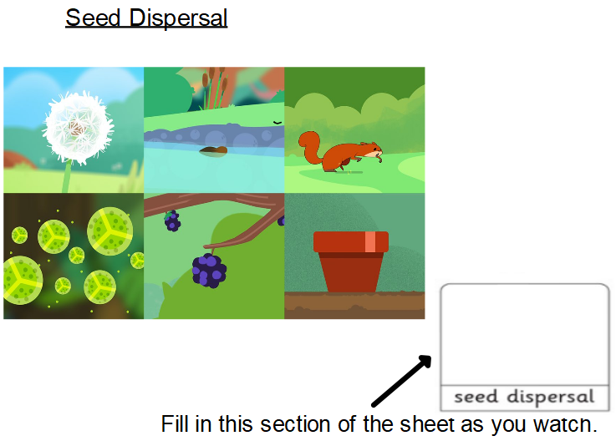
https://www.bbc.com/bitesize/clips/znvfb9q

