Slide 1
Welcome to our Y6 SATs
Information Evening!
1) Please remain muted until the end of our presentation.
2) Open up the ‘Chat’ Feature – please feel free to ask any questions during our talk.
3) Download the 2018 SATs papers to see the types of questions the children will experience.

Slide 2
To measure the child’s progress and attainment
To measure effectiveness of the school in comparison to local and national data
Why do children sit SATs tests?
“It was the best week of Year 6!”
To inform parents
Secondary school data
Notes:
SATs are currently compulsory for all children in Year 2 and Year 6. Ultimately, they are used to measure the individual child’s attainment and progress in their time from Year 2 to Year 6.
They are also very important for measuring the effectiveness of a school – they are one way of measuring a whole cohort’s progress to see how far they have brought the children in their learning. School data is then compared to county and national data too.
SATs can help parents gauge the progress that their child is making academically. We will provide you with all of their scores from SATs practice that we do.
Secondary schools look at Year 6 SATs results, along with Year 7 CAT exams as part of the decision process when grouping students into sets or streams. GCSE target setting is based on end of KS2 data.
It is actually also very much for the child. It might sound hard to believe, but by the time they sit the tests, most children WANT to do them! They are so eager to try their best and show off all that they have learnt in their time here. We’ve had so many children say their SATs week was their favourite week of Year 6 – we think the biscuits in the morning and games all afternoon may help!!

Slide 3
- Their education throughout the whole of school - Revising & consolidating the curriculum in Year 6 - Re-visiting learning often (Early Morning Work, Flashback Maths) - SATs style homework tasks – CGP books - Practice papers (formal and informal) - Keeping track of progress to inform parents and to adapt our teaching - Interventions - Official Mock SATs week around April - Gathering evidence to determine which children may require extra provision e.g. an adult to read questions to them in maths, extra time etc.
Preparation and Support
Notes:
So how do we support and prepare the children?
The SATs test skills and the knowledge gained not only from Year 6, but throughout the entirety of primary school. Less than 50% of the content on the 2019 SATs papers came from units studied in Year 6, with the remaining content coming from their Year 5, 4 and 3 learning.
By revising and consolidating the curriculum in Year 6 – we can make sure gaps are filled and really secure their knowledge, not just for SATs, but for their secondary education too.
We regularly re-visit key number practise and skills – don’t give them chance to forget this key knowledge. Drawn upon constantly.
4) SATs style HW. Hopefully you have all now seen the CGP revision books that have come home – exposes them to the style of questions they will have in SATs papers.
Practice tests - All practice tests allow us to identify gaps in their learning which inform our teaching, booster and intervention groups.
6) The Mock SATs week give chn the opportunity to experience proper exam conditions and know how the week will run. By the time the real SATs come, children will know what to expect and will hopefully feel calm.
Until the real SATs, we are also able to gather any evidence we may need to determine which children may require additional provision.

Slide 4
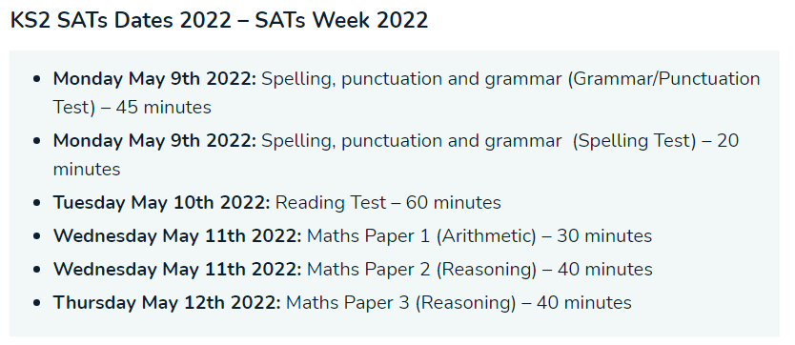
All exams are in the morning and there are none on Friday.
Please avoid booking holiday during this time, or the lead up to SATs. They will need to be in school promptly or can attend a breakfast club.
Notes:
3rd Week after the Easter Holidays
Most children will sit their tests in the same classroom that they have been learning in all year. In some cases and for a range of reasons, some children may be in smaller rooms around the school. Tests will be done under exam conditions – smaller groups of children one table each.
The papers themselves, whilst being designed to test your child’s knowledge, will consist of questions that are similar to the ones they would have seen in class.
All exams are in the morning and there are none on Friday.
Please avoid booking holiday during this time, or the lead up to SATs. They will need to be in school promptly so they can relax before the SATs begin.

Slide 5
Reading
1 hour to complete the test
3 texts, usually a range of fiction and non-fiction
A set of questions (usually around 12) about each text
Not a memory test – the children can refer to the questions as much as they want!
Focus on understanding language style and vocabulary, retrieval of information and their comprehension through inference/deduction style questions.
Scored out of 50 – 1, 2 and 3 mark questions
Notes:
The assessment has been designed to measure whether children’s comprehension of age-appropriate reading material meets the national standard.
It a standard timing of 60 minutes, including reading the texts and answering questions. There are three different set texts for the children to read, which could be any combination of non-fiction, fiction and/or poetry.

Slide 6
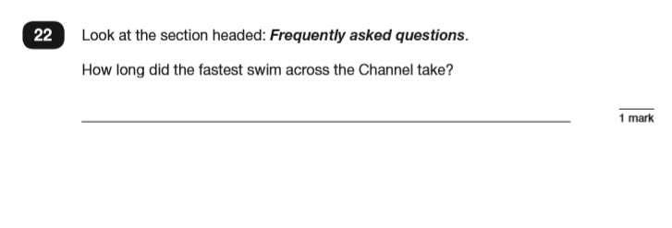
Retrieving Information – 28%
Notes:
The Reading paper focuses on the following areas known as Content Domains: 2a) give/explain the meaning of words in context; 2b) retrieve and record information/identify key details from fiction and non-fiction; 2c) summarise main ideas from more than one paragraph; 2d) make inferences from the text/explain and justify inferences with evidence from the text; 2e) predict what might happen from details stated and implied; 2f) identify/explain how information/content is related and contributes to meaning as a whole; 2g) identify/explain how meaning is enhanced through choice of words and phrases; 2h) make comparisons within the text.

Slide 7
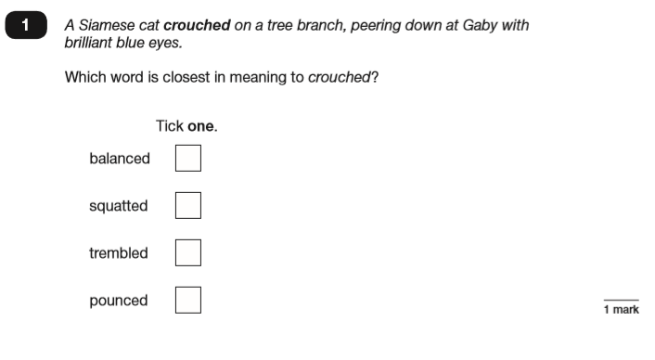
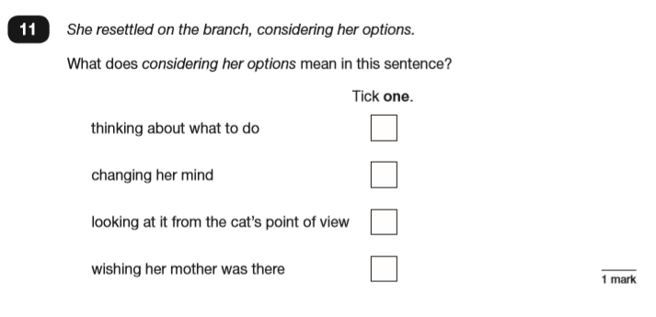
Vocabulary/ Understanding Language – 20%
Notes:
The Year 6 Reading SATs paper requires a range of answering styles, including responding to multiple choice questions, one-word answers, and multiple mark questions which require more formal paragraph-length answers.

Slide 8
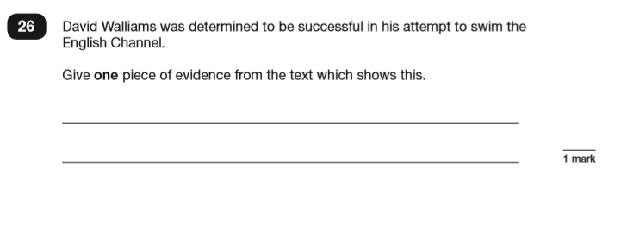
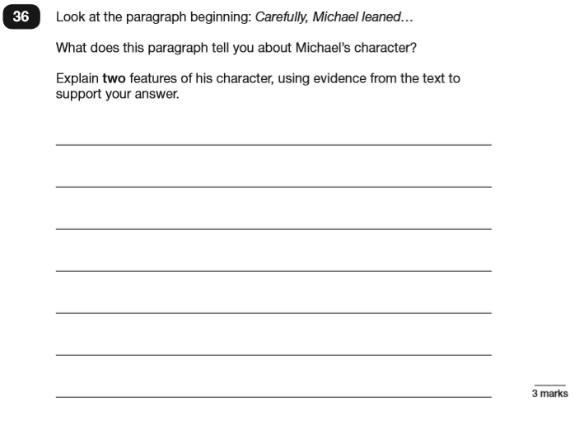
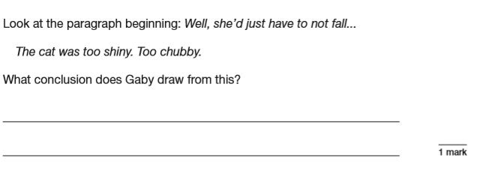
Comprehension/ inference/ deduction – 44%
Notes:
Almost half the marks are on inference and deduction.

Slide 9
Consider the type of questions you are asking your child when they are reading…
What does that word mean? Can you think of another word which means something similar?
What impression does the word (provide word and context) glare give us about how Shirley felt towards her cousin?
Can you find a word in this paragraph that is closest in meaning to (provide word) annoyed?
In what year did (provide fact) the French authorities make it illegal for people to swim from France to England?
In the last paragraph, X does not want to do something. Give two reasons why X does not want to do this.
How was the character feeling when…? How do you know? What evidence is there in the text?

Slide 10
Spelling, Punctuation and Grammar (SPaG)
Comprised of 2 tests – combined score
Test 1 (45 minutes) measures their punctuation, spelling and grammar skills: terminology, word class, sentence types and structures (50 marks)
Test 2 measures their ability to spell words using a variety of rules plus the ability to remember key exception words (20 marks)
Notes:
Grammar, Punctuation and Spelling is made up of two papers
Paper 1 is the longer paper lasting 45 minutes, children will be tested on grammar, punctuation and spelling generally;
Paper 2 is a shorter paper where children will be tested on spelling only
Marks are combined but it more heavily weighted on Paper 1 – weaker spellers are still able to do well if they know their grammar

Slide 11
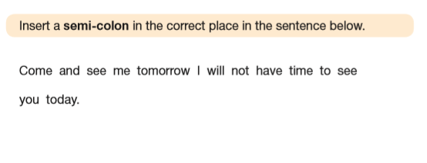
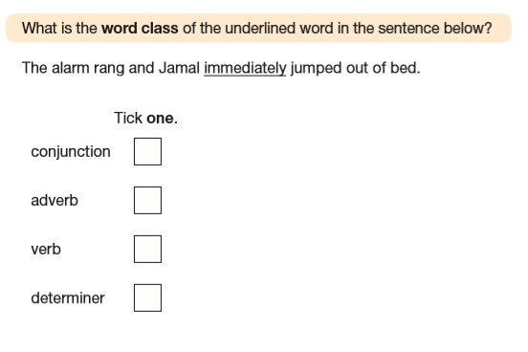
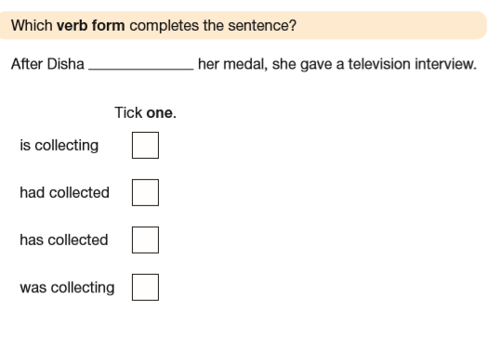
Notes:
Grammar, Punctuation and Spelling (Paper 1) is the longer paper lasting 45 minutes.
The children will be prepared by their class teacher so they are equipped with a good knowledge of the technical vocabulary needed to identify and describe various aspects of grammar and punctuation marks.
Grammar, Punctuation and Spelling (Paper 1) focuses on the following areas: - Grammatical terms/word classes; - Functions of sentences; - Combining words, phrases and clauses; - Verb forms, tenses and consistency; - Punctuation; - Vocabulary; - Standard English and formality.
This paper requires a range of answer types such as circling missing capital letters, multiple choice questions, one-word answers, but does not require longer formal answers.

Slide 12
Notes:
Grammar, Punctuation and Spelling (Paper 2) is the shorter paper lasting 20 minutes (although there is no time limit really)
– they are asked to fill in a blank within a sentence, attempting to spell out the spelling word in context correctly.

Slide 13
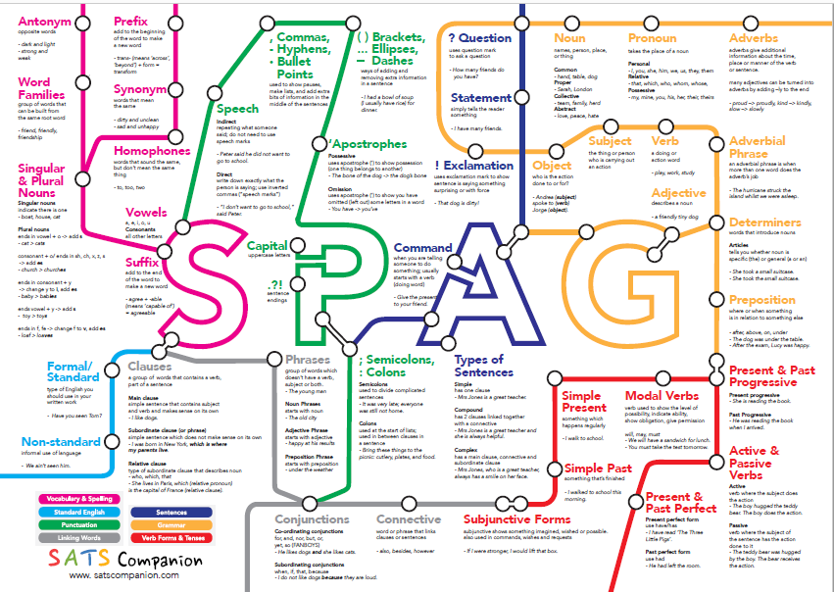

Slide 14
Mathematics
Comprised of 3 tests
Test 1 (30 minutes) Arithmetic
Not in context and a focus on number, fraction and percentages.
Encourage the children to use efficient methods
Test 2 and 3 (each 40 minutes) Reasoning
Questions are in context or require a deeper level of understanding than just procedural mathematics. Number geometry, coordinates, fractions, decimals and percentages, angles, algebra are covered

Slide 15
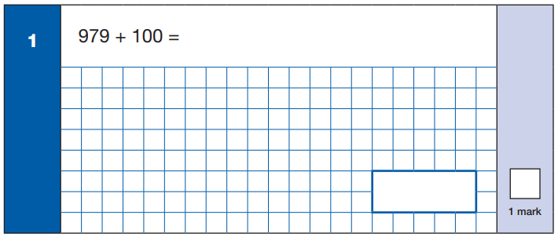
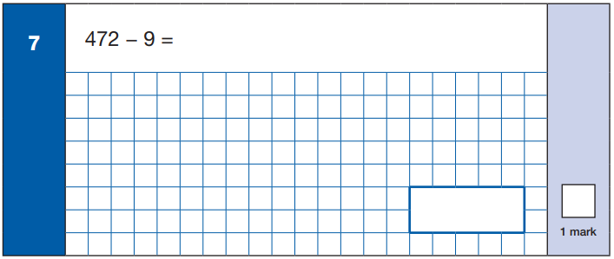
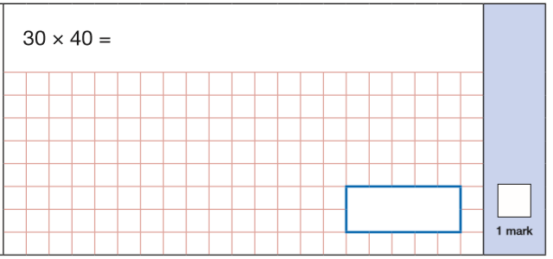
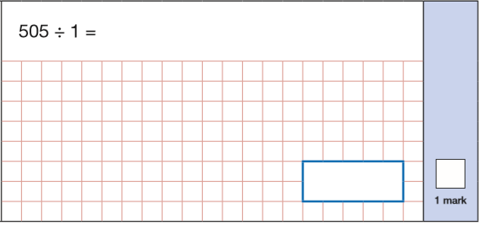
Notes:
Maths Paper 1 (Arithmetic) has a standard timing of 30 minutes and is worth a total of 40 marks across 36 questions.
It covers the four operations (addition, subtraction, division, multiplication) – many of them requiring mental calculation only. They don’t even have 1 minute per question so drawing on their mental calculation as the most efficient method is so important.

Slide 16
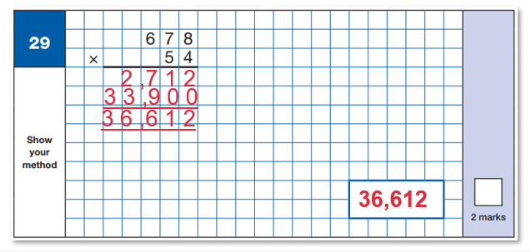
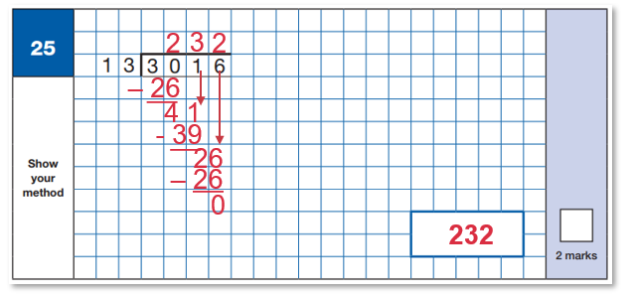
1 – 13
2 – 26
3 – 39
4 – 52
5 – 65
6 – 78
7 – 91
8 – 104
9 - 117
10 - 130
Notes:
Some will require written methods. These are examples of 2 mark questions – long multiplication and long division.

Slide 17
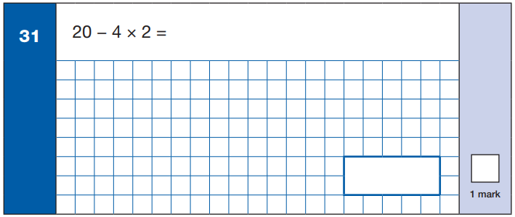
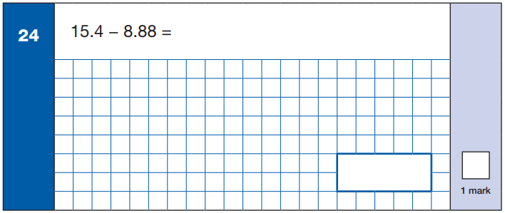
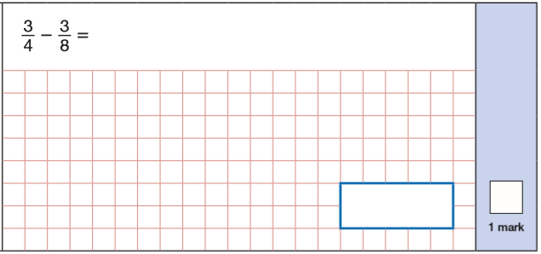
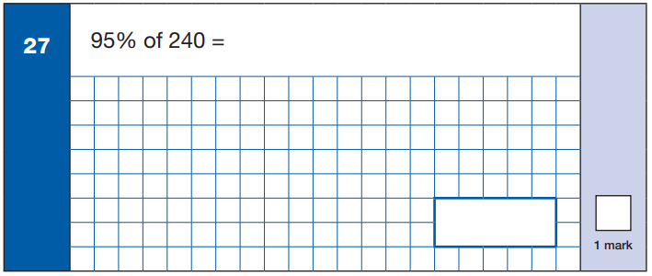
Notes:
It also assesses them on their knowledge of mixed operation calculations requiring BIDMAS, calculating percentages of amounts, calculations using decimals, and calculations using fractions.

Slide 18
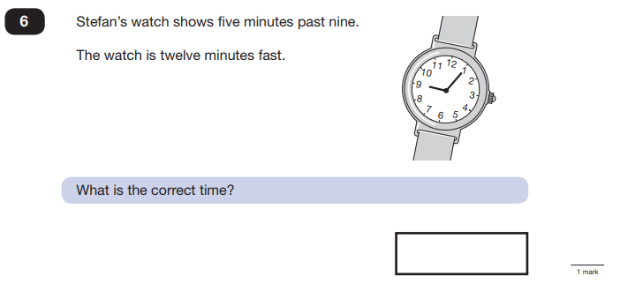
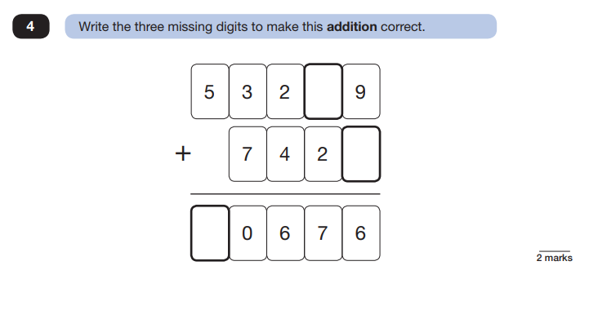
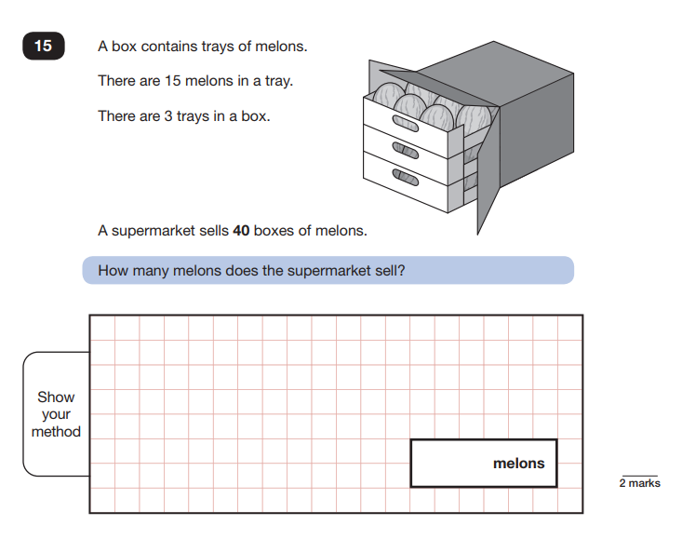
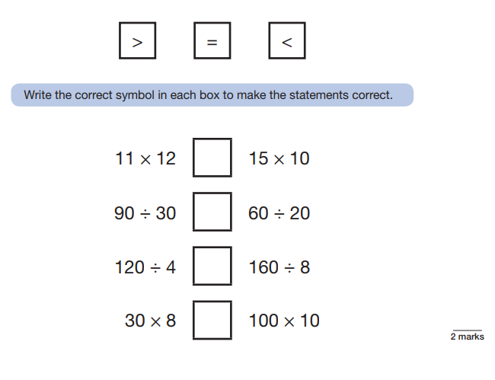
Notes:
Maths Paper 2 (Reasoning) will take place on Wednesday.
Maths Paper 3 (Reasoning) is scheduled for Thursday.
Both have standard timings of 40 minutes and are worth 35 marks each.
These papers require children to demonstrate their mathematical knowledge and skills, as well as their ability to solve problems and their mathematical reasoning.
Questions focus on the following Mathematical topic areas: - Number and place value– including Roman Numerals; - Addition, subtraction, multiplication and division (calculations); - Geometry – properties of shapes; - Geometry – position and direction; - Statistics; - Measurement – including length, perimeter, mass (weight), volume, time and money; - Algebra; - Ratio and proportion; - Fractions, decimals and percentages.

Slide 19
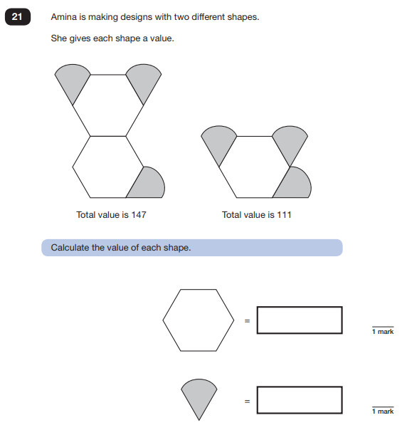
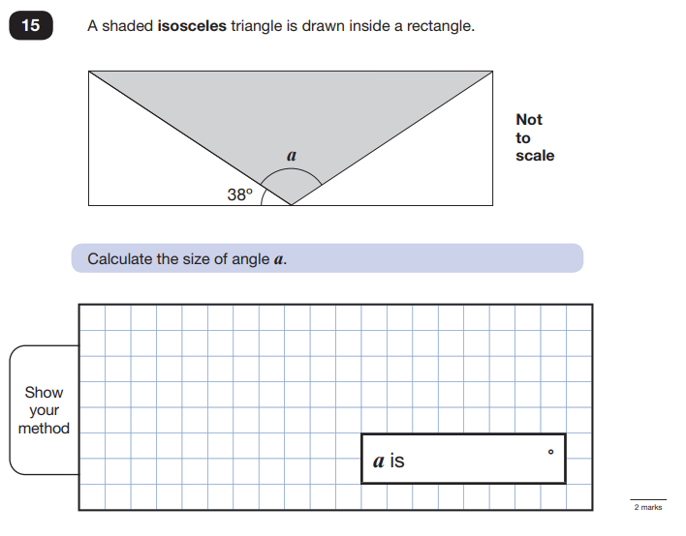
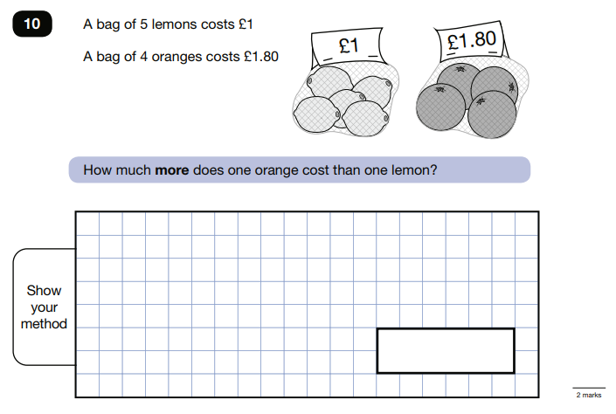
Notes:
The questions get harder throughout the paper.
It is not unusual for a child to be unable to complete the entire paper in time.

Slide 20
How well did my child do?
The Test
A raw score (number of correct answers)
Scaled score
Once all children’s results are in nationally, their raw score is converted into a scaled score.
What’s reported?
Your child’s SATs raw score, scaled score, school and national average scaled score and teacher assessment for science and writing.
Notes:
Each test provides a raw score – how many correct answers.
Once raw scores have been gathered nationally, they are converted to scaled score – will look at in a mo.
Parents will then receive all of this important information at the end of the school year with their report.

Slide 21
Scaled Score
Child C
Raw score 42/50
Standardised score of 114
110 or over is classed as
‘Greater Depth’
Child A
Raw score 17/50
Standardised score of 93
Has not yet met the expected standard
Child B
Raw score 26/50
Standardised score of 100
Met the expected standard
Meeting the expected standard indicates that the child is in a good academic position to access the KS3 curriculum as their KS2 curriculum knowledge and understanding is at a good standard.
Of course, some children will not meet the expected standard so we will endeavour to get them as close to this as possible as we will focus on their progress.
Notes:
The raw score that is decided as the expected standard is converted into a scaled score of 100. So 100 is technically a pass.
Meeting the expected standard indicates that the child is in a good academic position to access the KS3 curriculum as their KS2 curriculum knowledge and understanding is at a good standard.
Of course, some children will not meet the expected standard so we will endeavour to get them as close to this as possible as we will focus on their progress.

Slide 22
End of Year Report

Slide 23
End of Year Report
Notes:
We know that tests do not define the child and quite often, children don’t perform their best due to pressure.
Throughout the year, regular Teacher Assessment takes place too. Termly reports in foundation subjects. At the end of year with SATs results, we provide teacher assessment for writing and science.
By using teacher assessment we are able to judge a child’s performance in a subject over a longer period of time. This means that teachers are able to account for a child’s whole knowledge and ability in a subject, not just that which comes from sitting a test.

Slide 24
Home support to prepare for SATs
Encourage them! A positive attitude goes a long way!
Try to provide a quiet corner of the house for homework and study, that’s as free from distractions as possible
Encourage your child to talk to us if they express persisting anxieties about SATs. Remember that a small amount of anxiety is normal and not harmful;
Listen to them read (with effective questioning!)
Support them with homework
Avoid using past papers – there are plenty of inexpensive or free SATs practice materials for parents available.
Direct them to useful websites (Rockstars/BBC bitesize)
Bring learning into everyday life - practise key skills like times tables and practise mental maths in real world scenarios (shopping/cooking)
Help them to become resilient learners
Plan something restful for the weekends before and something fun for the weekend after SATs – this will help your child start the week well and also give them something to look forward to;
Ensure your child has breakfast before school and brings in a snack and water bottle and ensure that they are getting a suitable amount of sleep.
Notes:
Bring learning into everyday life but keep it light – practice key skills like times tables and practice mental maths in real world scenarios, like adding up prices in the shops, working out discount deals, and asking questions like, “If there are 1,300 grams of flour in this pack, what is that in kilograms?”

Slide 25
We want these exams to be as relaxed and as stress-free as possible! Emphasis will be on effort and progress rather than attainment ☺
Any questions?
Notes:
SATs focus on what they know about Maths and English - won’t reflect how talented they are at Science, Geography, Art or PE, and they certainly won’t highlight positive personal characteristics such as kindness and integrity.
SATs results don’t always tell the whole story - don’t let your child see SATs as a simple case of ‘pass’ or ‘fail’.
SATs last for one week - In reality it’s just one or two papers lasting 30-60 minutes each day. We can’t emphasise enough the importance of keeping that in perspective.

