Slide 1
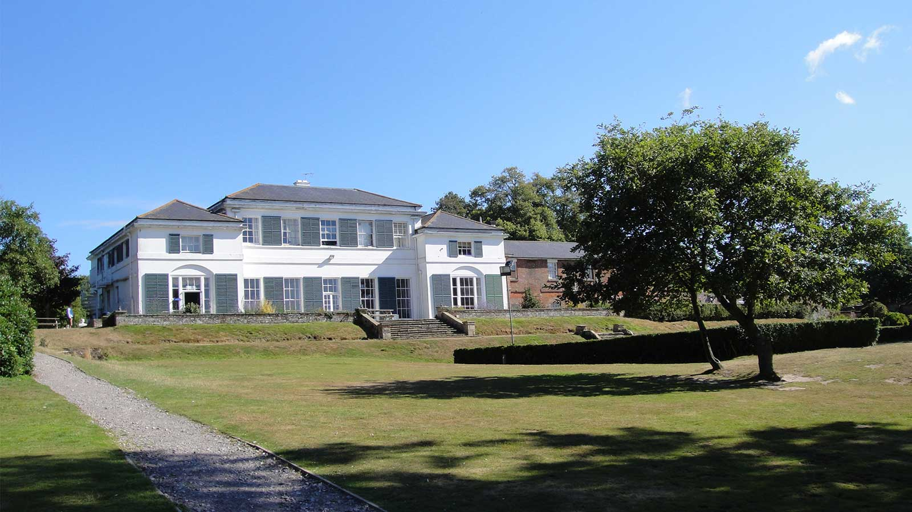
Windmill Hill 30th October – 3rd November 2023

Slide 2
Dates
30th October – 3rd November 2023
Monday - Leaving school at approximately 10.30am.
Friday - We expect to depart at about 1.30pm and should return to school by 4.00 pm.
If there are any delays, we will telephone school.

Slide 3
What is PGL?
'Parents Get Lost!’
Takes its name from the man who started it all in the 1950s - Peter Gordon Lawrence.
For children to have fun and grow in confidence through adventure and outdoor activities.
A week’s trip to encourage independence and self-care.
Build relationships between pupils and staff
Develop empathy with peers and risk taking within themselves

Slide 4
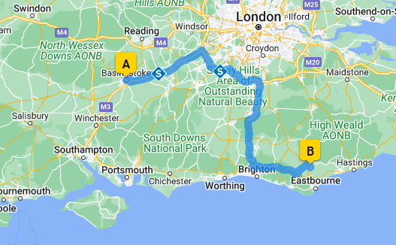
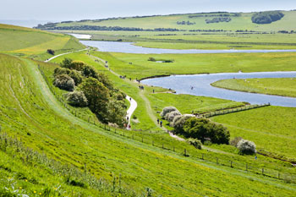
Located close to the Sussex Downs, the PGL Windmill Hill site is in Hailsham.
Leave school Monday morning
Stop at Seven Sisters country park for lunch and a walk through the woods (weather permitting).

Slide 5
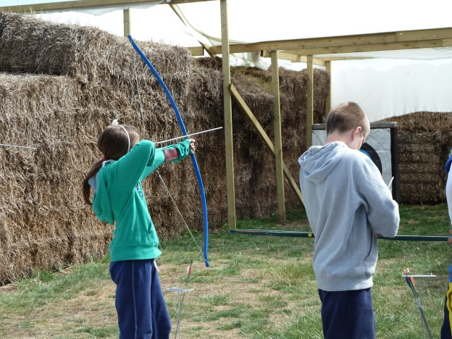
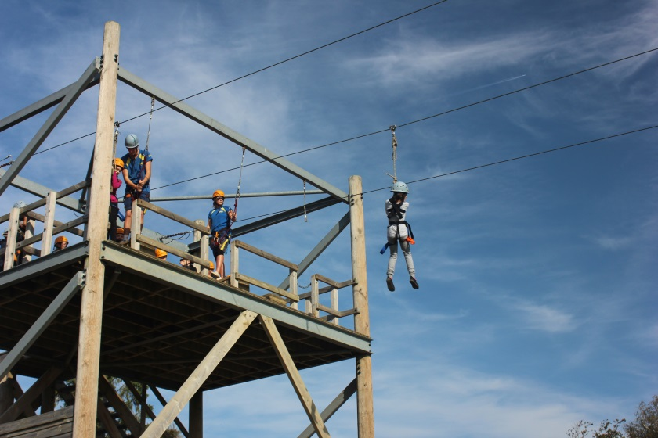
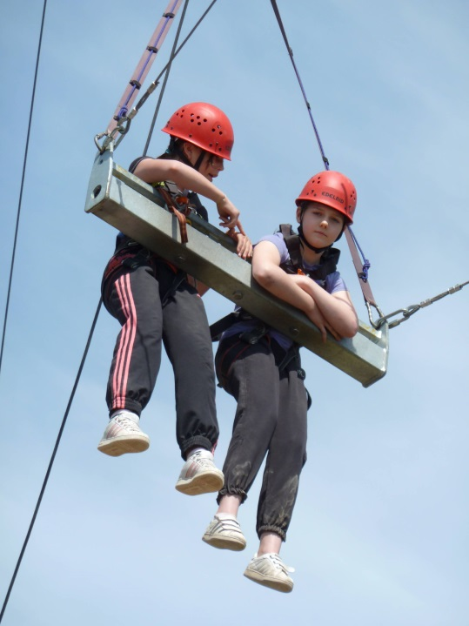
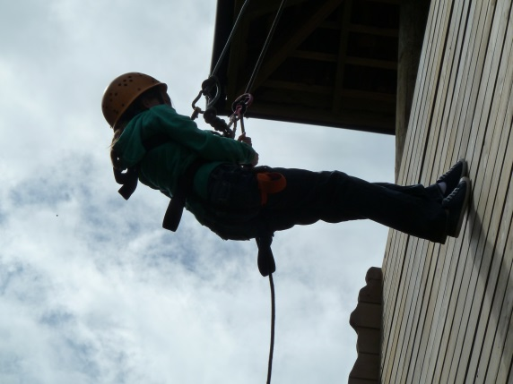
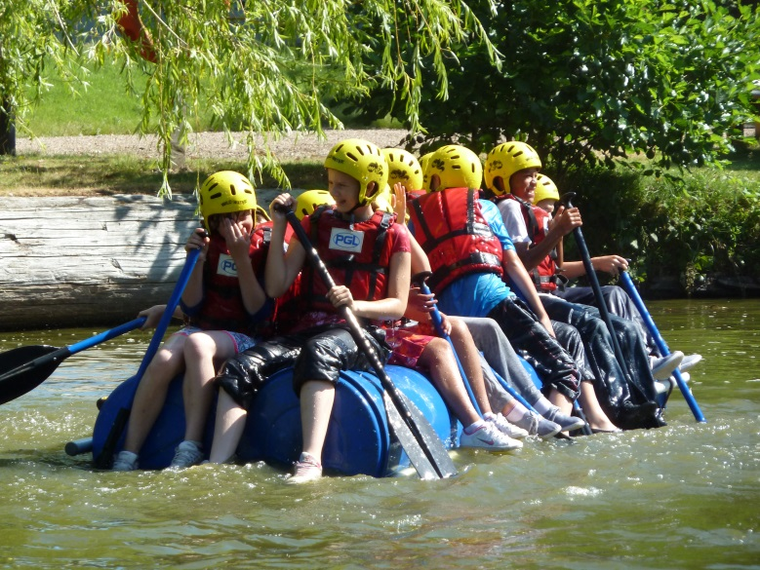
Activities https://www.pgl.co.uk/en-gb/school-trips/primary-schools/centres/windmill-hill

Slide 6
Activities
Trapeze
Aeroball
Climbing
Abseiling
Zipwire
Jacob’s ladder
Tunnel trail
All aboard
Orienteering
Fencing
Canoeing
Raft Building
Sensory Trail
Problem Solving
Challenge Course
Archery
Giant swing
Campfire
Capture the flag
Disco
Wacky races
Cluedo
Around the world

Slide 7
A Typical Day
7.00am – Teachers wake the children
7.30am – Breakfast
8.30am – Free time/ showers/ room tidying
9.30am – Morning activities
11.30am – Free time/ room inspections
12.30pm – Lunch
2.00pm – Afternoon activities
5.00pm – Dinner
6.00pm – Free time/ room inspections/ teddy bear competitions
7.15pm – Evening activity
9.00pm – Get ready for bed
Notes:
2 morning activities
2 afternoon activities
Dinner – menu that they choose from various different options

Slide 8
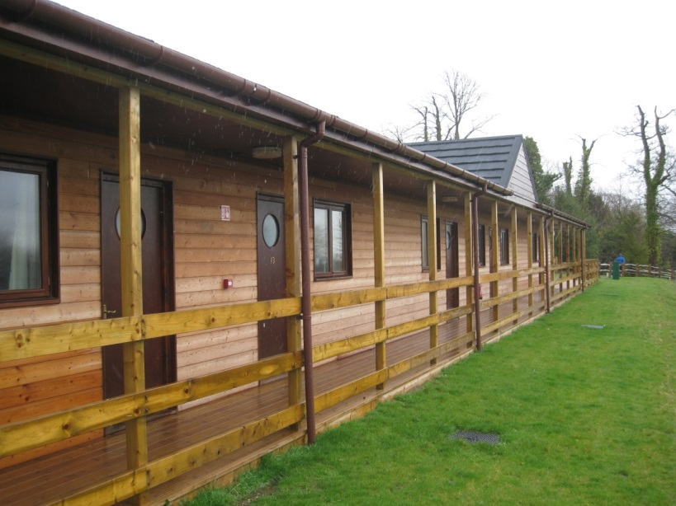
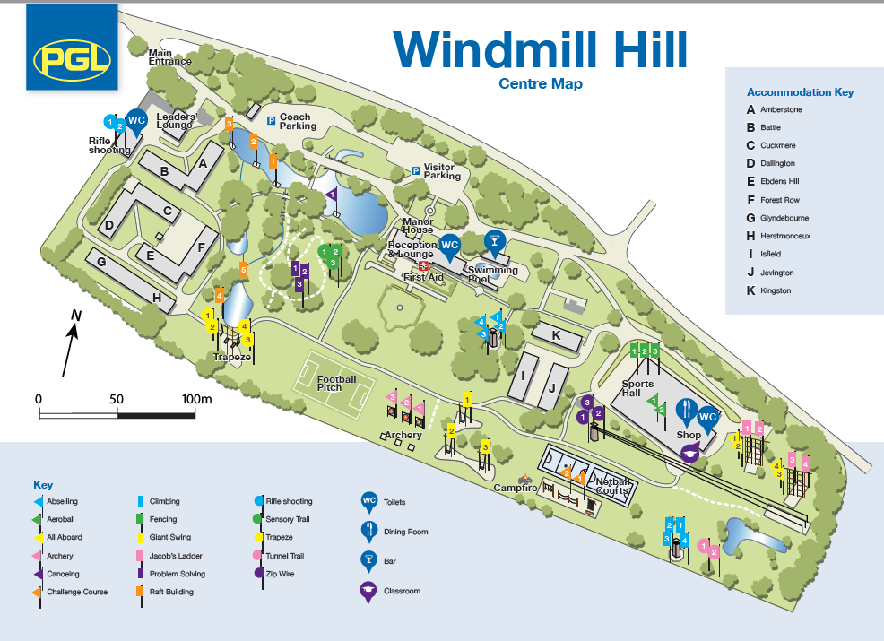
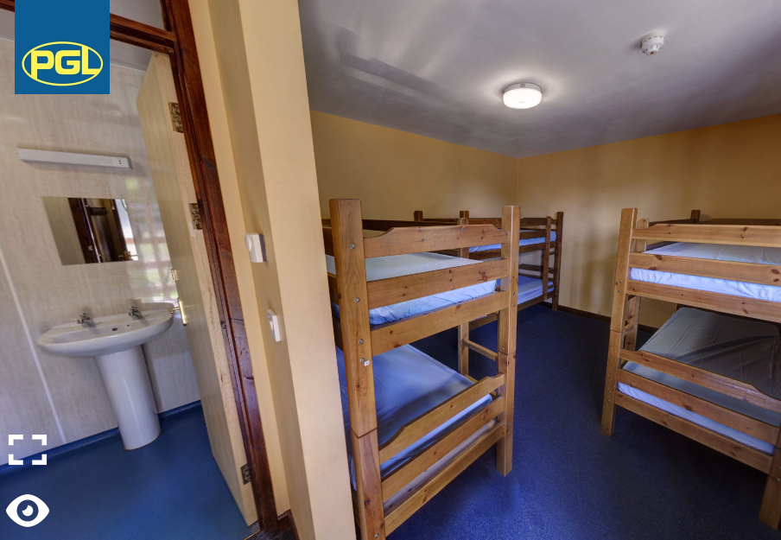
Accommodation
Usually in 2 blocks close by
Rooms for up to 6 children
Toilet, shower and sink in each room
Teachers evenly spaced at end of blocks

Slide 9
Activity Groups
The children will be split into 8 activity groups with a member of school staff in each group.
Groups will all experience the same activities over the course of the week.
No activities are guaranteed but we have always enjoyed a great range of exciting opportunities.
Activities are led by PGL staff.
High standards of behaviour will be expected to ensure the safety and enjoyment of all children.

Slide 10
Catering for…
Vegetarian/ vegan
Allergies and intolerances
Diabetics
Fussy eaters

Slide 11
No one goes hungry at PGL!

Slide 13
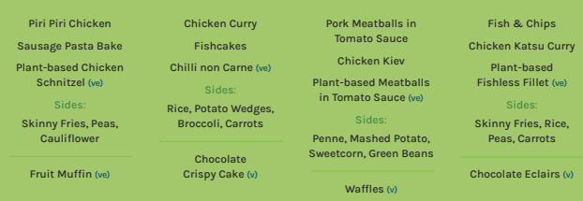

Slide 14
Medical needs
A detailed medical form will go home in September 2023
Medication will go to the teachers on the Monday morning
Medication will be administered mostly by their group leaders at the appropriate times
Please discuss more in-depth needs with the class teacher well in advance to ensure we can make provision for them – risk assessments may need to be written!
Notes:
This might include things like:
-sleep walking
-bed wetting

Slide 15
A rough outline of what to bring
A waterproof/warm jacket is essential (on coach – not packed)
Enough clothes for 5 days – cheap, old clothes!
One jazzy outfit for the disco
2 lots of trainers / clothes which can get wet!
A sleeping bag/duvet (under sheets are provided)
A pillow
A cuddly toy!
Not permitted – electronics including mobile phones, aerosols
A detailed kit list will go home at the end of year 5 and early in Year 6

Slide 16
How do we prepare children for Windmill Hill?
Worships beforehand
Circle time to discuss worries
Look at website
Some ELSA sessions (where needed)
Sharing previous children’s experiences
Please remember it is normal to have worries.

Slide 17
Payments
Non-refundable deposit deadline - £50 due by Wednesday 1st February, 2023.
Interim payment - £60 due Friday, 31st March, 2023
Balance of £188 paid by Thursday, 31st August, 2023.
Any questions…please email year5@stmarksce.org.uk and year6@stmarksce.org.uk ☺
There will be a reminder session with more detailed information at the Year 6 curriculum evening.

Slide 18
It’s a great week away that the children remember for ever.

